Slide 1
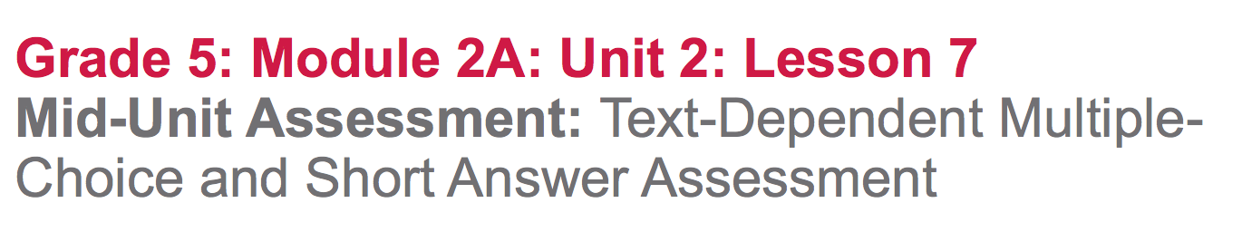

Slide 2
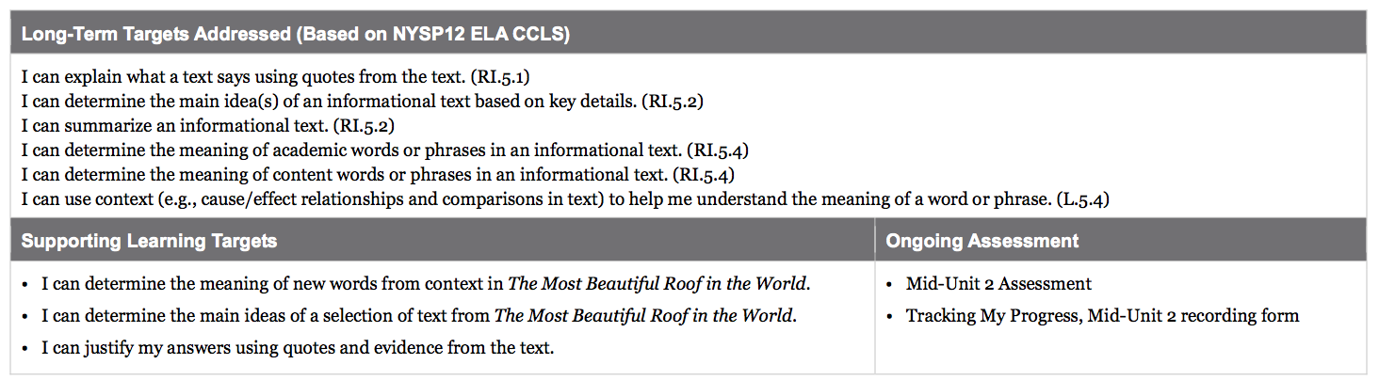

Slide 3
Opening
Reviewing Homework and Engaging the Reader (10 mins)

Slide 4
Take out your journals.
Look at your Meg Lowman Rainforest KWL chart.
Pair share one new thing you learned about Meg Lowman and one new vocabulary word that is related to what you learned from your homework.

Slide 5
Work Time
Mid-Unit Assessment: Text-Dependent Short-Answer Quiz (30 mins)

Slide 6
Learning Targets
“I can determine the main ideas of a selection of text from The Most Beautiful Roof in the World.”
“I can justify my answers using quotes and evidence from the text.”

Slide 7
We have worked on both of these targets throughout this unit. Can someone state them in their own words?
“I can determine the main ideas of a selection of text from The Most Beautiful Roof in the World.”
“I can justify my answers using quotes and evidence from the text.”

Slide 8
Take out The Most Beautiful Roof in the World as I pass out your mid-unit assessment.
Scan the test and ask any questions before we begin.

Slide 9
Early Finishers
Add the U column of your AQUA anchor charts, with new information that you learned from pages 22-23 of The Most Beautiful Roof in the World, or you may work on your glossaries adding new words that you haven’t had a chance to yet.

Slide 10
B. Learning Target Reflection
(10 mins)
“I can reflect on my learning.”
You’re going to get a Tracking My Progress form. This is a self-assessment, exactly like the progress trackers you completed in unit 1.

Slide 11
Closing and Assessment
In pairs, share your reflections.

