Slide 1


Slide 2
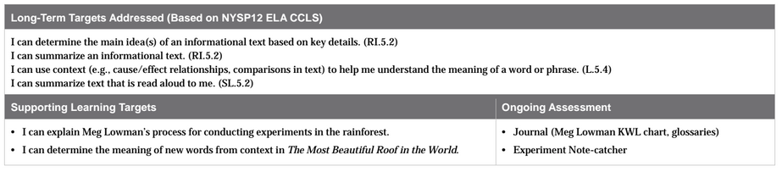

Slide 3
Reviewing Homework and Engaging the Reader (10 mins)
Take out your journals. Share information that has been added to the Meg Lowman KWL chart and one new vocabulary word in each glossary with a partner.

Slide 4
We are going to watch a short video about scientists in France tracking lizards and butterflies. The French scientists are conducting an experiment in the natural world. All scientists follow a typical process when conducting experiments. You will learn something about that process as you watch the video. After, you will get to read about some experiments that Meg Lowman conducts as part of her work.

Slide 5
Set a purpose
Listen to how these scientists conducted experiments on lizards and butterflies.
Listen to how these scientists conducted experiments on lizards and butterflies.

Slide 6
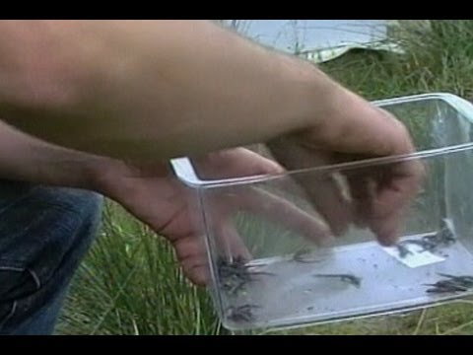

Slide 7
Think-Pair-Share
What did you see and hear about how these scientists conducted experiments on lizards and butterflies?

Slide 8
Work Time
Read aloud and Taking Notes: Meg Lowman Experiments in the Rainforest (15 min)

Slide 9
“I can explain Meg Lowman’s process for conducting experiments in the rainforest.”
What does conducting mean?
What do you remember the word process meaning?

Slide 10
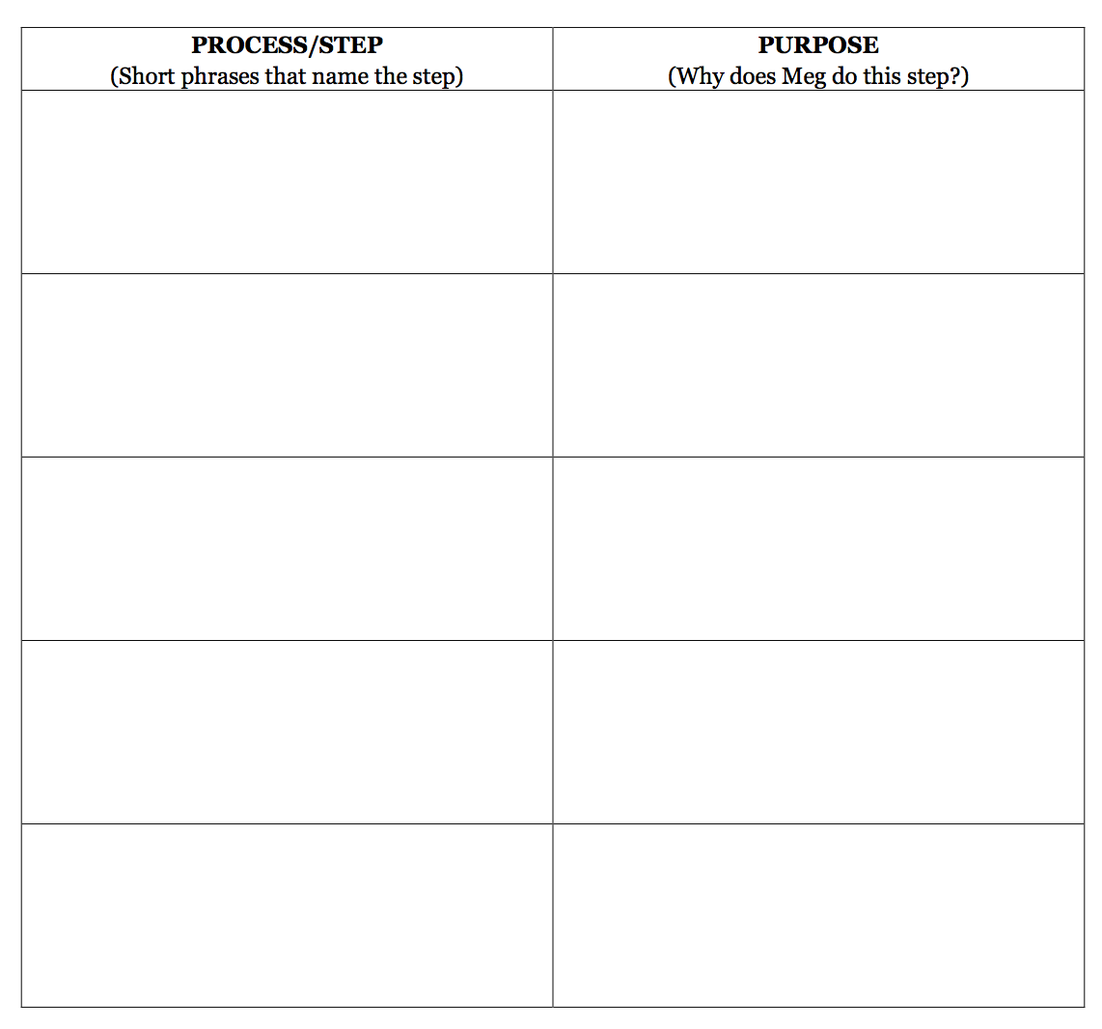
As I read aloud, follow along silently and pay attention to what the text tells us about Meg Lowman’s process for conducting experiments in the rainforest. I will stop after each chunk of text.

Slide 11
Read
Open your book to page 17. Follow along as I read this page. (stop at the end of the page.)
What was the 1st step of Meg Lowman’s process?
What was Meg Lowman’s purpose? Why did she follow this step?

Slide 12
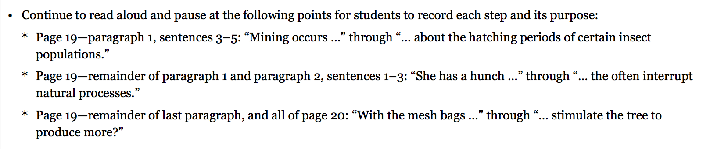
1st 2 sentences on page 19 (Leaf number...notebook.)

Slide 13
B. Group Read: Rereading, Revising, and Sharing to Music (20 mins)
You will reread a portion of the text. Your purpose is still to focus on determining what Meg Lowman’s process is for conducting experiments in the rainforest. You will then be able to discuss your thoughts and revise your note-catchers with your group.

Slide 14
You will have 7-8 minutes to independently read from the last paragraph on page 17 (“Meg begins taking…”) through to the last full sentence on page 19 (“exclusion experiment.”)

Slide 15
Talk with your group members about the process/steps Meg Lowman uses to conduct her experiments. Pay close attention to any information that you initially listed in your note-catchers that you now want to revise based on your new understandings.

Slide 16

Milling to Music
When the music plays, mill around until it stops. When it stops, find a partner and share the steps on your note catchers.

Slide 17
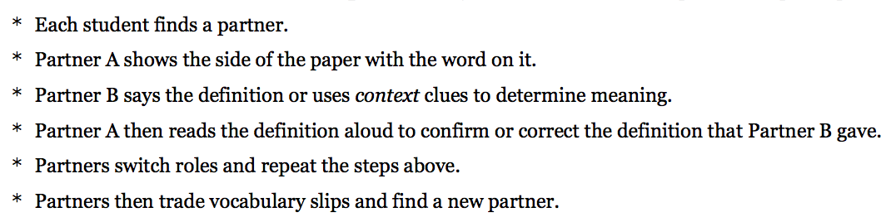
C. Vocabulary to Deepen Understanding (10 mins)
We are going to do the Quiz-Quiz-Trade routine. Remember:

Slide 18
acquires:
theory:
ongoing process:
exclusions:
barrier:
consume:
stimulate:
gets; gains; obtains
idea or belief about something based on knowledge and experience.
constant/unending experiments and/or steps in an experiment.
leave something out
obstacle that blocks access to something
eat; chomp through
increase; speed up

Slide 19
Closing and Assessment
What have we learned about Meg Lowman as a scientist?
Add some of the things you either said or heard to your Meg Lowman KWL

Slide 20
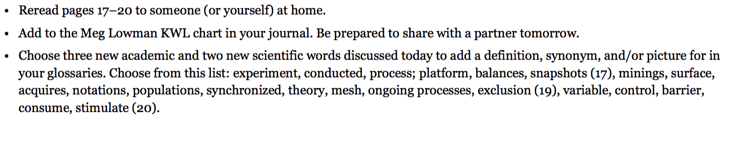
Homework

