Slide 1
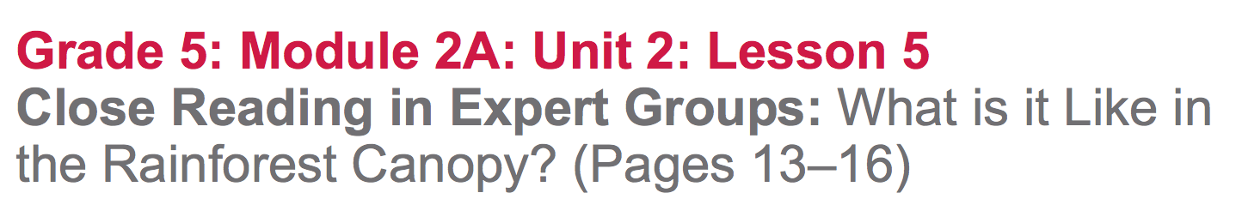

Slide 2
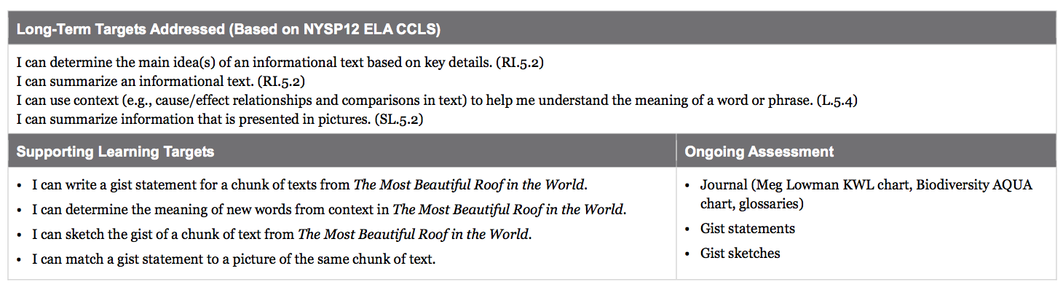

Slide 3
Reviewing Homework and Engaging the Reader (5 mins)
Take out your journals.
Think about one key detail that seemed important from last night’s reading about how difficult it is to study the canopy of a rainforest (13-16).

Slide 4
Group Read: Determining the Gist of Pages 13-16 (25 mins)
“I can write a gist statement for a chunk of text from The Most Beautiful Roof in the World.
“I can determine the meaning of new words from context in The Most Beautiful Roof in the World

Slide 5
Open your books to page 13 and follow along silently. “Meg Lowman believes that science…”
Turn and talk to a partner about what you think this part of the text is mostly about.

Slide 6
I’m going to pass out the Rainforest Canopy task cards to each group.
You will have 5 minutes to independently read the chunk of text named on your task card.
You will then discuss with your group what that chunk was mostly about.

Slide 7
Keep in mind your initial thinking about the gist of your chunk of text. You are going to focus on some important vocabulary terms that may help you be even clearer about the gist.

Slide 8
Reread the text and look for the key vocabulary words listed on your task cards.
As you reread your chunk of text, make sure to use context clues to help you figure out the meaning of key words listed on your task card. Understanding the meaning of these words will help you get even clearer about the gist of your text

Slide 9
Once you have reread your chunk of text and determined the meaning of key words from the task cards, recall your initial thinking about the gist.
Discuss with your group what you think the gist of the text is now that you’ve focused on key vocabulary (2 mins)

Slide 10
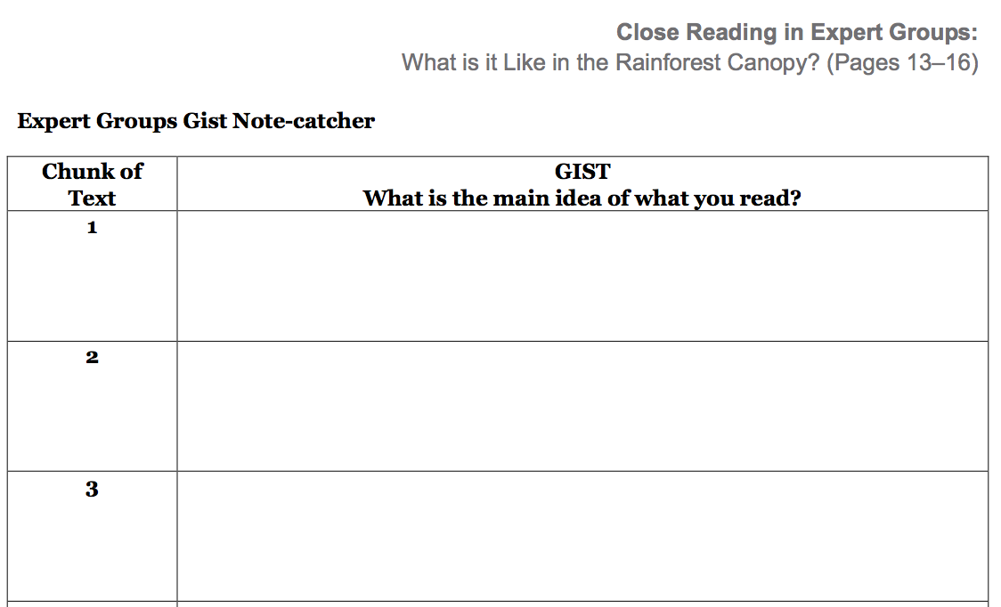
As a group, write a gist statement in the section corresponding to your chunk of text.

Slide 11
B. Jigsaw, Part 1: Sketching the Gist (10 min)
“I can sketch the gist of a chunk of text from The Most Beautiful Roof in the World”
What do you think it means to sketch the gist??
Sketch the gist: make a picture that shows what the chunk was mostly about; no words, just images.”

Slide 12
You are each going to get 2 index cards. In a few minutes, we are going to do a match activity. On one index card, write the number of the chunk of text you read (1-7) and the gist statement about that chunk that you wrote on the note-catcher.
On the second card, sketch a picture of your gist statement; DO NOT write the chunk number or any words on this card.

Slide 13
C. Jigsaw, Part 2: Matching Gist Statements and Sketches (15 min)
“I can match a gist statement to a picture of the same chunk of text.”
Gather you book, note-catcher, and 2 index cards. I am going to place you in groups of 7.

Slide 14
Directions:
Each student needs to place both index cards on the table.
Mix the cards up.
Match gist statements with drawings.
Be sure to read the gist statements aloud and justify why you think a drawing matches the statement with evidence from the drawing.

Slide 15
Once you have matched all of the statements with the drawings, fill in the remaining rows of your note catcher for the other six chunks of text that you didn’t read closely today.
Use the index cards as well as each other to share the key vocabulary that was used to write the statements.

Slide 16
Closing and Assessment
Debrief and Review Learning Targets
(5 mins)

Slide 17
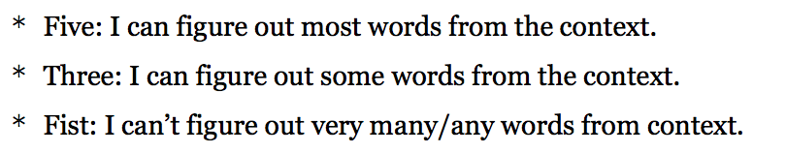

Slide 18
