Slide 1
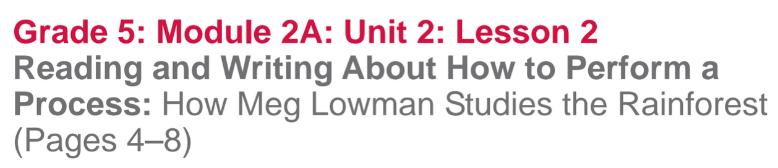

Slide 2
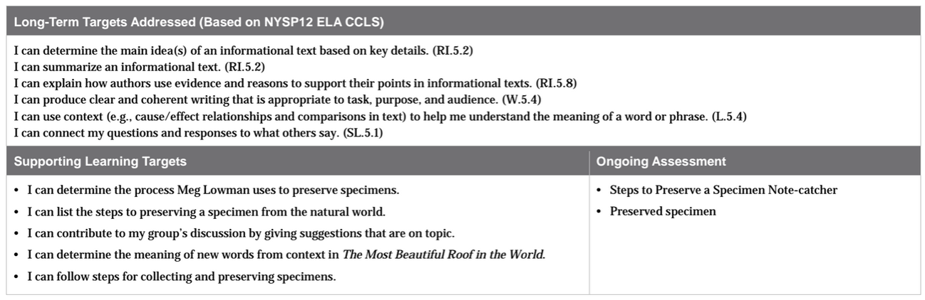

Slide 3
Opening
Reviewing Homework and Engaging the Reader (5 min)

Slide 4
Take out your journals and share with a partner one more thing that you learned about Meg Lowman from your rereading and the vocabulary homework.

Slide 5
Today, we are going to read about how Meg Lowman collects and preserves specimens in the rainforest and then you will get to follow her process to do the same with your samples that you’ve collected.

Slide 6
B. Introducing Learning Targets (5 min)
Learning Target”
“I can determine the process Meg Lowman uses to preserve specimens”
“ I can outline the steps to preserving a specimen from the natural world.”
*What does process mean?*

Slide 7
Work Time
Read-aloud and Main Idea: How Meg Lowman Studies the Rainforest (10 mins)

Slide 8
Join your reading groups bringing your journal and your text.
During the 1st read, remember to pay attention to the “gist” or the “main idea”
On page 4, find the paragraph that begins with “When Meg is at Selby Gardens…”
(teacher read pgs 4-8 “...tanks of bromeliads)

Slide 9
Briefly discuss the gist of the read-aloud with your group members.

Slide 10
B. Group Read: Rereading and Listing Details (10 mins)
“I can contribute to my group’s discussion by giving suggestions that are on topic”
How can you contribute to the discussion?

Slide 11
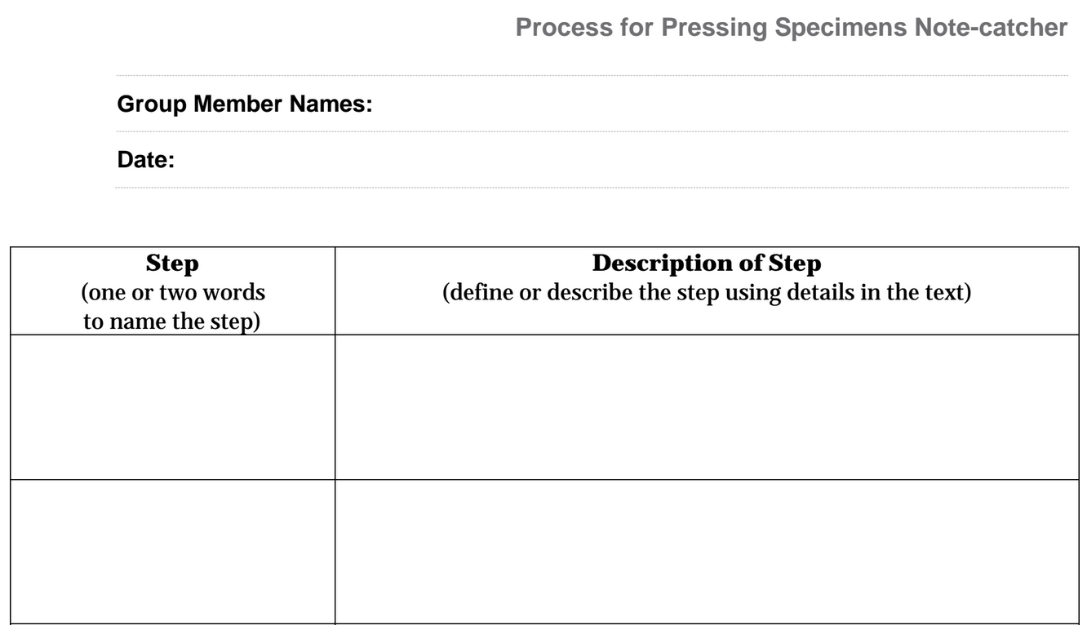

Slide 12
Read the single paragraph on page 7 and the 1st paragraph on page 8 on your own.
Pay close attention to the process Meg Lowman uses to preserve her specimens, specifically her process for pressing.
Examine the photographs well, these are a valuable feature of the text.

Slide 13
After you’ve finished reading, discuss with your group:
“What steps does Meg Lowman use for pressing specimens?”
You will create an outline of those steps to use for pressing your own specimens.

Slide 14
C. Key Vocabulary to Deepen Understanding
“I can determine the meaning of new words from context in The Most Beautiful Roof in the World”
What does context mean?

Slide 15
Quiz-Quiz-Trade
You will now participate in an activity called quiz-quiz-trade to help you review and/or learn definitions for some of the key vocabulary from the reading.

Slide 16
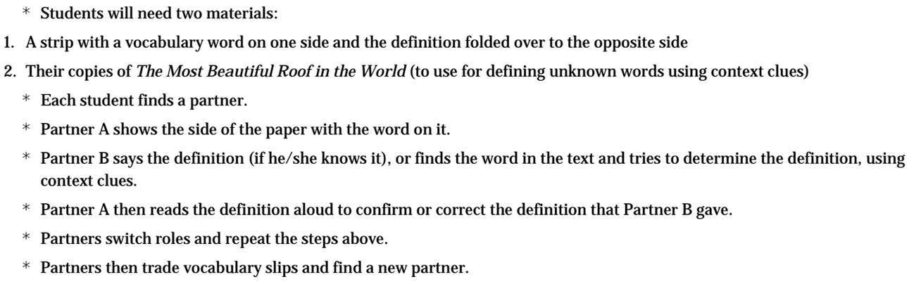
You should meet with at least 2 partners.

Slide 17
Share the meaning of these words:
ascent:
sorts:
specimens:
collection:
foilage:
bromeliad:
herbarium:
climb; a move upward (academic)
places into categories; arranges; classifies (academic)
examples; samples; a type of something (academic)
a set of objects; a group of things (academic)
plant life (scientific)
a tropical plant with fleshy leaves; often grown on other plants (scientific)
a plant library (scientific)

Slide 18
Now that you are more familiar with some of the key vocabulary from the text, take a moment to revise any steps that you listed and described on your Process for Pressing Specimens Note-catcher.

Slide 19
C. Following Steps to Preserve Specimen (15 mins)
Each group will receive the following materials:
a “low temperature oven”
4 sheets of newspaper
cardboard
acid-free paper
glue
Specimen from nature

Slide 20
Learning Target
“I can follow steps for collecting and preserving specimens”

Slide 21
“You will now “press” your own specimens.
* Trade your note-catcher with another group.
*Each member of the group will follow the steps that the OTHER group wrote on their note catcher.

Slide 22
Discuss with the group you traded papers with:
How well were you able to press your specimens based on the steps listed?
Share positive feedback first, and then make one suggestion for improving your written steps for a process.

Slide 23
Closing and Assessment
Debrief (5 min)
Let’s look back at the Meg Lowman KWL chart.
Share what you learned about Meg Lowman from the reading today.

Slide 24
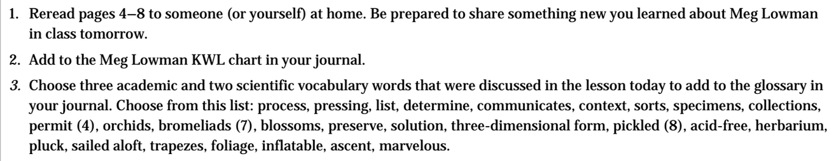
Homework

