Slide 1
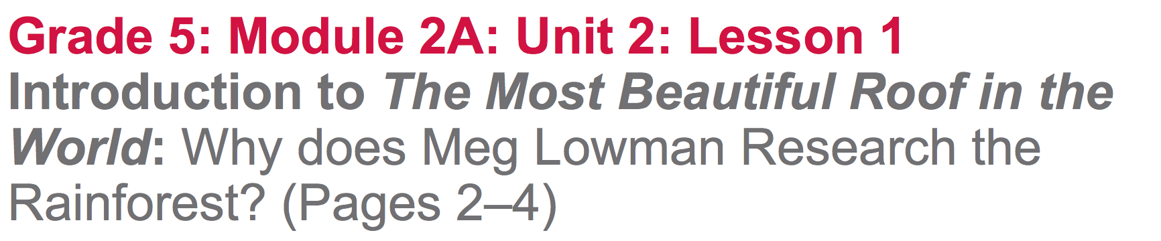

Slide 2
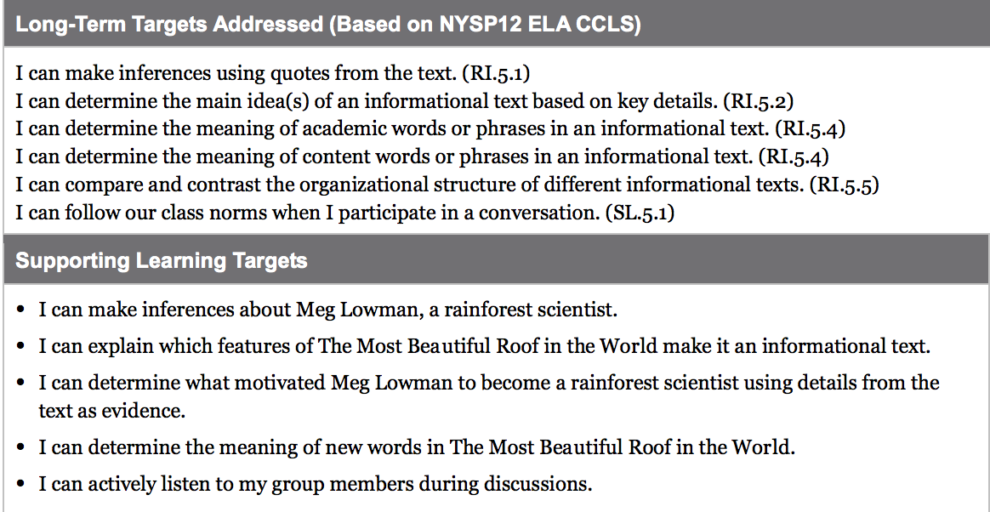

Slide 3
Opening
Engaging the Reader:
Interviewing Meg Lowman (10 min)

Slide 4
We studied several rainforest scientists in Unit 1, and learned about the ways that they communicate their research.
What do you remember about who these scientists were, where they researched, and/or what they studied?

Slide 5
In this unit, you are going to go much more in-depth about one rainforest scientist, named Meg Lowman. Today, we will begin by reading two very short excerpts from interviews with Dr. Lowman.

Slide 6
Concentric Circles
Place students in 2 concentric circles (an even number of students in an inner and an outer circle
Students in the outer circle are the interviewer
Students in the inner circle are Meg Lowman

Slide 7
Focus just on questions and answers A and B
Preview the text, highlighting what you will read out loud.
Take a few minutes to “interview” your partner, reading aloud A and B

Slide 8
Shift two places to the left to face a new partner.
Repeat the same process for C and D, but reversing roles this time.
  Outer circle: Meg Lowman
  Inner circle: Interviewer

Slide 9
Share/Discuss
What do you now know about Meg Lowman?

Slide 10
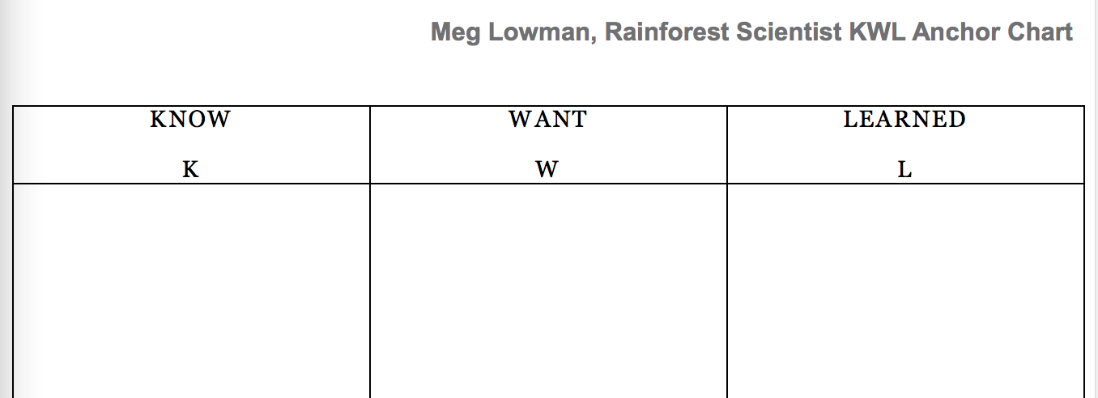
Meg Lowman, Rainforest Scientist KWL
Using 3 pages create a new KWL chart

Slide 11
Now that you have read excerpts from two interviews with Meg Lowman, what do you know about her?
As I record on the anchor chart, you can record in your journal.

Slide 12
W-Want to Learn
What else do you want to know about Meg Lowman?
We will be learning a lot about Meg Lowman and her rainforest research in the coming weeks. You will keep adding to the KWL chart. It’s important to take good notes, since you will get to use them on the end of unit assessment.

Slide 13
B. Introduce Learning Targets (5 mins)
“I can make inferences about Meg Lowman, a rainforest scientist.”
“I can explain which features of The Most Beautiful Roof in the World make it an informational text.”
“I can determine what motivated Meg Lowman to become a rainforest scientist using details from the text as evidence.”

Slide 14
Inferences
What does the word “inferences” mean?
Coming to a conclusion based on evidence or reasoning; coming to an answer without it being explicitly stated in the text

Slide 15
What do we mean by “features”?
~Specific parts, elements, or qualities
What does “determine” mean?
~decide, figure out, conclude

Slide 16
Work Time
Text Structure: Scanning The Most Beautiful Roof in the World (10 mins)

Slide 17
We are going to read an informational book called The Most Beautiful Roof in the World, by Kathryn Lasky, to learn more about Meg Lowman’s work in the rainforests.
*What features do you notice that hint to it being an informational text?

Slide 18
Features of Informational Text
Let’s look back at our anchor chart from unit 1 and add “book” as a type of text. What are some features of an informational book that we can add?

Slide 19
B. Group Read and Discussion: Who is Meg Lowman (15 mins)
Learning Target:
“I can actively listen to my group members during discussions.”

Slide 20
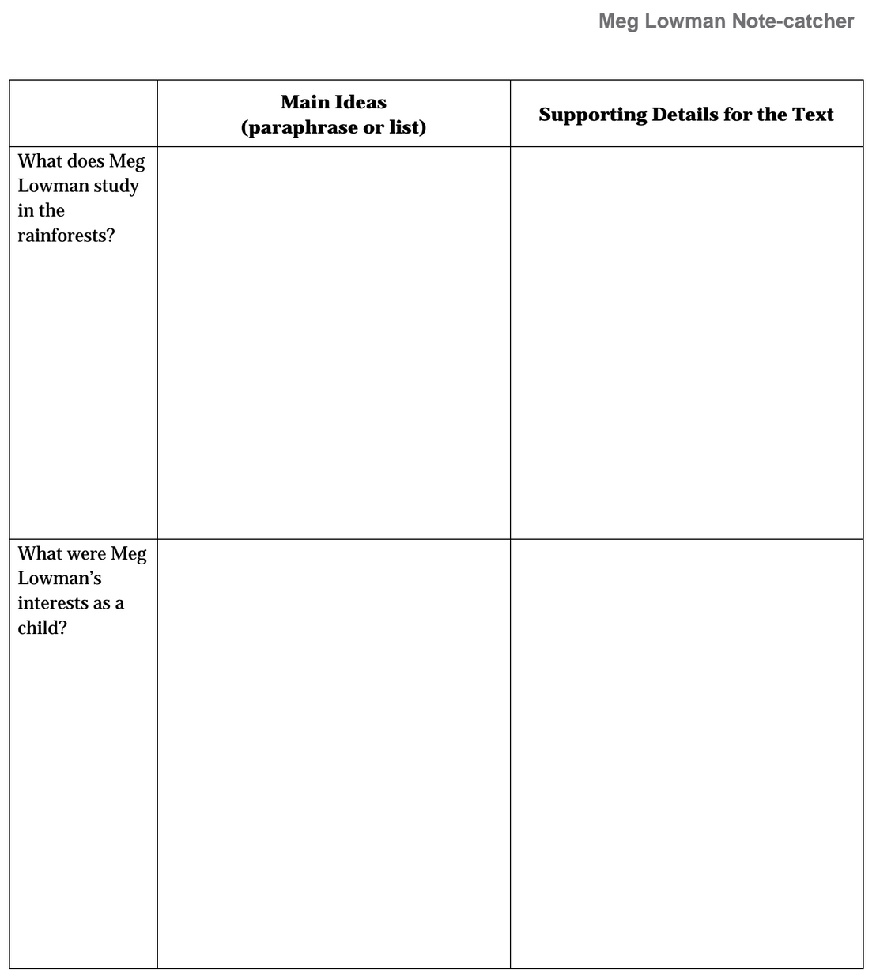
You will hear the first few pages of the book read aloud. You should follow along and look/listen for ideas that answer two questions:
What does Meg Lowman study in the rainforests?
What were Meg Lowman’s interests as a child?

Slide 21
Talk with your group…
What have you heard or seen in the text that answers the question “What does Meg Lowman study in the rainforest?”
*Record ideas on the note catcher under “main idea”*

Slide 22
Working with your group, look back in the text and find the specific details or evidence that supports each main idea.
“according to the text…”
“the book says…”
*Record under “key details from the text”
(repeat with the 2nd question)

Slide 23
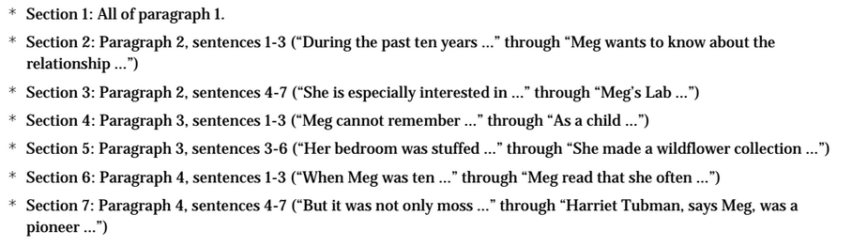
Each group will read their passage silently and then briefly discuss and record any new main ideas & supporting details on their note catcher.

Slide 24
Now that we have read and recorded information about what Meg Lowman studies and what her interests were as a child, what inferences can we make about why Meg Lowman conducts research in the rainforests? What details from the text support those inferences?
*Discuss in small groups, but don’t share whole group*

Slide 25
C. Key vocabulary to deepen understanding
Learning Target”
“I can determine the meaning of new words in The Most Beautiful Roof in the World.”
What strategies have you learned to help you determine the meaning of unfamiliar words?

Slide 26
Glossary
Remember the glossaries that we started in unit 1? We will work with those in much more depth in unit 2.
Notice the glossary in the back of the book. What type of words are those? Scientific or academic?

Slide 27
Knowing which words are which types helps you to determine the importance of vocabulary and therefore helps you to understand the texts better.
For homework every night, you will choose what you think are the most important academic and scientific words from the lesson and add them to your glossaries.

Slide 28
Now we are going to look back and work with some of the vocabulary from the reading today (interview and book).
Turn to a new page in your journal and split it into 2 columns.

Slide 29
Scientific words
words about science
Academic words
other words that help you understand concepts
You may not know what these words mean right now, and that’s okay. You are to discuss them with your group and decide which words you think are science words, and which words you think are academic words.
Canopy
Base
Samples
relationships
herbivory
conservation
treetops
biodiversity
environmentalist
intrigued
fascinated

Slide 30
As we review the vocabulary, you DO NOT need to copy them all down. You will choose a few words to focus on for your homework.

Slide 31
gadgets:
eureka:
canopy:
base:
samples:
relationships:
herbivory:
tools; equipment (scientific)
aha! discovery; understanding (academic)
tops of the trees in rainforests (scientific)
bottoms of trees in rainforests (scientific)
pieces; examples (scientific)
how things work together; depend on each other (academic)
leaf and plant eating by insects and other animals (scientific)

Slide 32
Conservation:
treetops:
biodiversity:
environmentalist:
intrigued:
fascinated:
preservation of a species of plant or animal (scientific)
canopy; tops of trees (scientific)
many plants and animals living in one location (scientific)
someone who cares about/researches/preserves natures (scientific)
curious; interested (academic)
mesmerized; completely focused on; intrigued (academic)

Slide 33
Now that all of the words have been defined, I’m going to give you a minute to discuss whether you now think a words belongs in a different category from where you placed it.
Were any words difficult to categorize? why?

Slide 34
Closing & Assessment
Debrief and Review Learning Targets (5 min)

Slide 35
What have we learned about Meg Lowman as a scientist?

Slide 36
Learning Target
“I can actively listen to my group members during discussions”
How well did you meet this target?

Slide 37
Homework
Reread pages 2-4 of The Most Beautiful Roof in the World to someone (or yourself) at home. Be prepared to share something else that you learned about Meg Lowman and add it to your L column of the KWL chart
Choose 2 academic and 2 scientific vocabulary words to add to your glossaries. Choose from: features, determine, inferences, gadgets, biodiversity, eureka, samples, relationships, herbivory, conservation, canopy, base, treetops, environmentalist, intrigued, fascinated.

