Slide 1


Slide 2
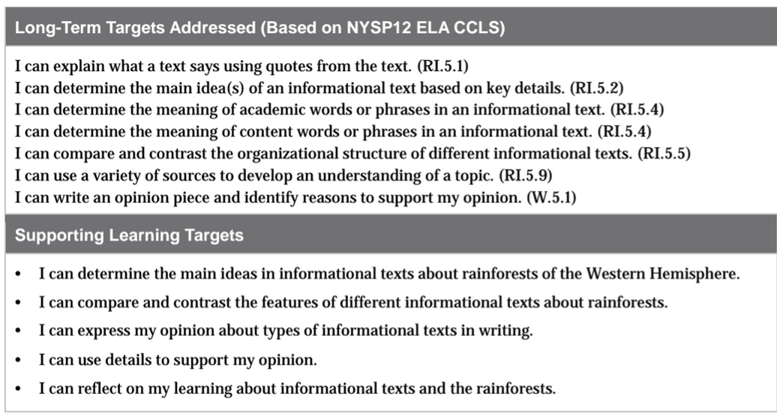

Slide 3
Review Learning Targets (5 min)
Today you are going to take the end of unit assessment so they can show all that you’ve learned about rainforest of the Western Hemisphere; what you know about how scientists communicate their research; and the different types of informational texts that helped you learn more about the rainforets.

Slide 4
Important words:
Express-
Share ideas through writing.
Opinion-
What I think; my own feelings about something.
Details-
Specific ideas; supporting facts/information
Support-
Use details/information from sources to justify/explain thinking.

Slide 5
Work time
End-of-Unit 1 Assessment: Analyzing an Interview with a Rainforest Scientist Part 2
&
Comparing and Contrasting Texts about Rainforest Biodiversity (40 min)

Slide 6
Today you will read excerpts from the second part of the “Live Online Interview with Eve Nilson.” Then you will respond to some questions about this text, as well as the other informational texts that you’ve read/viewed throughout this unit.

Slide 7
This is an “open book” assessment, which means you may use your resources, but you must work on your own. You may use your journal notes, other texts, and all anchor charts to support your responses to the questions/prompts.

Slide 8
B. End of Unit 1 Tracking My Progress: Reflecting on Learning
(10 mins)
Learning Targets:
I can determine the main ideas in informational texts about rainforests of the Western Hemisphere.
I can compare and contrast the features of different informational texts about rainforests.

Slide 9
Recall the meaning of these terms:
Determine-
decide; conclude
Compare-
identify similarities
Contrast-
identify differences
Features-
specific parts; elements; characteristics

Slide 10
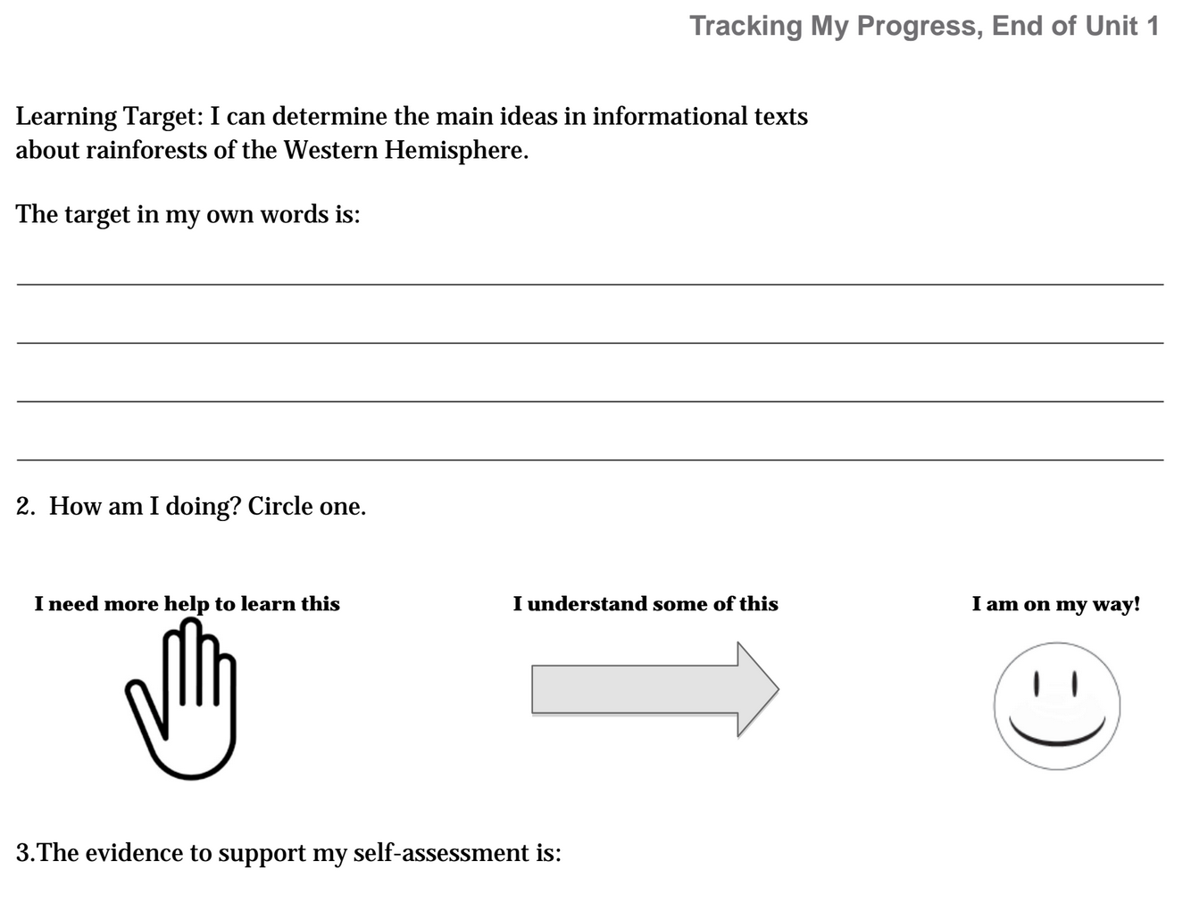
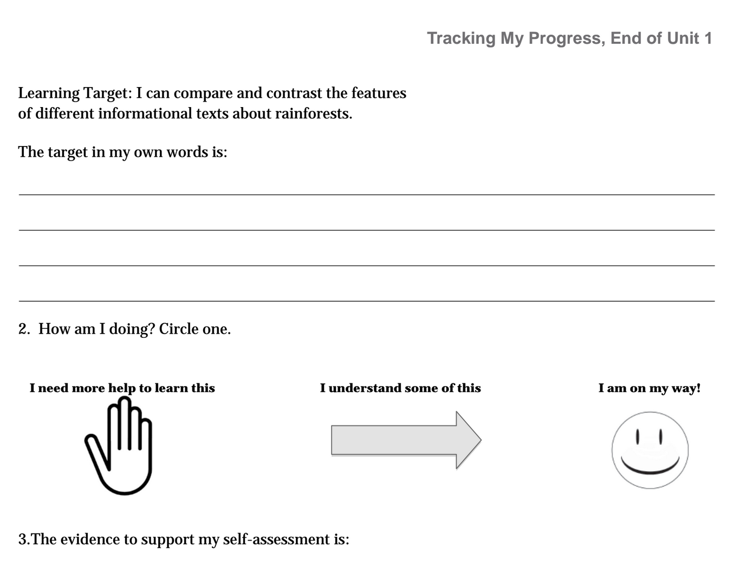
Tracking My Progress
You did a similar self-assessment a few lessons ago, and you’ve been reflecting on your learning daily.

Slide 11
Closing and Assessment
Exit Ticket (5 min)
If you could meet one of the scientists we read about in our informational texts, what question about the rainforest would you want to talk about with her/him about? Why?

