Slide 1
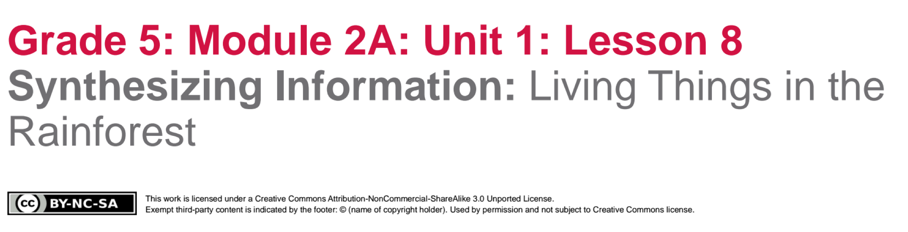

Slide 2
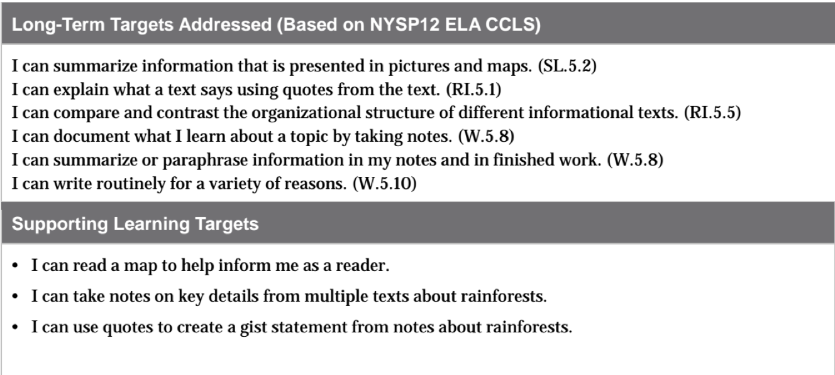

Slide 3
Engaging the Reader:
Maps as Informational Text (5 min)
Learning Target: I can read a map to help inform me as a reader.
What does inform mean in this target?

Slide 4
Features of Information Text Anchor Chart
Let’s review the types of informational text features that we’ve seen in an interview, an article, and a video.

Slide 5
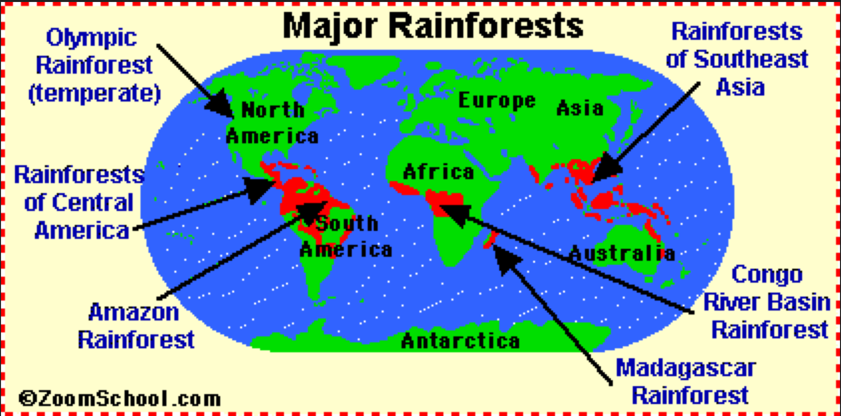
What text features on the map help you understand information about rainforests?

Slide 6
Follow up Questions
How is a map a type of informational text?
What information can we learn about rainforests from this map?
Let’s add your ideas to our Text Features chart and KWL chart.

Slide 7
B. Review Homework (5 mins)
Share your Venn Diagram Comparing the Features of Two Types of Informational Text with a partner.

Slide 8
Note-Taking for Research (20 min)

Slide 9
Review Learning Targets:
I can take notes on key details from multiple texts about rainforests.
I can use quotes to create a gist statement from notes about rainforests.
What is a quote?

Slide 10
The purpose of reading/viewing informational texts is to learn more about a topic. One of the reasons that you’ve been working with a variety of informational texts and text features was to learn about unique things found in rainforests
You are going to take notes about those unique living things from the texts that you’ve read and heard.

Slide 11
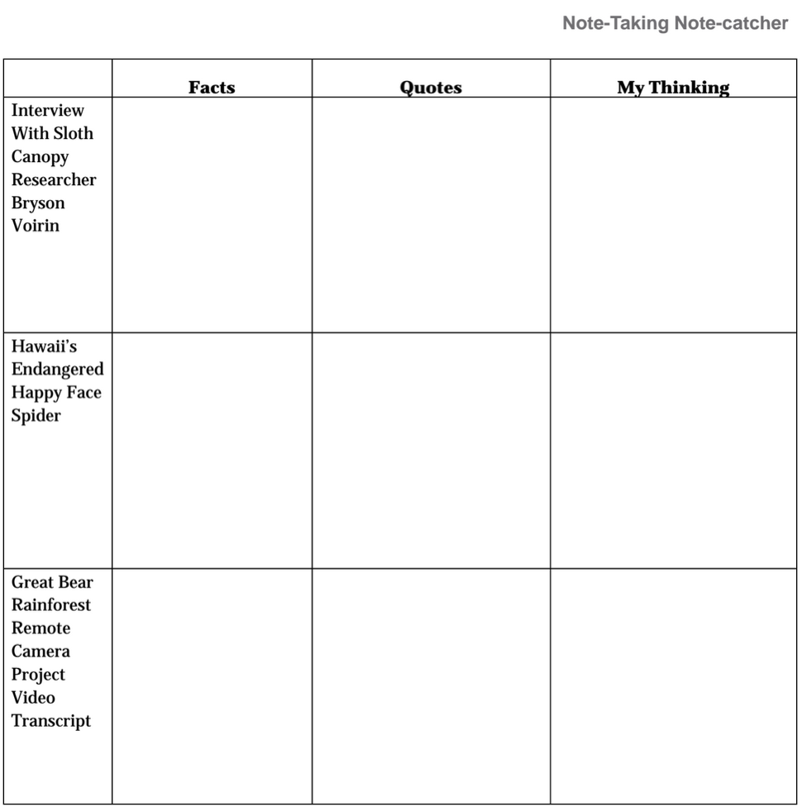
Let’s reread the question “Why did you want to study frogs?
Based on this question and answer, can you identify a unique thing found in the rainforest.
(follow notes in plan)
TEXT
“Live Online Interview with Eve Nilson”

Slide 12
Working in your table groups, work together to fill out the note-catcher about the different texts we’ve read throughout this unit.
Remember: your goal is to identify key facts/details about the unique things found in rainforests

Slide 13
B. Synthesizing Notes:
Paragraph about unique life in the rainforest (10 mins)

Slide 14
You are going to write a quick paragraph to inform others about the unique life that exists in the rainforest. You may use anything from your note-catchers that you just created. Your paragraph should include facts/key details about unique life in the rainforests, from each of the informational texts; and a quote that supports each fact/key detail, from each of the informational texts.

Slide 15
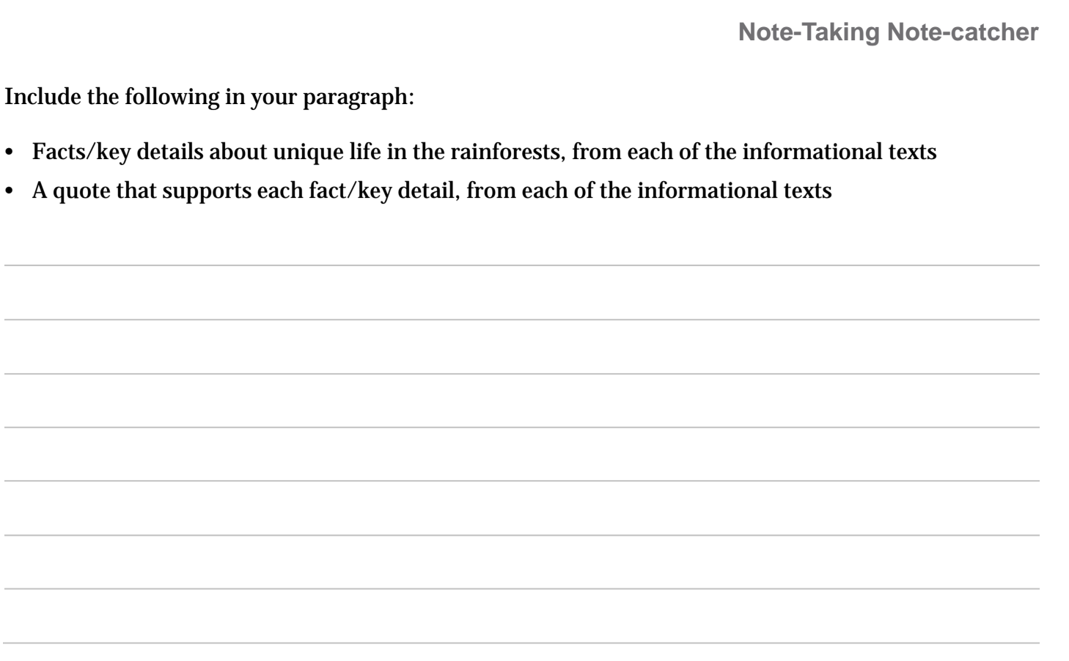
Writing time: 15 mins

Slide 16
Closing and Assessment
Let’s look at our Rainforest KWL anchor chart. Let’s review the questions in the W column. Have we answered some of these questions already? Let’s circle the ones that haven’t been answered yet. Are there any additional questions you would like to add?

Slide 17
Exit Ticket (5 mins)
Respond in writing (½ sheet):
What are the commonalities in how scientists of the rainforest gather evidence?
Why is it important to draw from multiple texts when doing research?
Share your writing with a partner

Slide 18
Homework
What questions do you still have about rainforest? Add any new questions to the W column of the Rainforest KWL chart in your journal.
Tomorrow, you will be taking the end of unit assessment. You will be reading another section of the interview with Eve Nilson.

