Slide 1
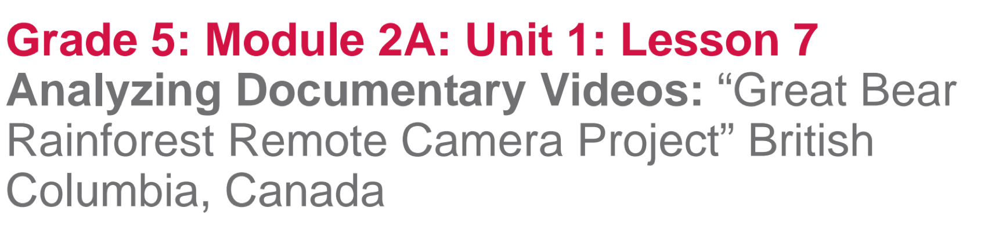

Slide 2
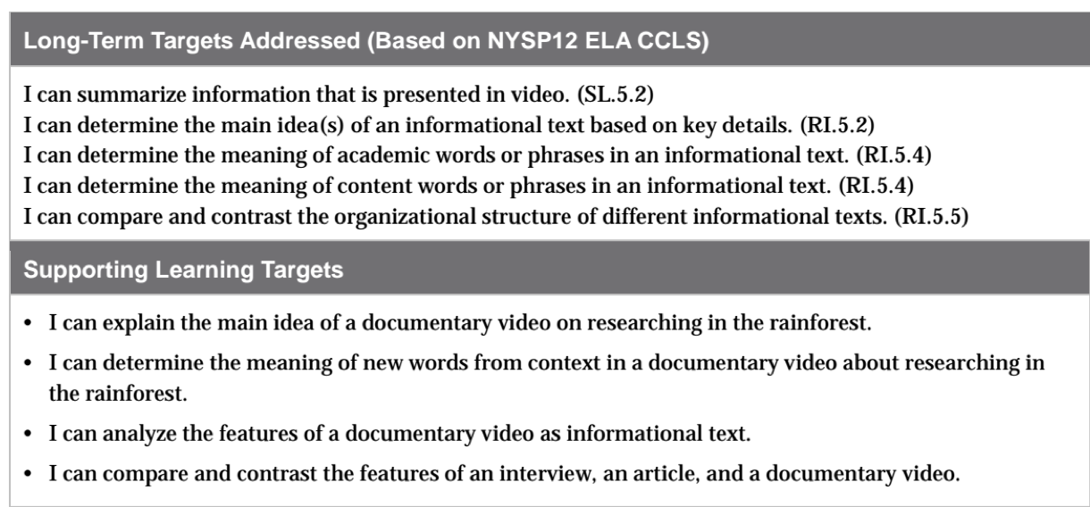

Slide 3
Opening
Engaging the Reader: Rainforest of British Columbia, Canada (5 mins)

Slide 4
You will be learning about research in another rainforest, the Great Bear Rainforest in British Columbia, Canada.

Slide 5
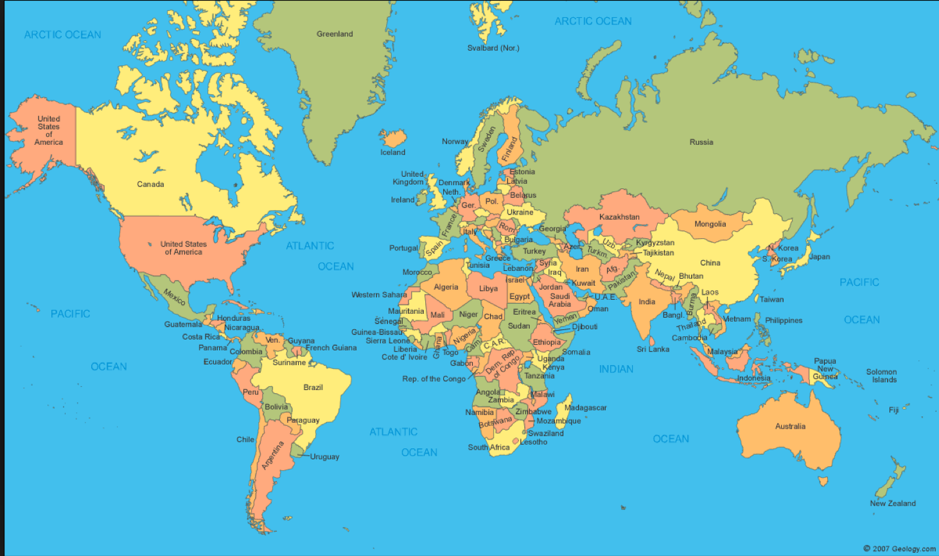
California
Hawaii
British Columbia
Where is the British Columbia Rainforest located in relation to both Panama and Hawaii?

Slide 6
Think-Pair-Share
What are you noticing about where rainforests are located around the world?

Slide 7
B. Review types of Informational Text
You are learning about different ways that scientists communicate their research about rainforests. Scientists use a wide range of informational texts to inform people about their research.

Slide 8
Informational Text Anchor Chart
Think about what types of informational texts we’ve already read.
Add documentary video
What makes a video informational?
What root word do you see in documentary
Are all videos informational?

Slide 9
A documentary is a film or TV program about history, science, or other topics, that provides factual information.
Documentaries often include interviews and they should be unbiased, yet often present the filmmakers’ opinion.

Slide 10
Work Time
First View: Getting the Gist of What Scientists Are Researching in the Great Bear Rainforest (15 mins)

Slide 11
Review Target Learning
I can explain the main idea of a documentary video on researching in the rainforest.
What does main idea mean?

Slide 12
We’re going to view another type of informational text, a documentary video, to learn more about the work of scientists in the Great Bear Rainforest.
We are going to watch it several times, just like we’ve re-read our texts several times.

Slide 13
1st Viewing
For this 1st view, you will watch 6 shorter segments. After each segment, you will think, talk, and write, recording a gist statement about what you heard and saw.

Slide 14
Journal
Begin a new page in your journal to write your gist statements. You will write a total of 6 statements, one for each segment.
Leave space after each statement since you’ll be adding other notes on the segment later.

Slide 15
Great Bear Rainforest Remote Camera Project
Teacher:
Pause at each pause point to allow students to briefly discuss and record their gist statements.

Slide 16
Second View: Determining the Meaning of Words in Context (15 mins)

Slide 17
Learning Target
I can determine the meaning of new words from context in a documentary video about researching in the Rainforest.
How do we determine the meaning of a word using the context?

Slide 18
Great Bear Rainforest Remote Camera Project
You will now watch the video again. This time, you will listen carefully for words about what and how these scientists are learning in the Great Bear Rainforest. Each time the video is paused, you should write down specific words in your journal, underneath the gist statement for that segment of the documentary. Don’t worry about spelling right now.

Slide 19
Share with your group the words that you chose from the video, listening for words listed in the vocabulary section of this lesson.
Think of how the word was used in context.

Slide 20
C. Third View: Documentaries as Informational Text (10 mins)

Slide 21
Learning Targets
I can analyze the features of a documentary video as informational text.
I can compare and contrast the features of an interview, an article, and a documentary video.
What does it mean to analyze

Slide 22
Features of an Informational Text anchor chart
What is meant by “features of a video”?

Slide 23
3rd Viewing video
Each student will get 3 sticky notes
As you watch the video a third time, you will analyze the features of a documentary video as a type of informational text. You will use the sticky notes to write down informational text features that you notice in the video.

Slide 24
Discuss with your group:
What features did you notice?
What types of oral and visual clues in the video helped you understand what scientists were trying to communicate?

Slide 25
Closing and Assessment
Debrief: What have we learned about the Rainforest? (10 mins)

Slide 26
Discuss in groups:
What type(s) of technology did they use to track wildlife?
What types of wildlife were they tracking?
What were they able to learn about the wildlife, using this technology?
Justify your answers by referring directly back to the words from the video.

Slide 27
Rainforest KWL anchor chart
Share out ideas that you want to add about what you have learned about rainforests from their discussion to the L column of the anchor chart.

Slide 28
Review learning targets:
I can explain the main idea of a video on researching in the rainforest.
I can compare and contrast the features of an interview, and article, and a video.
Use glass, bugs, and mud to indicate your level of mastery towards the targets.

Slide 29
Homework
Choose two of the informational texts examined so far (interview, article, and/or video) and complete the Venn diagram comparing and contrasting the features of these different types of informational text.

