Slide 1


Slide 2
Opening
Review Learning Targets

Slide 3
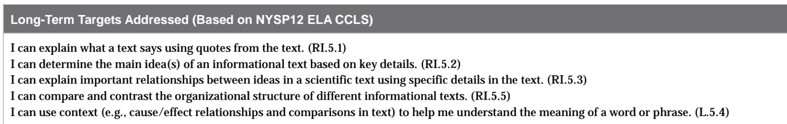
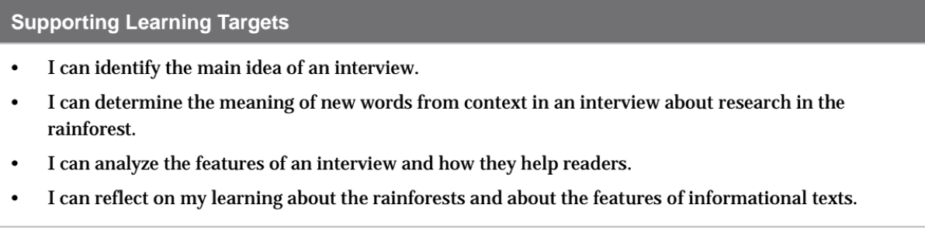

Slide 4
B. Review How Scientists Communicate Research about the Rainforest and Features of Informational Text (10 mins)

Slide 5
Today, we’ll be taking our mid-unit assessment.
There have been two main focuses for your learning so far in this unit. You will now have an opportunity to review what you’ve already learned by looking back at your journal and the class anchor charts with 2 other students.

Slide 6
Form groups of 3.
First, look at your Rainforest KWL charts
  Discuss: What did I learn about rainforests?
Then, review the Features of Informational text anchor chart and your Venn diagrams.
  What is similar and what is different about the texts?
  What are some specific features of each?
  What features helped you the most?

Slide 7
Work time
Mid-Unit 1 Assessment: Analyzing an Interview with a Rainforest Scientist Part 1 (30 mins)

Slide 8
When you receive your papers, quickly scan the assessment.
Are there any clarifying questions?

Slide 9
Early Finishers:
You may work on your glossaries in your journals. Add new words from the “Online Interview with Eve Nilson” that you just read, or add synonyms, phrases, and/or pictures to any words that you haven’t had time to complete.

Slide 10
B. Mid-Unit 1 Tracking My Progress: Reflecting on Learning (10 mins)

Slide 11
Introduce Learning Target
I can reflect on my learning about the rainforests and about the features of informational texts.
What does reflect mean?

Slide 12
Self-Assessment
This is a self-assessment, and it is very much like the self-assessing that you’ve done at the end of most lessons. You will reflect on your progress towards the learning targets.
Complete your self-assessment honestly and independently. Hang on to it when you’re finished.

Slide 13
Closing and Assessment
Debrief: Sharing Reflections on Learning Targets (5 mins)

Slide 14
In pairs, share your reflections on the Mid-Unit assessment.
Group share out

