Slide 1
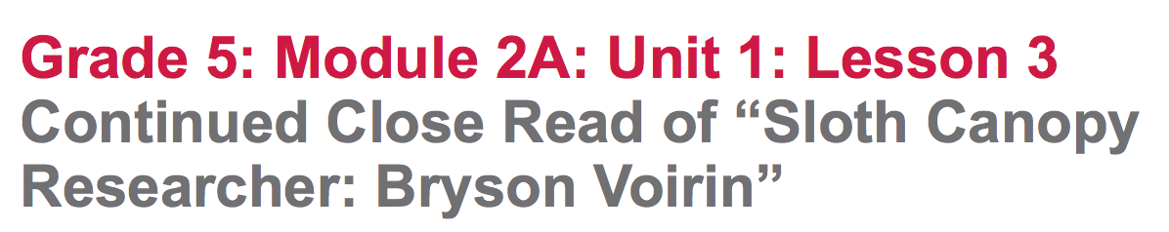

Slide 2
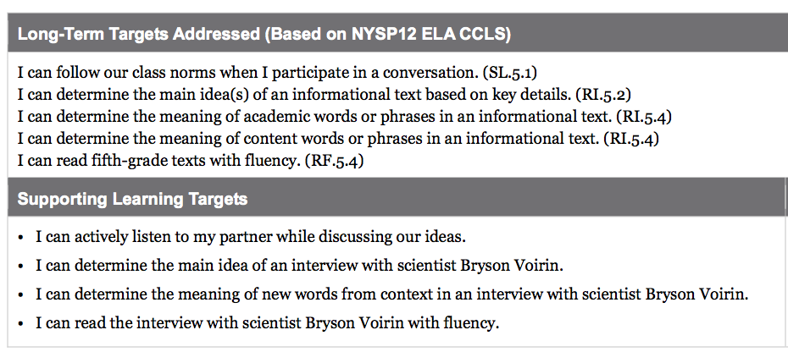

Slide 3
Opening
Engaging the Reader: Rainforests of Panama (5 mins)

Slide 4
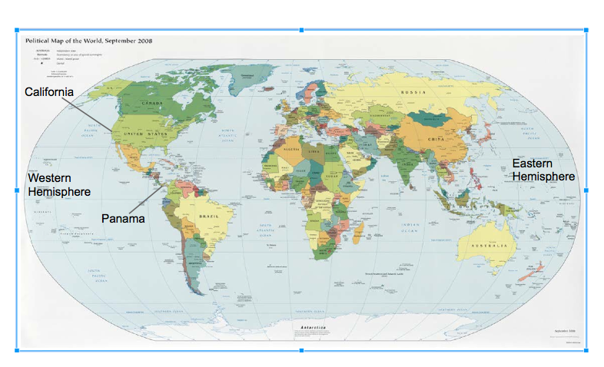

Slide 5
A. Engaging the Reader: How Do You Learn? (10 minutes)

Slide 6
Review Learning Targets
“I can actively listen to my partner while discussing our ideas.”
What do you remember about listening actively?

Slide 7
Find another student to read your Journal response question to.

Slide 8
* Glass = “I was able to identify and write about a text feature/element that really helped me understand the text better.”
* Bugs = “I was able to identify a text feature/element, but I’m not sure yet how it helps me understand the text better.”
* Mud = “I’m not sure about text features/elements or how they help me understand the text better.”
• Ask students to raise their hand to indicate if they were “glass.” Then ask for “bugs,” then “mud.”

Slide 9
Work Time
A. Text-Dependent Questions: “Sloth Canopy Researcher: Bryson Voirin” Remaining Interview Questions and Answers (15 Min.)

Slide 10
We are going to continue reading the interview with Bryson Voirin, paying attention to key vocabulary as well as to text features that help you find information about rainforests.

Slide 11
“I can determine the main idea of an interview with scientist Bryson Voirin”
“I can determine the meaning of new words from context in an interview with scientist Bryson Voirin.”
Recall the meaning of the word determine.

Slide 12
*** Students briefly review the “gists” they wrote about Questions 1-3 of the interview in their journal.

Slide 13
Students get into pairs.
• Read the remaining questions and answers of the interview
(4 through 7) aloud - students to follow along in their text.
• Students work with their partner first to discuss and then to write answers to the four text-dependent questions.
(8-10 min)

Slide 14
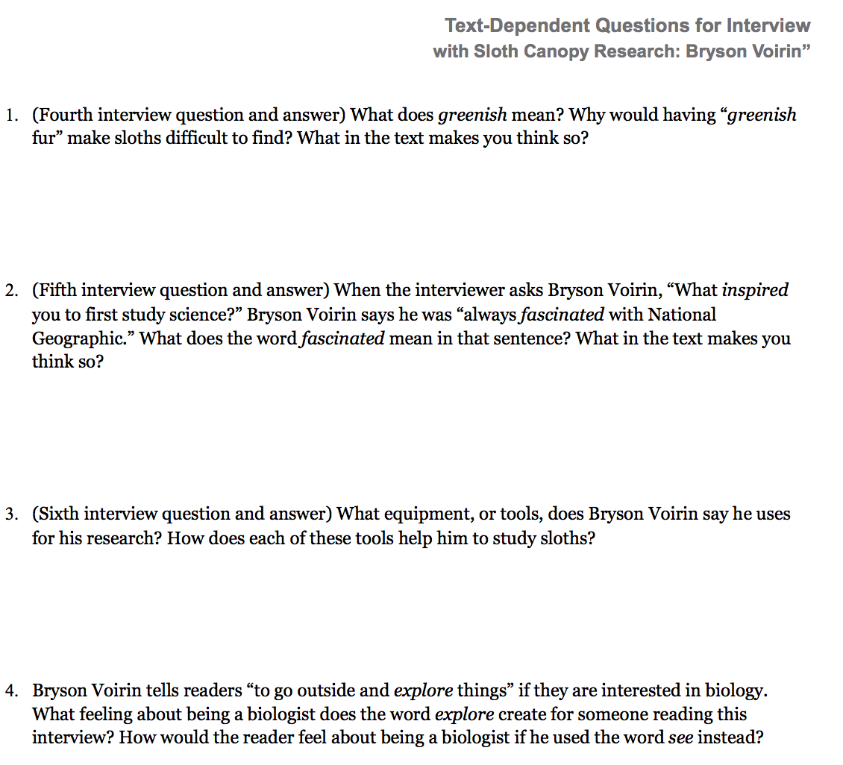

Slide 15
B. Rereading: What Else Can We Learn from Bryson Voirin’s Research about the Rainforest? (15 minutes)

Slide 16
You will reread the entire interview with your partner, looking for new things you can learn about the rainforest.

Slide 17
Learning target
“I can read the interview with scientist Bryson Voirin with fluency.”
Focus on the word fluency,
reminding students to remember what reading with fluency looks and sounds like.

Slide 18
In your student pairs determine your roles:
One person will be the interviewer, and the other will be Bryson Voirin.
5 minutes to read aloud.

Slide 19
Discuss the new things they were able to learn about rainforests during this read of the interview. Remember, add your new learning to the L column in your journals. (Do not have students share out now, as they will share out during the debrief.)

Slide 20
C. Determining Words in Context
(10 min.)
“Why do you think scientists choose such specific words when communicating about their research?”

Slide 21
* “What does the word issue mean in this context?”
I used to imagine I was one of the scientist in each issue, exploring unknown lands or catching wild animals.

Slide 22
• Unknown Ask yourself, “What does the prefix un- mean?
What does the word root known mean?”

Slide 23
Academic Glossary Words
normal; usual; everyday
* typical =
* move about =
* advice =
go different places; not stand still; walk, etc.
guidance on how to do something; how to accomplish something, etc.

Slide 24
A. Debrief: What Have We Learned Now about the Rainforest? (10 min.)

Slide 25
Learning Lineup protocol to review two or three of the learning targets. Designate one end of the room where students will stand if they feel they are
Expert (completely understand and can apply understanding);
and an opposite end of the room where students will stand if they feel they are Beginner (still not quite understanding the target.)
Explain that they will stand somewhere in the middle of Expert and Beginner if they feel they are Novices (getting the idea) about the learning target.
Read through each target and pause to ask students to line up to indicate their mastery of the target.

Slide 26
CLOSING
“What is one new thing you have learned about the rainforest from the interview with Bryson Voirin?” (Share from L column on chart)

Slide 27
HOMEWORK
REREAD the interview with someone at home. Ask your partner to be the interviewer. You be Bryson Voirin.
After you are done reading, pretend to be Bryson Voirin and answer one more question:
“What would you like to explore further in the rainforest? Why?”
Write your answer to this question.

