Slide 1


Slide 2
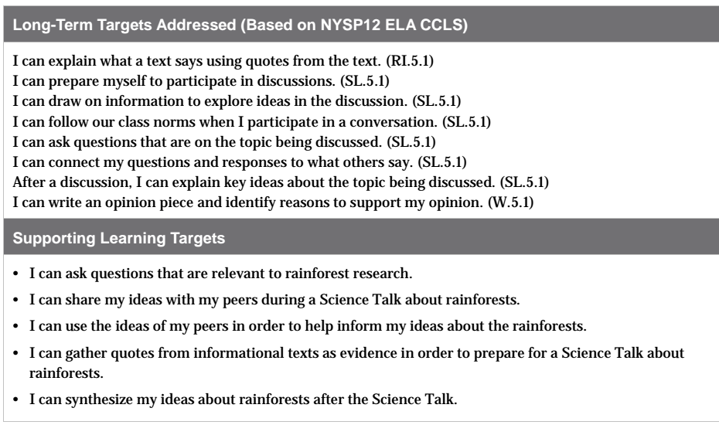

Slide 3
Opening
Engaging the Reader: Communicating like Scientists (2 min)

Slide 4
Congratulations on all that you’ve learned about the rainforests! We’ve also been focusing on how scientists communicate their findings.

Slide 5
Today you are going to learn more about how scientists think and discuss, or communicate, their ideas with other scientists by participating in a Science Talk.
Now we are going to do what scientists do when they get together!

Slide 6
B. Review Learning Targets (8 min)
I can ask questions that are relevant to rainforest research.
What does it mean to ask relevant questions about rainforest research?

Slide 7
With a partner, refer back to your journals and the informational texts that you’ve read/viewed in order to identify the relevant questions scientists you’ve learned about have asked.

Slide 8
Work Time
Establishing Norms for a Science Talk (10 mins)

Slide 9
A science talk is a discussion about a relevant, or a “big” question scientists have. While scientists discuss these big questions with one another, it is important for them to create a set of rules, or norms, that they will all follow so everyone’s ideas can be heard and considered.

Slide 10
Learning Target
I can share my ideas with my peers during a Science Talk about rainforests
I can use the ideas of my peers in order to help inform my ideas about the rainforests

Slide 11
Science Talk Norms Anchor Chart
What does it look like and sound like to share ideas with peers?
What does it look like and sound like to use the ideas of your peers to inform your ideas?

Slide 12
B. Participating in a Science Talk (20 min)
Learning Target:
I can gather quotes from informational texts as evidence in order to prepare for a Science Talk about rainforests.

Slide 13
You are now going to participate in a Science Talk, like real scientists do.
Gather in two concentric circles on the floor, with your journals. Be sure each student in the inner circle is facing a partner in the outer circle.

Slide 14
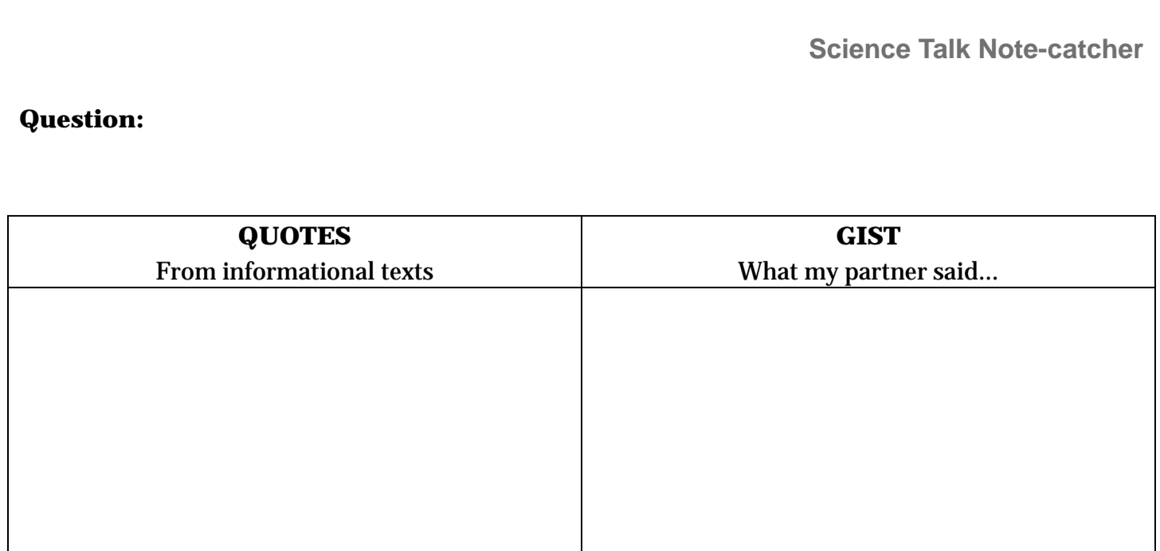
Note-Catcher

Slide 15
Notice the 3 parts of the Note-Catcher:
Question: Record the question you are discussing
Quotes: Record the quotes, from articles and/or journal notes, you refer to during the discussion of the question
Gist: Write a brief statement of what you and your partner said.

Slide 16
Question
Why is biodiversity important?
Write the question in your note-catcher.
Remember: As you discuss your ideas about the question, you will need to use quotes from the scientists, in their informational texts, to support your thinking.

Slide 17
Movement
Every few minutes have students move so they are facing new partners, but still discussing the same question.
Ask additional probing questions as necessary

Slide 18
C. Synthesizing Information from a Science Talk
Learning Targets:
“I can synthesize my ideas about rainforests following the Science Talk
What does synthesize mean?
Synthesize: put all the ideas together; summarize ideas/thoughts/information

Slide 19
You just had an opportunity to participate in a Science Talk around one of our big questions about rainforests.
In triads, discuss:
What answers to the question did you and your peers discuss?
What details and quotes, from the informational texts, did you and/or your peers use to support your thinking?

Slide 20
New journal page...
You will write a synthesis statement responding to the big questions you discussed during the Science Talk. For this statement, you are to write your answer to:
Why is biodiversity important? using evidence and details from the discussions you just had during the science talk./

Slide 21
Closing and Assessment
Debrief (5 min)
“I can share my ideas with my peers during a science talk about rainforests.”
Did you meet this target? Why or why not?

Slide 22
“I can use the ideas of my peers in order to help inform my ideas about the rainforests.”
Did you meet this target? Why or why not?

Slide 23
B. Exit Discussion (5 min)
Think-Pair-Share
How did participating in a science talk support your as a learner?

