Slide 1
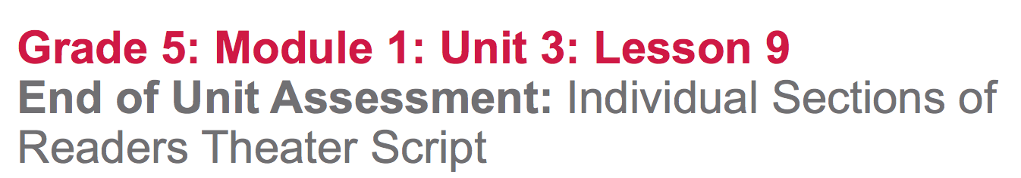

Slide 2
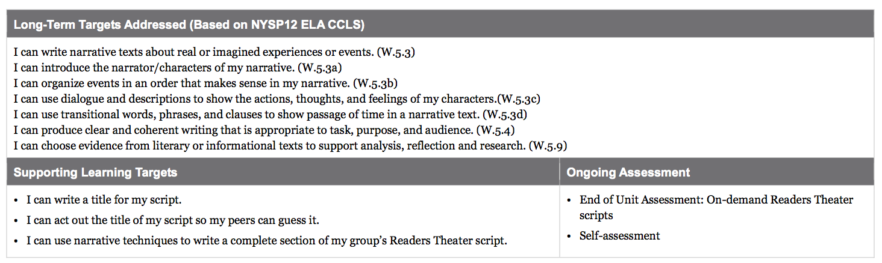

Slide 3
Opening
Reviewing Learning Targets (5 mins)

Slide 4
Learning Targets
I can write a title for my script
I can act out the title of my script so peers can guess it
I can use narrative techniques to write a complete section of my group’s Readers Theater script

Slide 5
For the past few days you have been working to identify and narrow passages from Esperanza Rising to use in your script. You may use all of these notes, as well as the sticky notes you have in your copy of the novel, during the assessment, but you will not get any help from me today.

Slide 6
The remaining lessons of this unit will give you more time to work with your group.
As a group, you will combine all of your individual scripts into one group script: a longer play that you will perform together during the final performance task.

Slide 7
Work Time
Let’s Play Charades! (20 mins)

Slide 8
You are each going to create a three- to- five- word title for your scripts, to be acted out in a game of charades.
Who is familiar with this game?
It is acting out the title of a play without using words--only body movements and facial expressions; then the audience tries to figure out what the title is.

Slide 9
Steps:
Hold up a number of fingers to show the audience how many words are in the title
In your mind, choose one word of the title. Hold up a finger to let the audience know which word you’re thinking of (2 fingers for the 2nd word)
Act out the word you chose
Audience tries to guess the word
When the audience guesses correctly, the actor writes the word on a sheet of paper
Continue until the audience has guessed all of the words in the title

Slide 10
Teacher model
see lesson plans

Slide 11
Gather in your Readers Theater groups. Take a minute to write a 3 or 4 word title for your script that you will act out for your group.

Slide 12
B. On-Demand End of Unit Assessment
(25 min)
Return to your seats with your script drafts.

Slide 13
Today you are going to write final copies of your individual scripts.

Slide 14
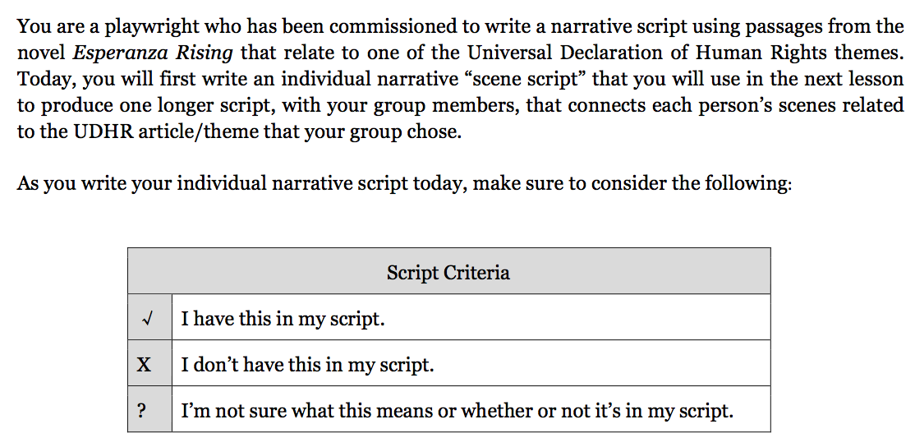

Slide 15
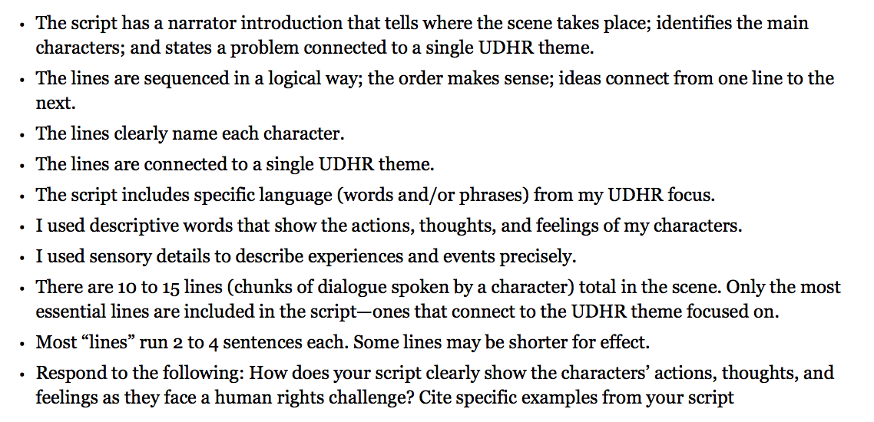

Slide 16
Closing and Assessment
Self-Assessment (10 mins)

Slide 17
Thinking about the success criteria, place a check next to the criteria you have in your script, and an X next to criteria you didn’t include, and a question mark next to criteria you’re uncertain about.
Next, write a brief statement addressing how well you believe you used dialogue and descriptive language to show the characters’ reactions to human rights challenges.

Slide 18
