Slide 1
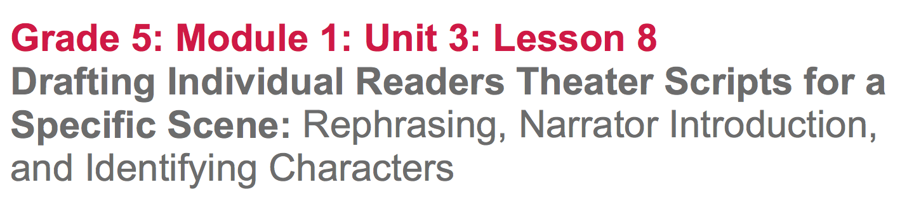

Slide 2
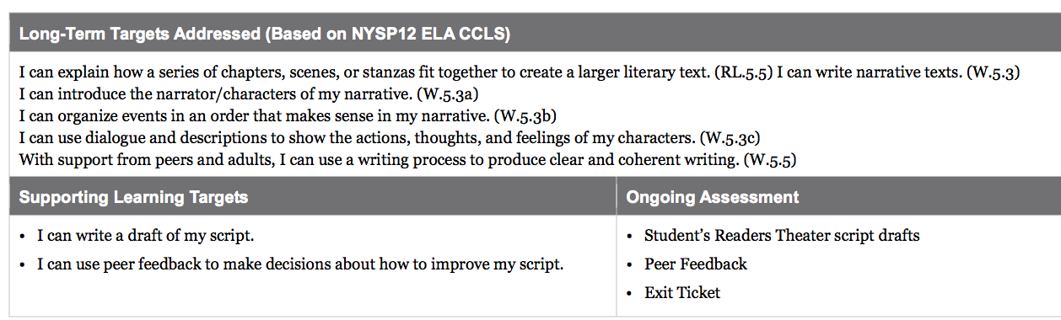

Slide 3
Opening
Reviewing the Learning Targets (5 mins)

Slide 4
Learning Targets
I can write a draft of my scripts
I can use peer feedback to make decisions about how to improve my script

Slide 5
Work Time
Individual Work: Drafting my Script (10 mins)

Slide 6
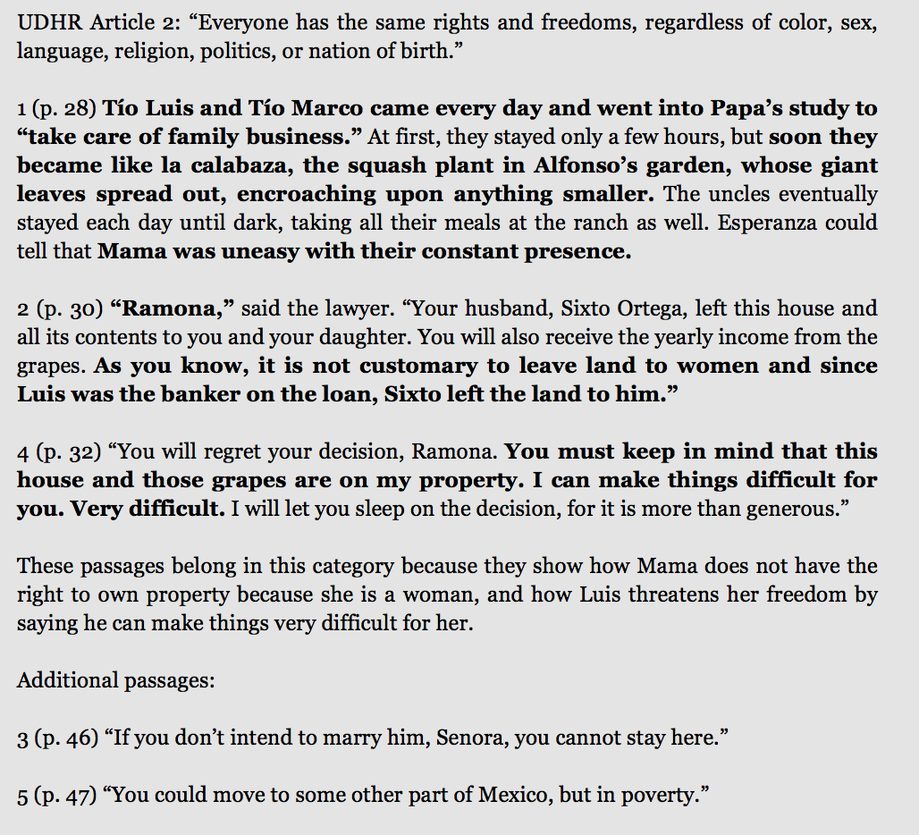
This is similar to the UDHR category cards that you’ve been working on.
Notice the sequence that I selected for the lines

Slide 7
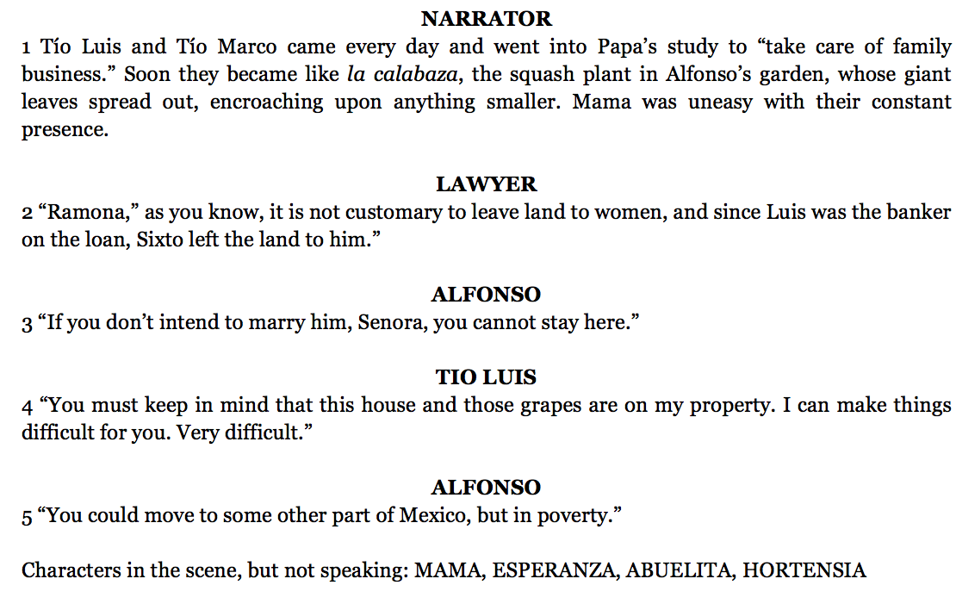
Script Re-write Sample 1
What do you notice about how this script is difference from the UDHR category card?

Slide 8
Transfer the text from your own UDHR category card (from lesson 7) onto a new sheet of paper, by writing only lines that are highlighted and using the order that you determined in lesson 7. You will also need to write “Narrator” and the names of the other characters who will be speaking above their respective lines.

Slide 9
B. Individual Work: Refining My Script (15 min)

Slide 10
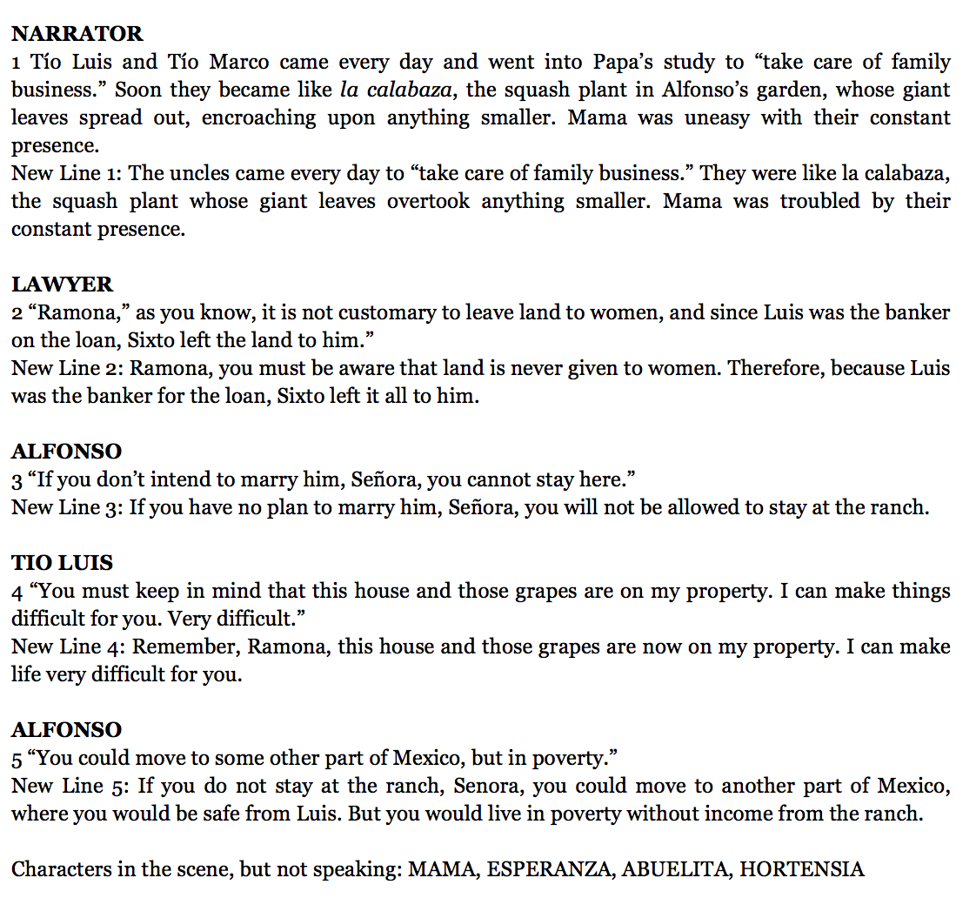
Sample 2
Now you are going to refine your scripts by rephrasing some of the lines. It will be important for you to make sure the setting and problem are clear to your audience.
Let’s read through the old and “new” lines of the script.
Why were these lines rephrased?
Work on rephrasing your lines.

Slide 11
C. Individual Work: Writing Narrator Introductions (15 mins)
Now you are going to write drafts of narrator introductions.

Slide 12
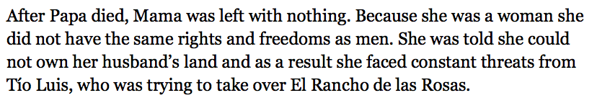
What do you notice about the sample introduction?
Begin drafting your introduction which should include:
Setting for the scene
Main character(s)
Problem/Challenge the characters face in connection to the UDHR

Slide 13
D. Peer Feedback (10 mins)
You are going to share your narrator introductions and the scripts you just revised with one or two of your peers in order to receive feedback about what you might want to revise about your scripts for the end of unit assessment in the next lesson, when you will need to turn in your final narrative scripts.

Slide 14
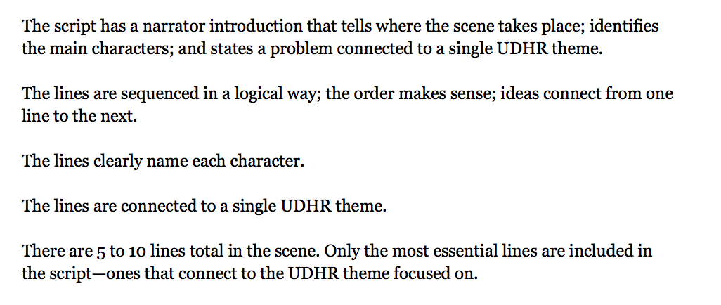
You will trade scripts, read silently, then take turns sharing feedback based on the criteria:

Slide 15
Closing and Assessment
Exit Ticket (5 min)
Write on the bottom of your script drafts from today, one or two things you want to revise about your individual scripts for the end of unit assessment in the next lesson. Your ideas for revision should be based on feedback you received.

Slide 16
