Slide 1
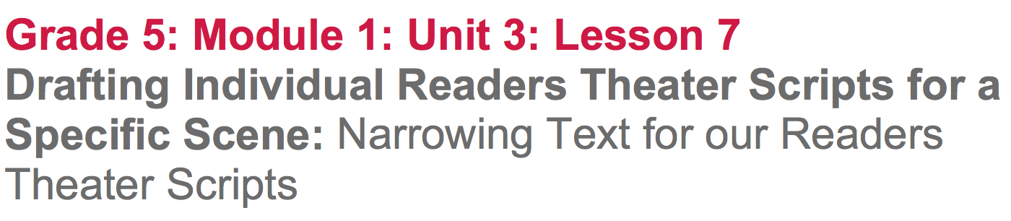

Slide 2
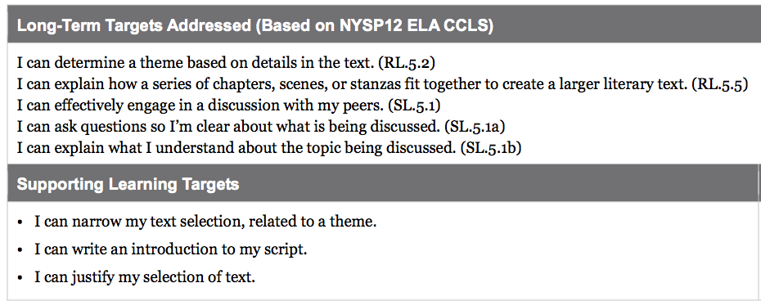

Slide 3
Opening
Reviewing Learning Targets and Key Vocabulary (5 mins)

Slide 4
Learning Targets
I can narrow my text selection, related to a theme and focus on narration and dialogue
I can write an introduction to my script
I can justify my selection of text.

Slide 5
Work Time
Teacher Modeling: Narrow Passage Selections, Focusing on Narration and Dialogue (15 mins)

Slide 6
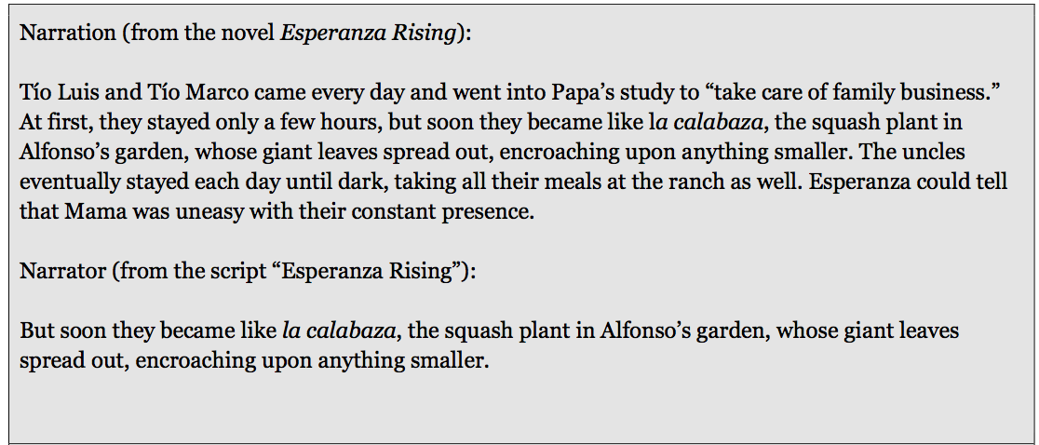
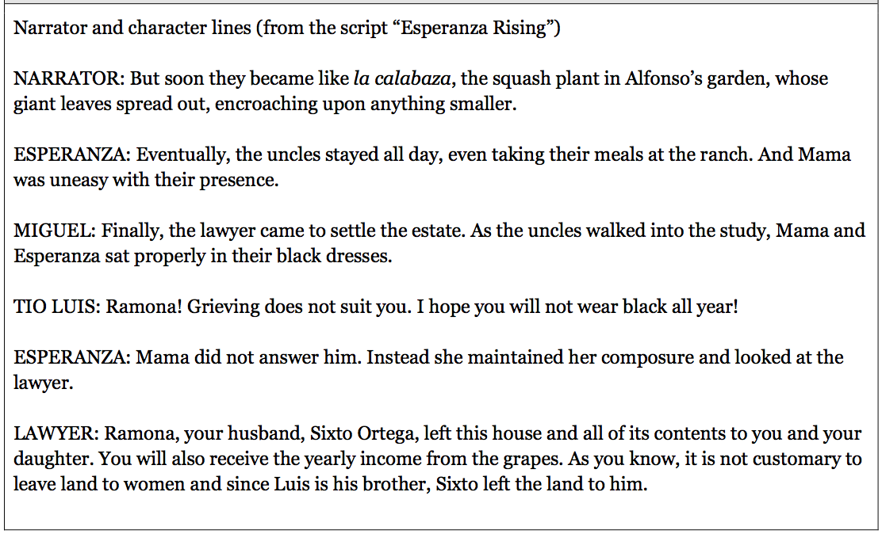
Earlier in this unit, you spent some time “noticing” and “wondering” about Readers Theater.
Follow along as we read the paragraph of narration and the narrator lines from the script.
What do you notice about the paragraph from the novel and the narrator lines from the script? Let’s add this to the “notice” column of our anchor chart.

Slide 7
How does the dialogue from the script, connect to the narration?

Slide 8
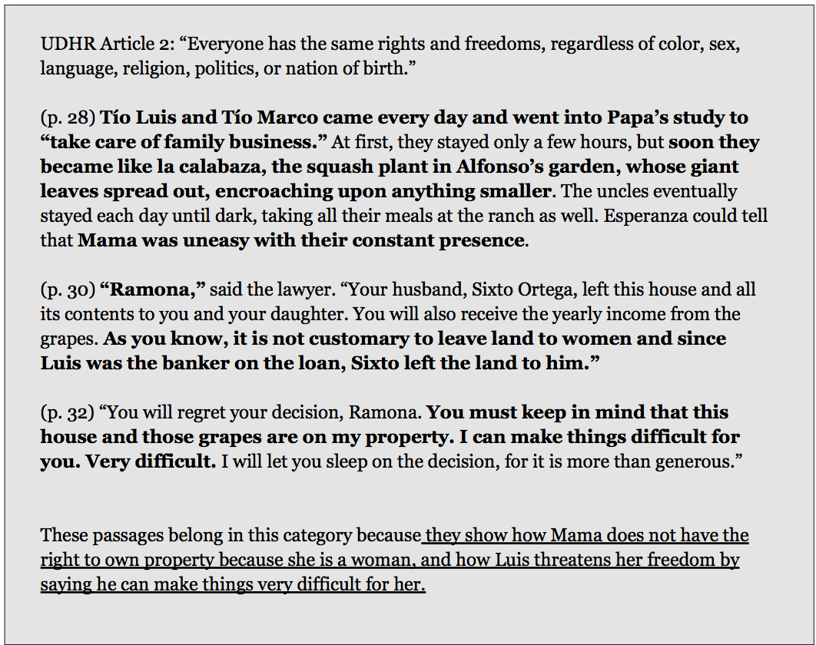
Remember, that in lesson 6 we worked with these cards to help us find details for our scripts.

Slide 9
Today we are going to work on narrowing our text selections, for a narrative script. We will also add the passages that we marked with sticky notes to our UDHR category cards. I’m going to model this for you with the sample I have displayed.
First, I’m going to reread the UDHR article I’m focusing on.

Slide 11
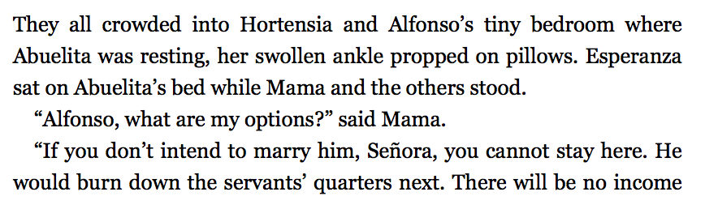
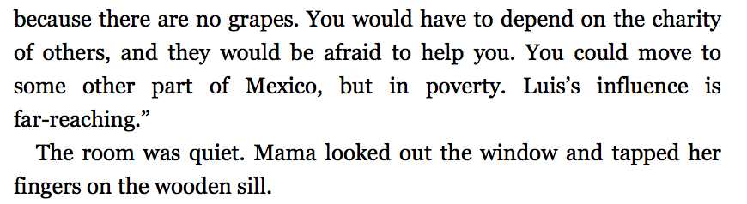
Pages 46-47

Slide 12
“If you don’t intend to marry him, Señora, you cannot stay here.”
“You could move to some other part of Mexico, but in poverty.”

Slide 13
B. Group Work: Narrowing Passage Selections (20 mins)
Join your Readers Theater groups that we formed in lesson 6 and take out your UDHR category card and your copies of Esperanza Rising.

Slide 14
Add the passages that are most strongly related to your UDHR article to the article category card.

Slide 15
C. Group Work: Dividing Script Passages and Determining Sequence (15 mins)

Slide 16
Each of you will be responsible for creating a Readers Theater script individually.
You will need to divide the passages you selected among the group members, making sure no one is using any of the same narration or dialogue, and that each script is unique.
Mark the lines by writing your initials by them.

Slide 17
Once you’ve decided which lines you’ll be using, read through them and decide what order to place them in for the script. Consider:
What would your audience need to know first?
What should go next?
When in time is this happening?
Look back in the novel to help you make decisions about sequence.

Slide 18
Closing and Assessment
Debrief (5 min)

Slide 19
Think about the scripts you started:
What did you find challenging about narrowing the text?
How did you decide what text to keep for your script?
How did you determine the sequence of the lines you highlighted and wrote onto your category cards?

Slide 20
