Slide 1
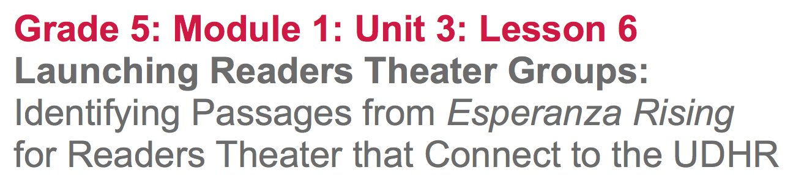

Slide 2
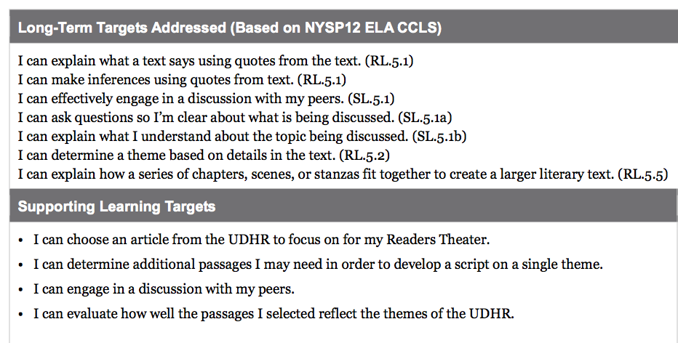

Slide 3
Opening
Reviewing Learning Targets (5 mins)

Slide 4
I can choose an article from the UDHR to focus on for my Readers Theater
I can determine additional passages I may need in order to develop a script on a single theme.
I can engage in a discussion with my peers.
I can evaluate how well the passages I selected reflect the themes in the UDHR.

Slide 5
Work Time
Teacher Modeling: Combining Text Passages for a Script (10 mins)

Slide 6
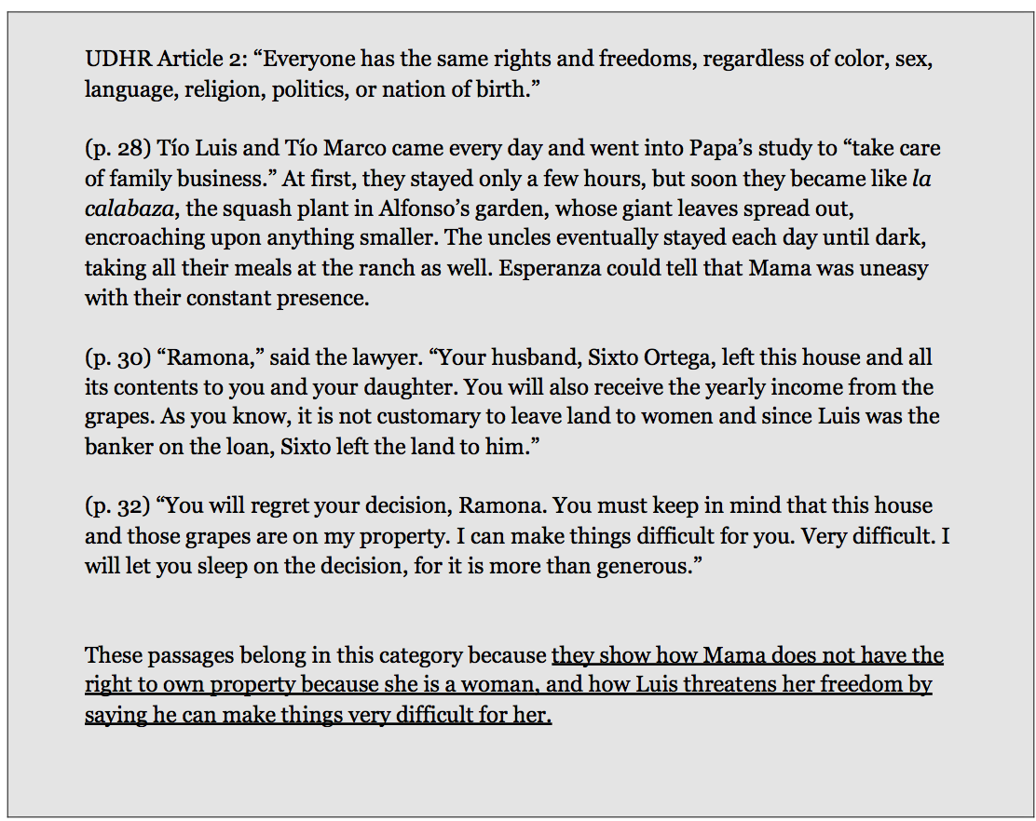
I’ve decided to focus on Article 2.
In lesson 5, we matched passages to Articles of the UDHR, now I’m going to go back to the novel to identify additional passages I think are good examples of how the character Mama has faced human rights challenges because she is a woman.

Slide 7
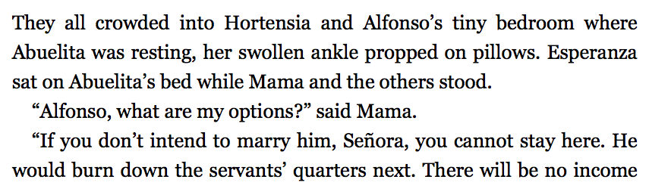
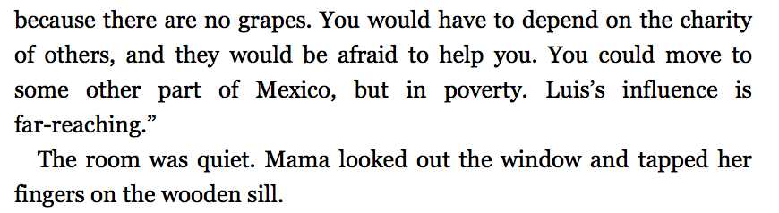
Pages 46-47

Slide 8
Passages related to the UDHR theme could be found in more than one chapter. You will be using the passages you’ve already identified on the UDHR category cards you created in lesson 5, and now you will work with your groups to locate additional passages from other pages/chapters in the book.

Slide 9
B. Launching Readers Theater Groups (5 min)
Join your groups and take out your copies of Esperanza Rising and evidence flags.
These are the groups you will be working with for the next week to write and perform their Readers Theater scripts.
**return UDHR cards from lesson 5**

Slide 10
C. Group Work: Identifying Passages from Esperanza Rising related to the UDHR
(30 min)

Slide 11
In order to create scripts for a Readers Theater, you will need to begin by identifying passages you could use from the novel that relate to the UDHR theme you are focusing on.
It is important to justify, or explain, why a certain passage fits.

Slide 12
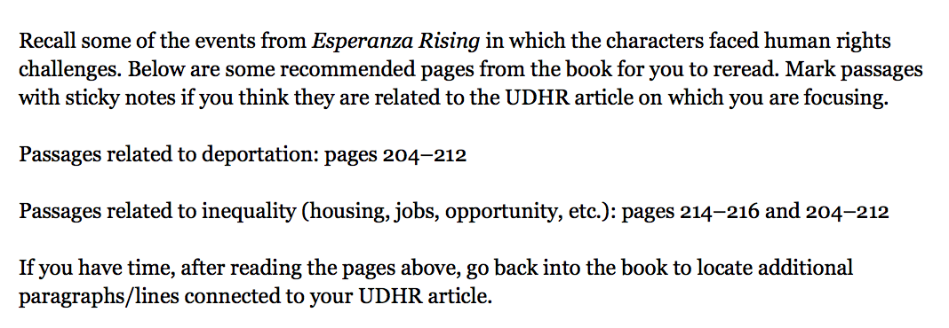
In your group, read the passages listed that you think are related to your UDHR theme, pausing to discuss with your group. Mark with an evidence flag.

Slide 13
Closing and Assessment
Evaluating and Sequencing Text Selections (10 mins)

Slide 14
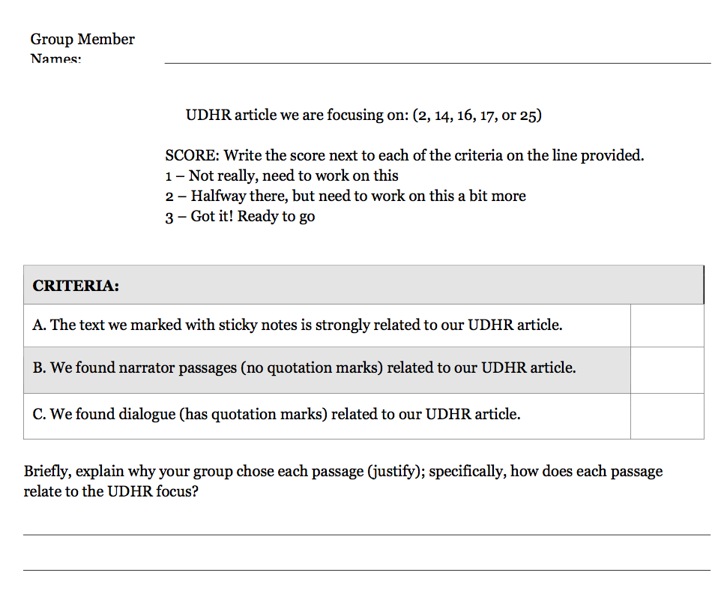
Group Exit Ticket

