Slide 1
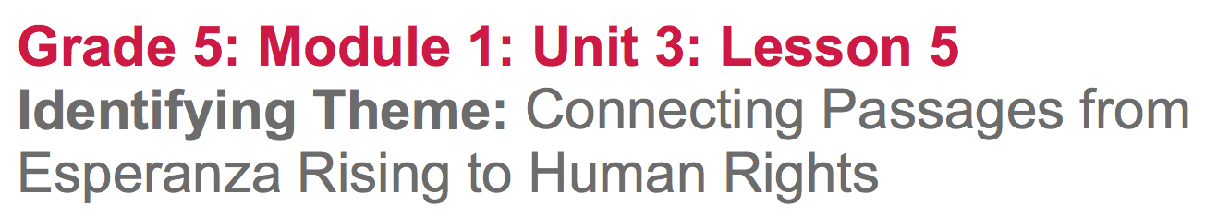

Slide 2
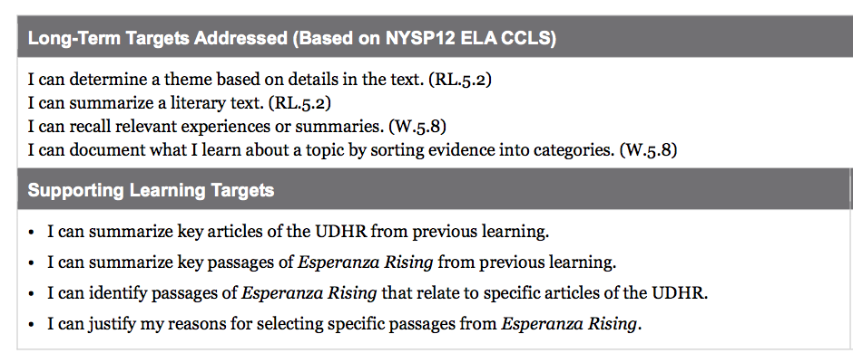

Slide 3
Opening
Reviewing Learning Targets (5 min)

Slide 4
Learning Targets
I can determine a theme based on details in the text.
I can summarize a literary text
I can recall relevant experiences or summaries
I can document what I learn about a topic by sorting evidence into categories.

Slide 5
B. Review of Previous Learning: UDHR Note-Catcher and Two-Voice Poem (10 min)
Take out your UDHR note catcher from unit 1 as well as your Two-Voice poems from unit 2. Open your notes to the Human Rights Challenges in Esperanza Rising anchor chart.

Slide 6
Today is an exciting day because you get to begin planning your own Readers Theater scripts! To help you think about this, you will need to look over the notes from all that we have been learning in this module.

Slide 7
Let’s look at our summaries of the UDHR articles, from Unit 1, as well as our two-voice poems and anchor chart from unit 2.
Which UDHR articles were you able to connect to the human rights challenges faced by the characters in Esperanza Rising when you created these poems?

Slide 8
Today, you are going to narrow your focus to 5 articles of the UDHR, in order to start identifying and categorizing passages for the creation of your own Readers Theater scripts, based on the novel Esperanza Rising.

Slide 9
Work Time
Narrowing Our Focus on the UDHR
(5-10 mins)
(Groups of 3-5 students)

Slide 10

We have been studying 11 UDHR articles, but now we are going to narrow our focus to 5 of those articles.
On your UDHR note-catchers, place a
next to UDHR Articles 2, 14, 16, 17, and 25.
Share your summaries of those 5 articles.

Slide 11
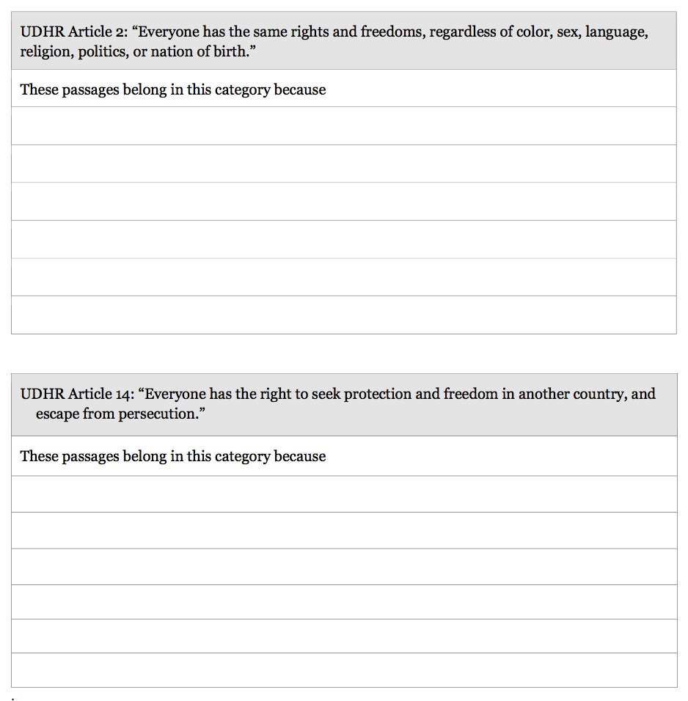
UDHR Category Cards
Put your name on the top of each card and cut apart along the lines, so you have 5 cards all together.

Slide 12
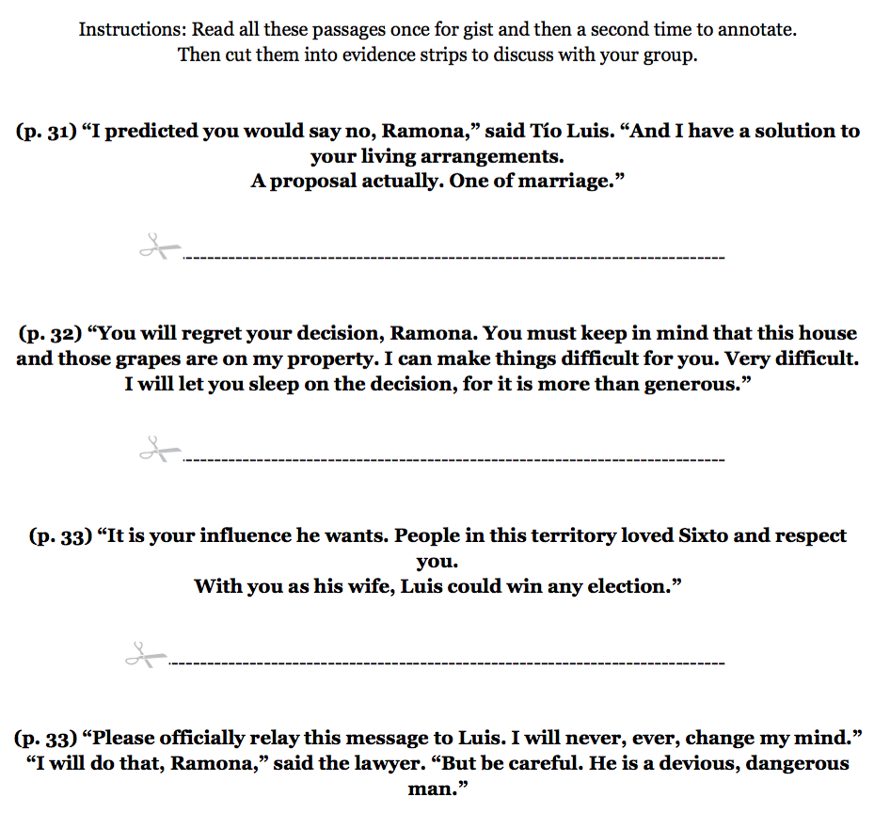
B. Group Work: Categorizing Passages from Esperanza Rising related to the UDHR (25 mins)

Slide 13
You are going to do something similar to an activity you did in Unit 1, when you looked at specific evidence from a firsthand human rights account and connected it to articles in the UDHR.
What do you remember from this activity?

Slide 14
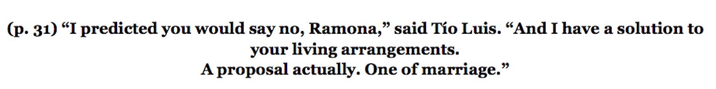
I’m going to start by reading the first passage from Esperanza Rising, then I am going to review my UDHR category cards, and think about which of the five UDHR categories I think this passage belongs in. I would like you to think about the category the passage belongs in as well.

Slide 15
Read through all remaining passages silently.
Cut the passages into individual strips.
Discuss with your group which passages belong in which category and why (justify)
Which passages relate to which UDHR articles?
What is your evidence?

Slide 16
Physically glue each passage onto the UDHR category card that best connects to the passage, based on your group discussion.
Remember, that in the next step, you will need to justify why you placed certain passages into a specific category.
** You will not fill in the sentence frames at the bottom until closing**

Slide 17
Closing and Assessment
Justifying Passage Selections (10 mins)

Slide 18
Were any of the passages difficult to categorize? If so, why?
Now that you’ve had a chance to think and talk, you are now ready to write.
Fill in the sentence frames at the bottom of each UDHR category card, in order to justify why you placed each passage into certain categories.

Slide 19
B. Exit Ticket (5 mins)

Slide 20
Write the following information:
Name
Rank order (1st, 2nd, and 3rd choice) of UDHR Articles 2, 14, 16, 17, and 25 that you’re most interested in focusing on for your Readers Theater script.
The names of at least 5 other students you’d like to work with on writing the script, and why.

Slide 21
