Slide 1
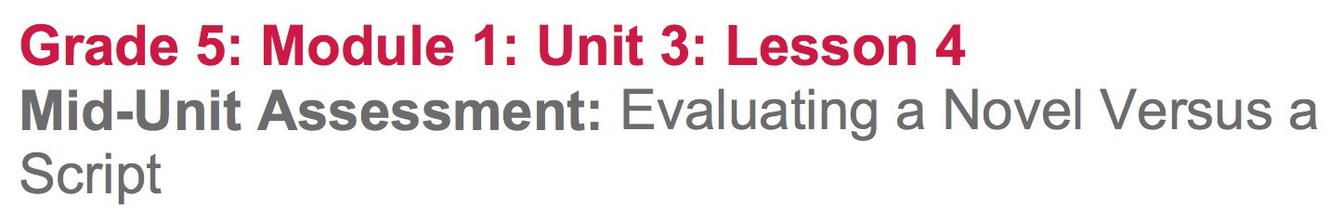

Slide 2
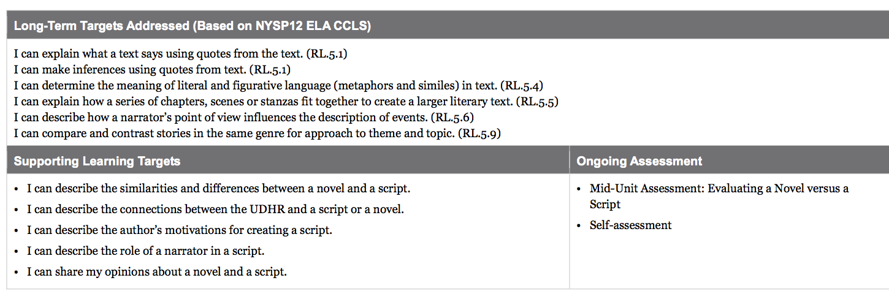

Slide 3
Opening
Reviewing Learning Targets (5 mins)

Slide 4
Learning Targets
I can describe similarities and differences between a novel and a script.
I can describe the connections between the UDHR and a script or a novel.
I can describe the role of a narrator in a script.
I can share my opinions about a novel and a script

Slide 5
B. Academic Vocabulary Clarification (10 min)
What does evaluate mean?
-to examine something more closely to judge it: to think about its strengths and weaknesses.

Slide 6
Turn and talk about a time you have been “evaluated” or have gotten to evaluate something.
Today, you will be evaluating two types of narrative writing: a novel and a script.

Slide 7
Often, when you evaluate something, you are comparing it to something else. For example, if you say that a movie is great, this is compared to another movie you didn’t like as much.
Today, you will first think about how novel and scripts are alike and different. You will complete a Venn diagram, which is a graphic organizer used to help compare and contrast.

Slide 8
Today you are going to complete a Mid-Unit 3 Assessment in which you will complete a Venn diagram comparing and contrasting scripts and a novel. You will then read selected passages from Esperanza Rising and the script based on the same novel, in order to respond to some short-answer questions. It will be important for you to support your answers by citing evidence from both the novel and the script.

Slide 9
Work Time
Mid-Unit Assessment: Evaluating a Novel versus a Script (40 mins)

Slide 10
Closing and Assessment
Self-Assessment (5 min)

Slide 11
Learning Targets
I can describe similarities and differences between a novel and a script.
I can describe the connections between the UDHR and a script or a novel.
I can describe the role of a narrator in a script.
I can share my opinions about a novel and a script

Slide 12
What is something you did well on the mid-assessment? Be specific.
What is something that was hard for you? Be specific.

