Slide 1
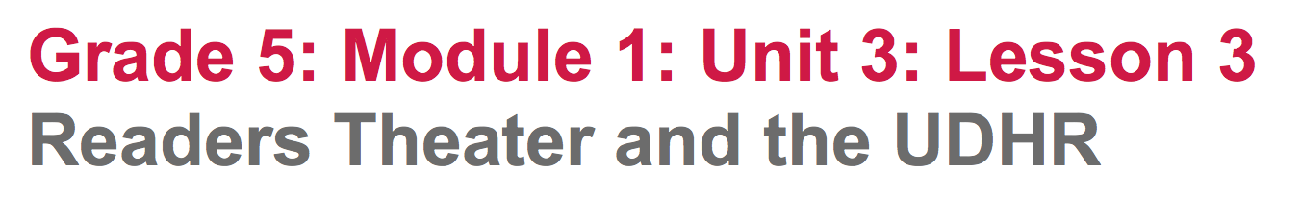

Slide 2
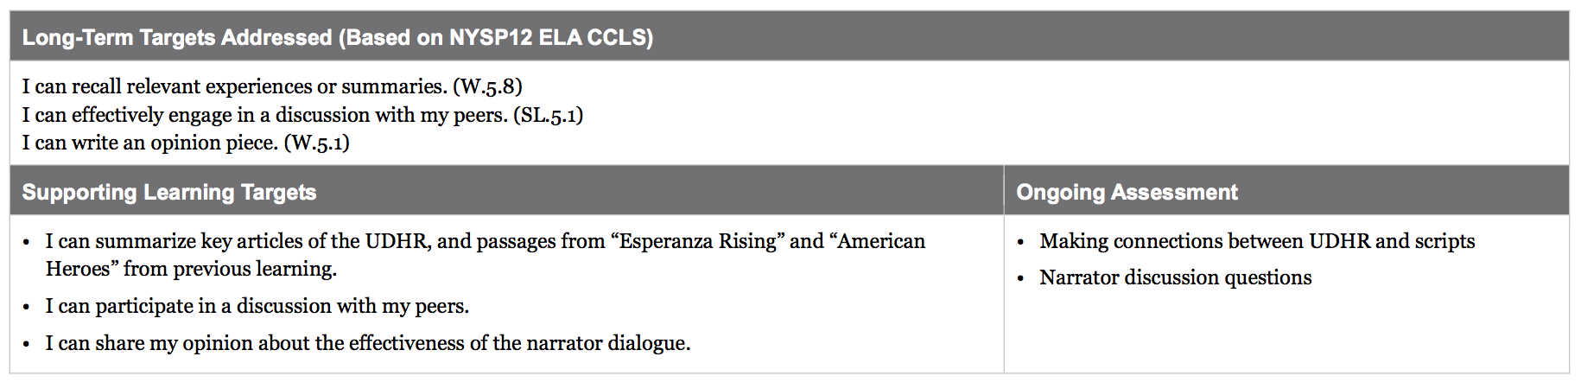

Slide 3
Opening
Reviewing Learning Targets (5 mins)

Slide 4
Learning Targets
I can summarize key articles of the UDHR, and passages from Esperanza Rising and American Heroes from previous learning
I can participate in a discussion with my peers.
I can share my opinion about the effectiveness of the narrator dialogue.

Slide 5
Connecting the UDHR to the Themes in Readers Theater Scripts (25 mins)

Slide 6
Today we are going to review the UDHR themes we have been studying in this module, in order to help us make connections between the UDHR themes and the narrative Readers Theater scripts we have been reading. Discussing these connections will help prepare you for later in the unit when you will need to write your own Readers Theater script based on one UDHR theme and passage from Esperanza Rising.

Slide 7
Take out your UDHR note-catcher (from Unit 1) where you summarized 11 articles from the UDHR.
Take a few minutes to review your UDHR summaries silently.
Review with your group.

Slide 8
Join your “American Hero” script groups from lesson 1. Bring both the American Hero and Esperanza Rising scripts.

Slide 9
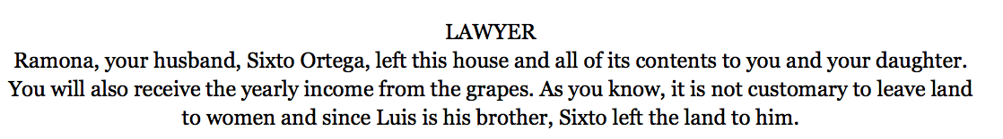
You are going to locate the connections between the UDHR themes we have studied and the Readers Theater scripts.
I underlined this sentence because I think this is a good example of the UDHR Article 17 “...everyone has the right to own property…”; now I am going to make a note next to this sentence by writing “UDHR 17” and explain briefly why I think this sentence is an example of that article by writing, “Mama can’t own property because she is a woman.”

Slide 10
Think-Pair-Share
Do you agree or disagree with my connection? Why or why not?
You have 10 minutes to independently identify connection between the scripts and the UDHR. Try to make at least 1-2 connections per script.
Share with your group.

Slide 11
B. The Role of Narration in Readers Theater (15 mins)
Underline all of the narrator lines in each script.

Slide 12
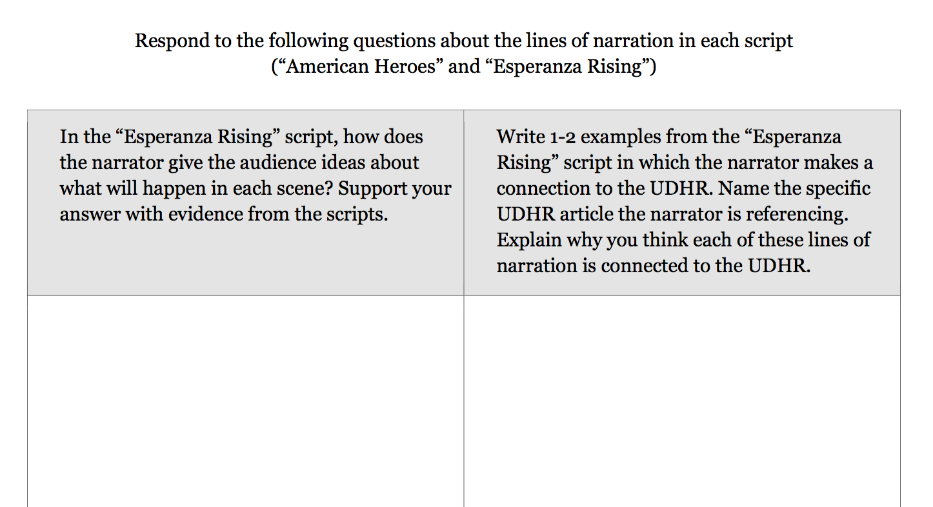

Slide 13
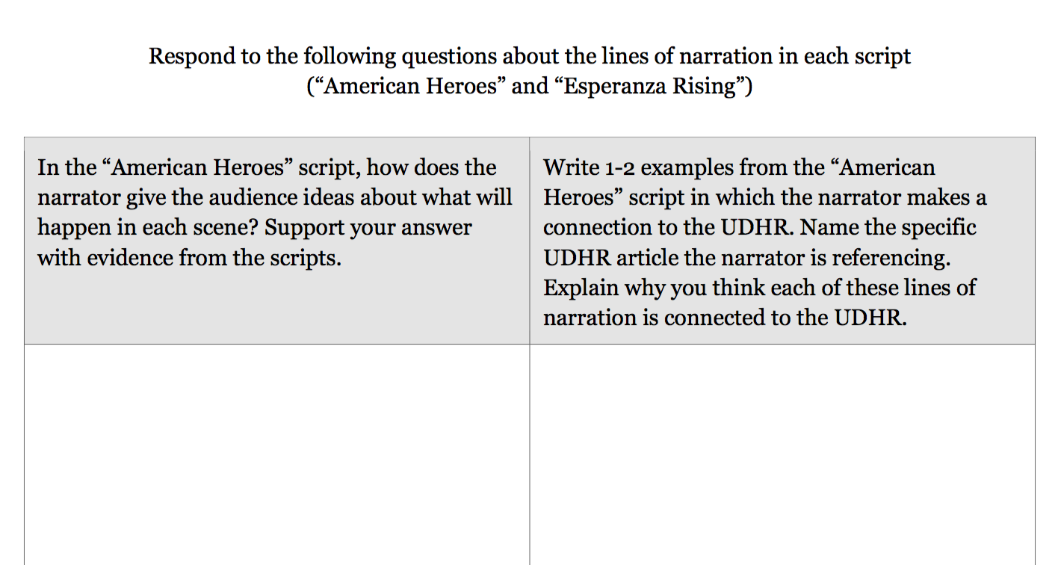

Slide 14
Closing and Assessment
Critique of the Narration in Esperanza Rising and American Heroes Readers Theater Scripts (15 mins)

Slide 15
Praise-Question-Suggest
You are going to critique the narrator lines of the scripts for American Heroes and Esperanza Rising

Slide 16
I would like you to evaluate both scripts based on the following criteria:
The narrator’s scene introduction is clearly connected to the dialogue in the scene.
The narrator makes a strong connection between the scene and one of the UDHR articles.

Slide 17
Write your comments directly on your scripts.
Write:
One Praise
One question
One suggestion

Slide 18
Homework
None :)

