Slide 1
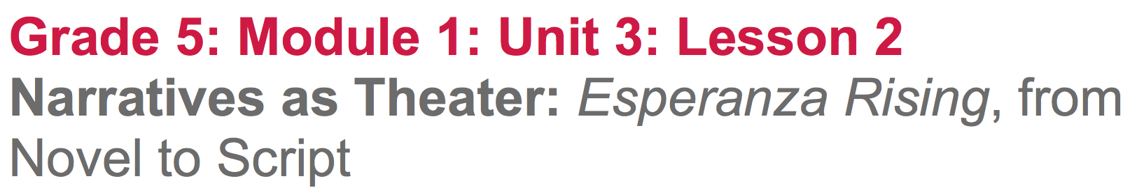

Slide 2
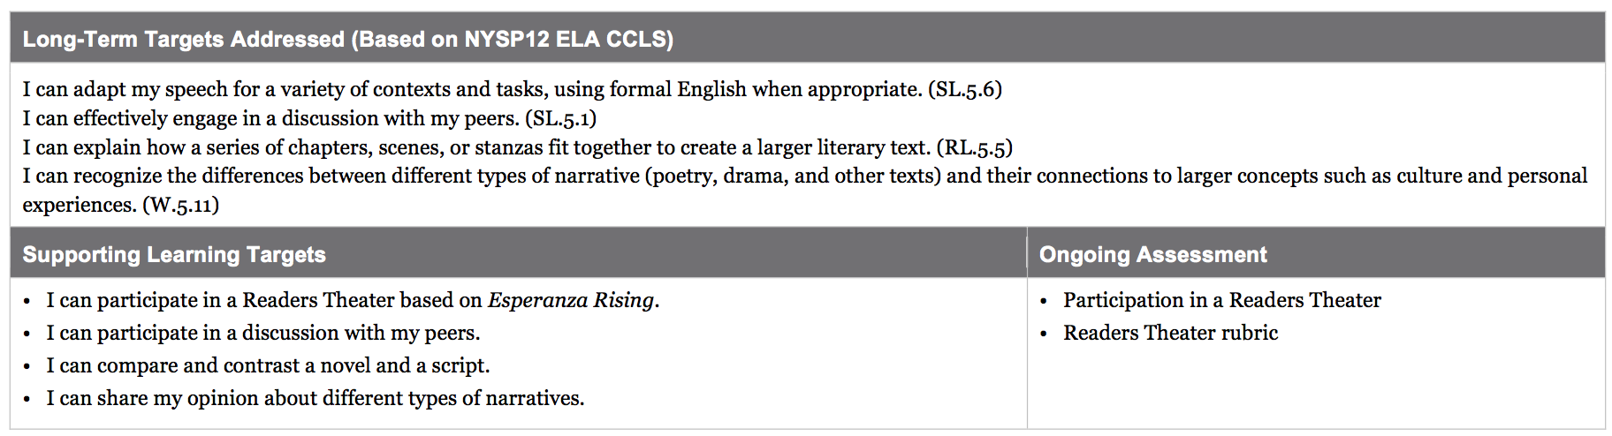

Slide 3
Opening
Reviewing Learning Targets and Readers Theater Rubric (5 min)

Slide 4
Learning Targets
I can participate in a Readers Theater based on Esperanza Rising.
I can participate in a discussion with my peers.
I can compare and contrast a novel and a script.
I can share my opinion about different types of narratives.

Slide 5
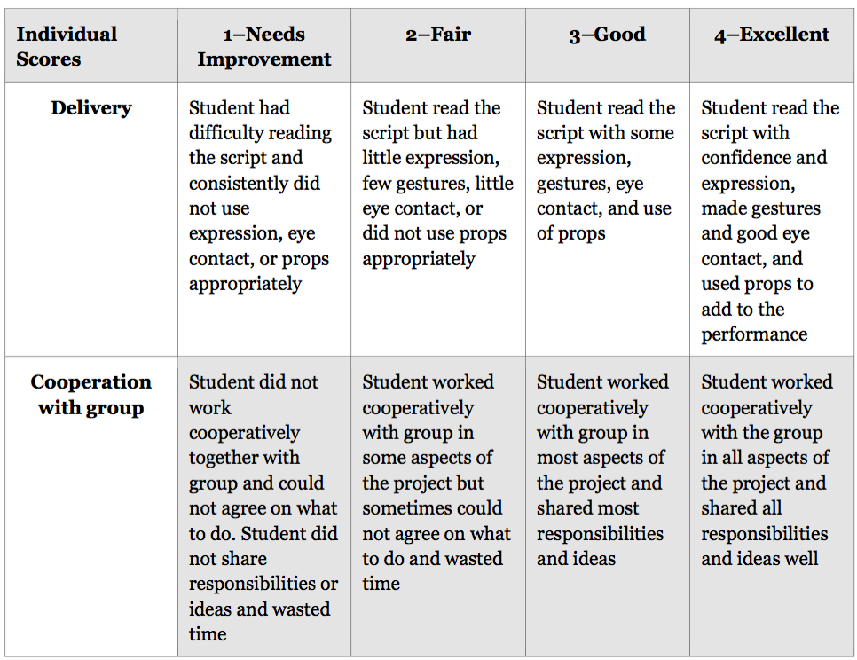
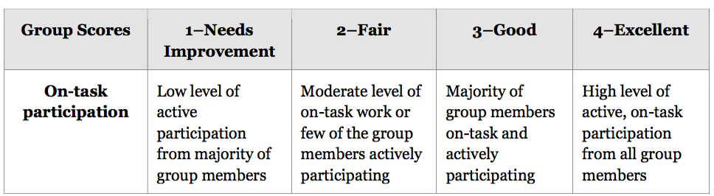

Slide 6
Work Time
Readers Theater: Pam Muñoz Ryan’s script for Esperanza Rising (35 mins)
You’re going to be working in groups of 5. Any group with less than 5 with have someone doing “double duty”.

Slide 7
Distribute Scripts
Each group will receive a copy of the Esperanza Rising Readers Theater Scripts.

Slide 8
Follow these steps with your scripts:
Prepare (5 min): Determine which role each group member will be responsible for. Each student in the group will highlight his/her lines
Practice (15 min): You will have several minutes to practice your lines with group members. Refer to the rubric for expectations.
Perform (15 mins): Each group will perform their script with audience feedback based on the rubric

Slide 9
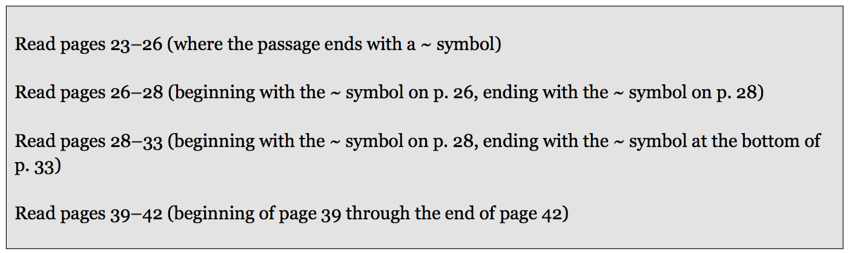
B. Read Aloud: Selections from the Novel Esperanza Rising (10 mins)
Independently read 2-3 of the recommended selections from below.

Slide 10
Now, you are going to read aloud passages from Esperanza Rising. As you read aloud and listen to your group members read aloud. Think about how the novel sounds similar to and different from the Readers Theater scripts you just performed.

Slide 11
C. Discussion: Comparing and Contrasting the Script and the Novel (5 min)
You will have 1-2 minutes to think on your own about how the script of Esperanza Rising was the same and how it was different from the novel when read aloud.

Slide 12
I Notice/I Wonder
Let’s look back at our anchor chart from lesson 1.
Share with your group what you think about the similarities and differences between the script and the novel.
What can we add to our anchor chart?

Slide 13
Closing and Assessment
Exit Ticket
Write a response:
Which narrative format do you like better, a novel or a script, and why?

Slide 14
