Slide 1
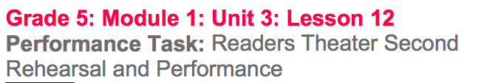

Slide 2
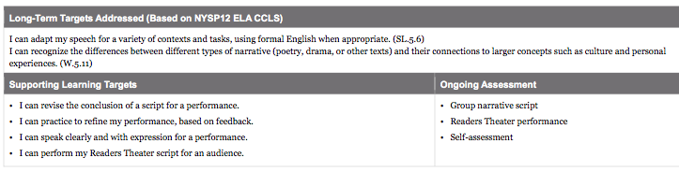

Slide 3
Opening
Reviewing Learning Targets (5 mins)

Slide 4
Work Time
Group Work: Practicing and Peer Feedback on our Performance (15 mins)

Slide 5
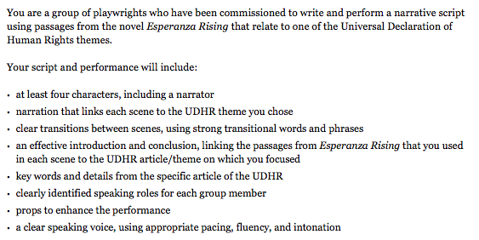
Performance Task

Slide 6
Today you will perform your Readers Theater.
First, you will have time to make final revisions to your group script, specifically the conclusion you wrote in lesson 11.

Slide 7
B. Performance Task: Readers Theater Performance for an Audience (35 mins)
You will now perform your Readers Theater for the class.

Slide 8
Closing and Assessment
Self-Assessment (5 mins)

Slide 9
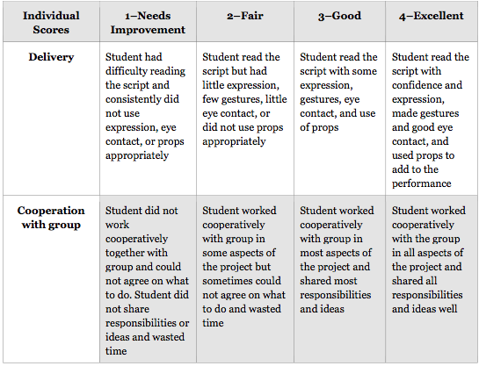
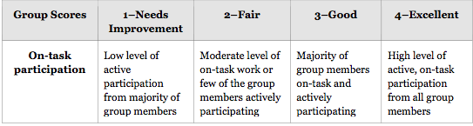

Slide 10
