Slide 1
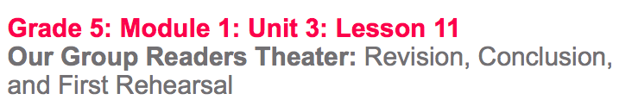

Slide 2
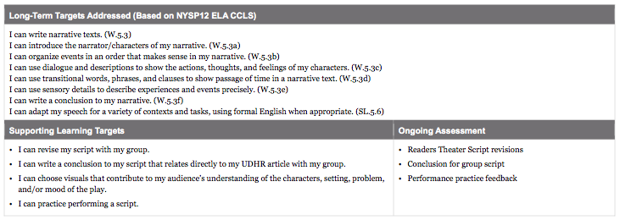

Slide 3
Opening
Reviewing Learning Targets and Vocabulary

Slide 4
Today you are going to work with your group members to make final revisions to your individual scenes and to write a conclusion for your Readers Theater script.
Additionally, you will perform your scripts for another group and receive feedback so you are able to refine your performance task in the next lesson.

Slide 5
Work Time
Group Work: Revising Scenes and Transitions (20 mins)

Slide 6
Now you will have an opportunity to revise [change] your script, working independently and with your group members, based on the written feedback, as well as the annotation you made during lesson 10.

Slide 7
Revision Instructions:
Scripts must include...
Words and phrases that show the characters’ actions, thoughts, and feelings
Words and phrases to clearly identify the setting
Words/phrases from the UDHR your group is focusing on
Words and phrases that make clear transitions between events and scenes.

Slide 8
B. Group work: Writing a Group Conclusion (15 mins)
Now you will be working with your group members to write a single conclusion to your full narrative group script

Slide 9
The purpose of a conclusion is to summarize the events of a narrative and to draw the audience’s attention to the theme of the narrative. The conclusion your group write will need to summarize the narrative by describing the challenge(s) your characters faced and connect back to the UDHR theme you focused on.

Slide 10
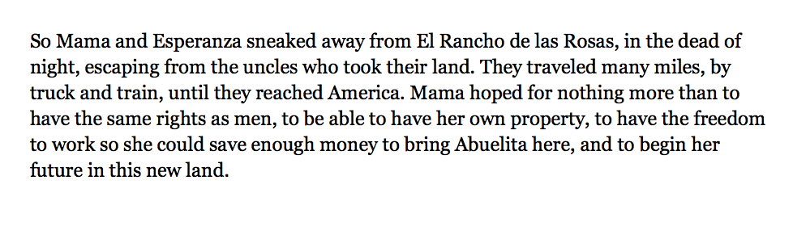
Here’s an example:
How does the conclusion describe the challenges the characters faced? How does it relate back to my UDHR theme?

Slide 11
Remember to summarize challenges faced by the characters and to connect back to the UDHR theme the group is focusing on, by using specific words/phrases from your UDHR article.

Slide 12
C. (Optional) Group Work: Brainstorm Visuals
You will need to think about what types of props and/or visuals you will want to use for your group performance of your narrative script during the next lesson.

Slide 13
The purpose of using props is to contribute to the audience’s understanding of characters, setting, problem, and/or the mood of the play.

Slide 14
Closing and Assessment
Practicing and Peer Feedback (15-20 mins)

Slide 15
You are now going to practice performing in front of another group. We will use your Praise-Question-Suggest protocol and a rubric to score the performances.

Slide 16
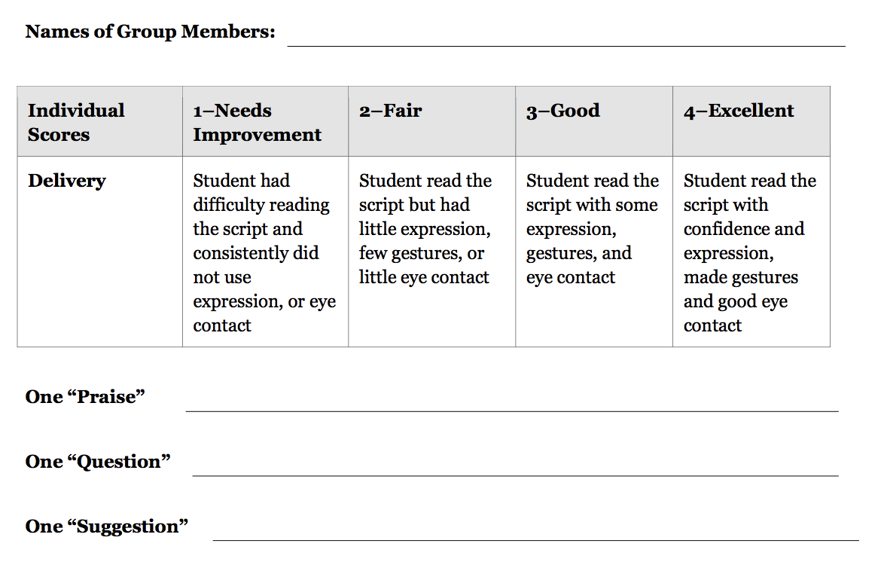

Slide 17
