Slide 1
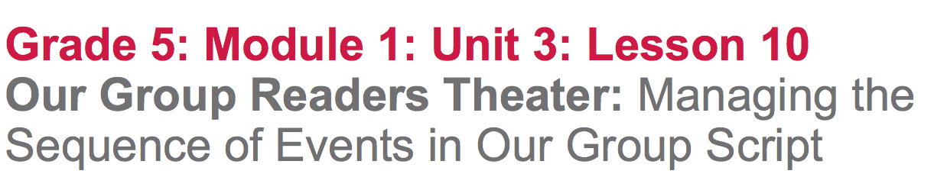

Slide 2
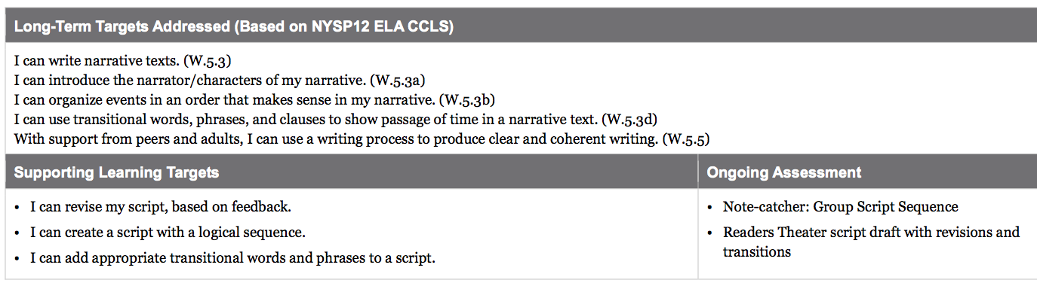

Slide 3
Opening
Reviewing Learning Targets and Sharing Out (10 mins)

Slide 4
Learning Targets
I can revise my script, based on feedback
I can create a script with a logical sequence
I can add appropriate transitional words and phrases to a script.

Slide 5
Join your group members and recall the titles that you came up with for the charades game in lesson 9.
Give group members feedback regarding how well the script title connects to your groups UDHR language.
“Your title makes a connection to UDHR article __ because you ______”

Slide 6
Work Time
Modeling: Storyboarding to Combine Our Script Scenes (15 mins)

Slide 7
Today in your Readers Theater groups, you will combine each student’s individual scene script into part of a larger group script. It will be important to think about the most logical sequence of those scenes, but there is no one “right” way for you to organize the script.

Slide 8
Evaluate based on the following criteria:
Clearly identified settings in each scene
Characters clearly identified in each scene
Consistent connections to the same UDHR in each scene
A chronological sequence of events
A flow of events that the audience can understand even if they’re not familiar with Esperanza Rising

Slide 9
In order to figure out the best sequence for your scripts, you are going to do a storyboard.
Think about the 2 parts of this word: story and board.
A storyboard is a series or sequence showing the plan for a production

Slide 10
Today you are going to do your storyboard physically, by standing up and moving around to see different ways they could organize the individual scenes into one group script/

Slide 11
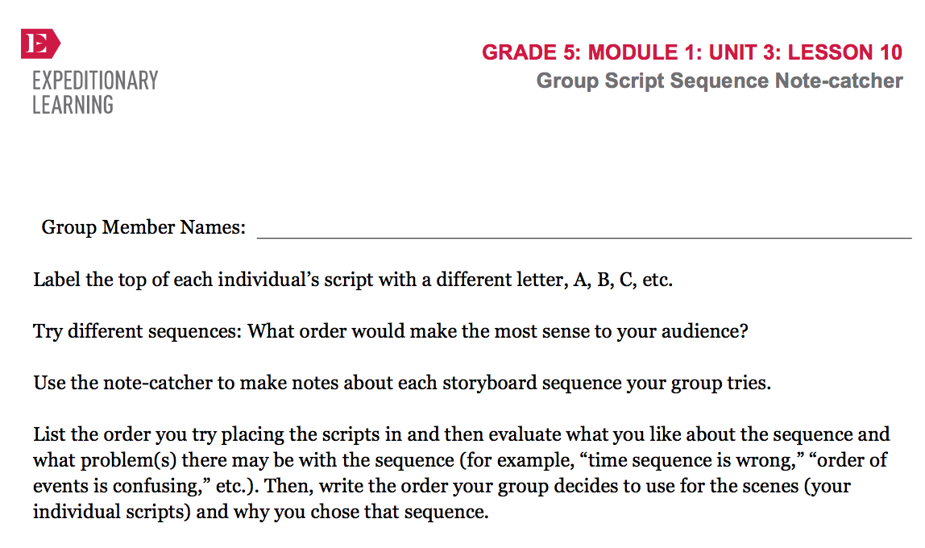
*see lesson plans

Slide 12
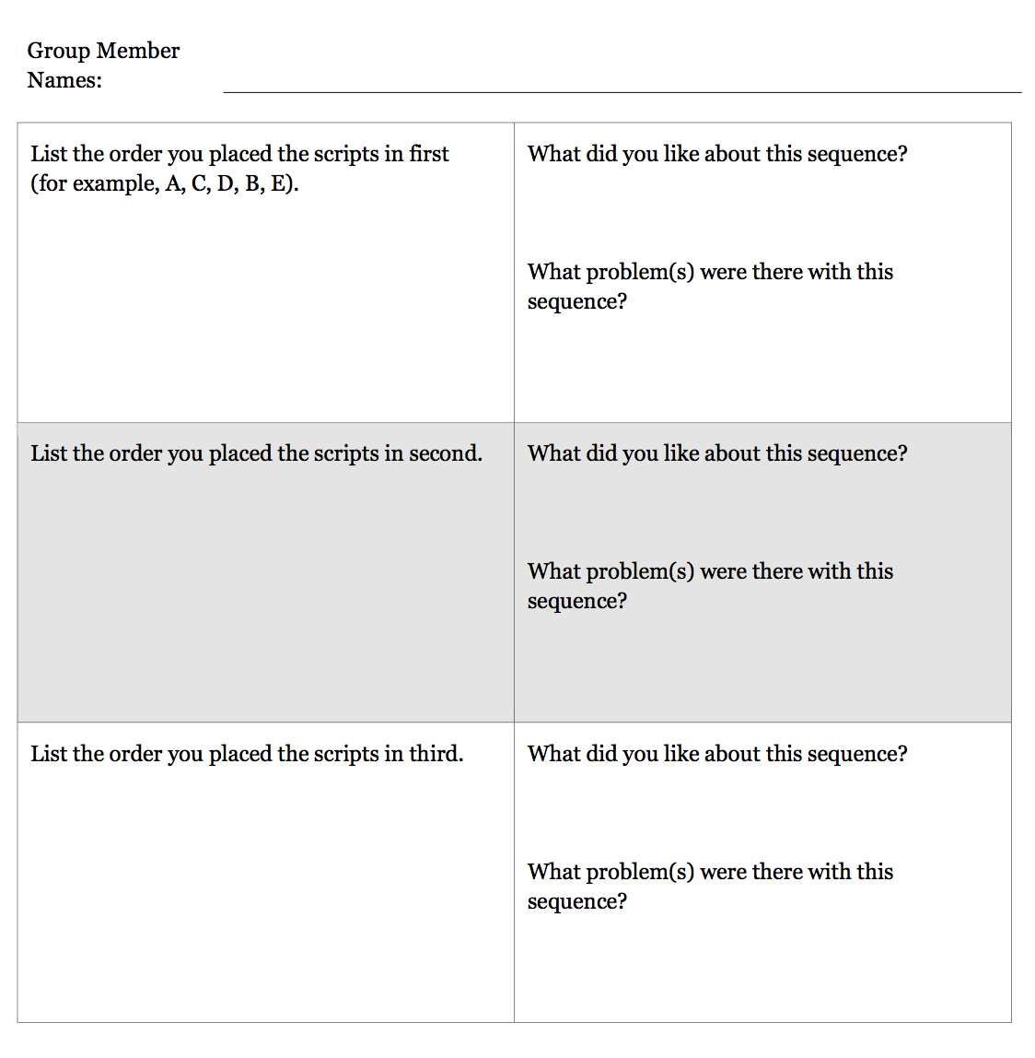
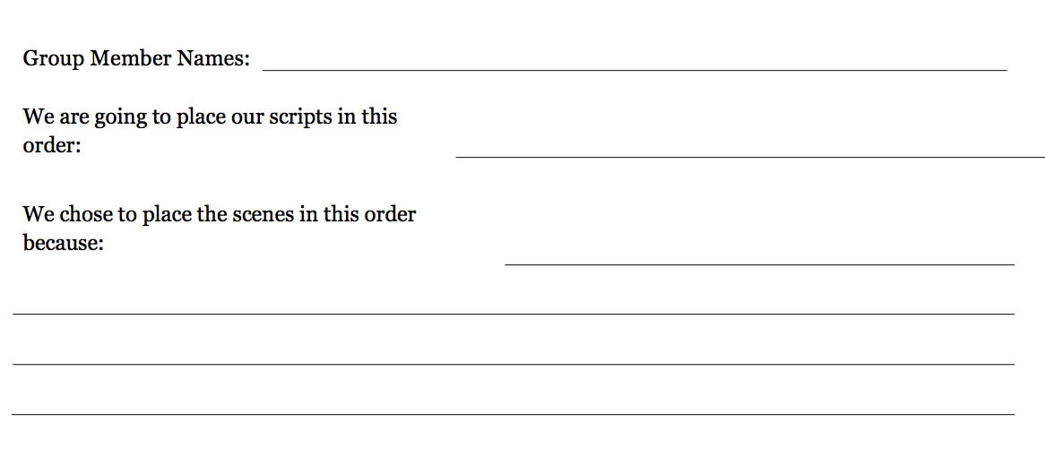

Slide 13
B. Group Work: Storyboarding to Combine Our Script Scenes and Organize a Clear Event Sequence (15 mins)

Slide 14
Steps:
Label each individual script with a different letter (A, B, C, D, E)
Skim each script to determine when each scene may have taken place
Group members stand up, physically holding scene scripts
Group members trade places to put their scripts into a sequence, or order, that might make sense
Read the scripts aloud to evaluate how the script flows with scenes arranged in this order
Complete the note-catcher

Slide 15
C. Group Work: Adding Transitions to Our Group Script (15 mins)
Once you’ve determined the sequence of your scenes, you will need to determine how you will revise existing narrator lines between each script by adding transitional words and/or phrases to that the group script flows smoothly from one scene to the next.

Slide 16
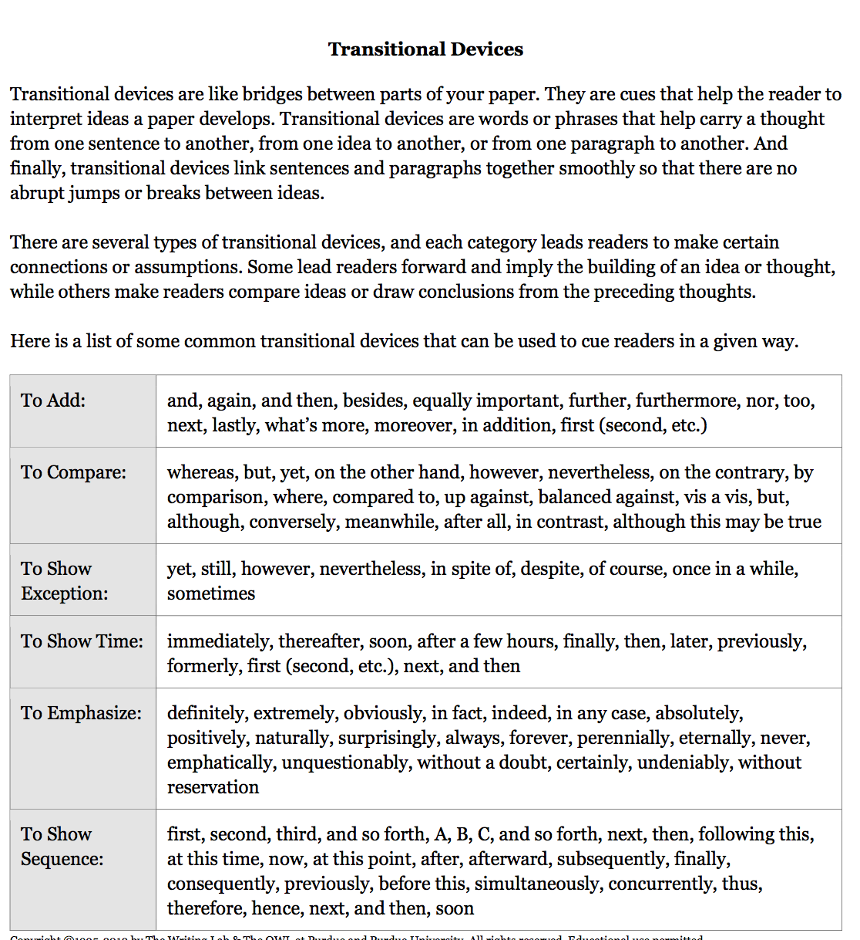

Slide 17
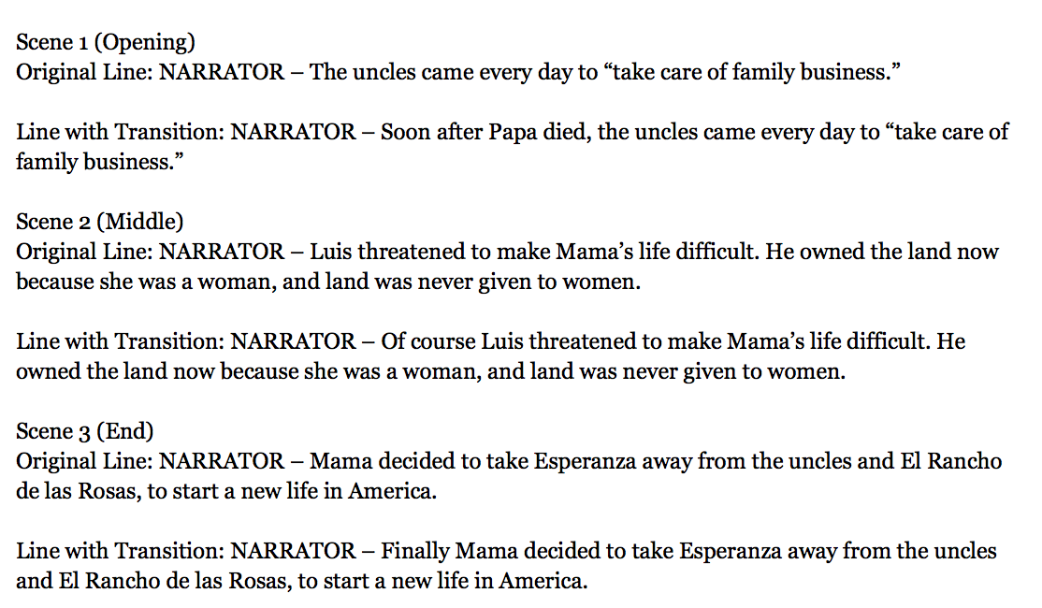

Slide 18
Which transitional devices do you think would help your group most with connecting one scene to another?
Which of these words/phrases would you add to the narrator lines between your scenes?
*Work with your group to add transitions to the narrator lines of the scenes*

Slide 19
Closing and Assessment
Exit Ticket (5 mins)
Write a response:
What was most difficult about combining individual scripts to create a group script?

Slide 20
