Slide 1
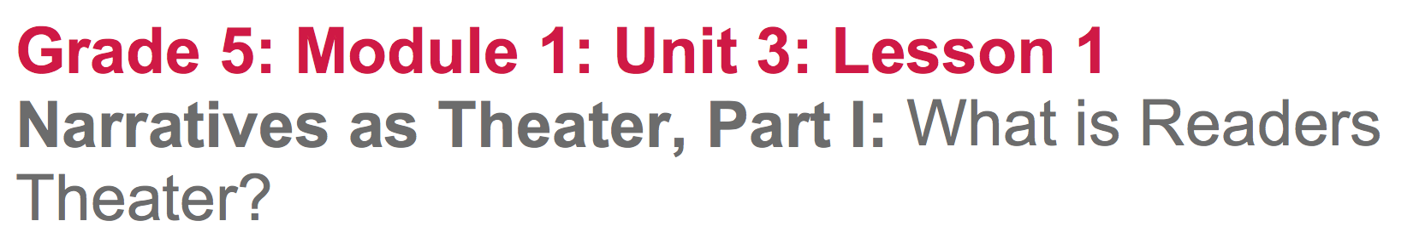

Slide 2
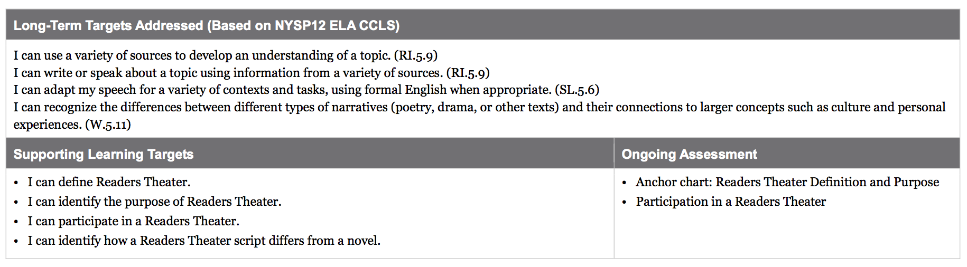

Slide 3
Opening
Reviewing Learning Targets and Vocabulary
(5 min)

Slide 4
Learning Targets
I can define Readers Theater
I can identify the purpose of Readers Theater
I can participate in a Readers Theater
I can identify how a Readers Theater script differs from a novel.

Slide 5
B. Engaging the Reader: I notice/I Wonder Anchor Chart (10 min)
Think about the connections you have made between the novel Esperanza Rising and the UDHR. Refer to the Human Rights Challenges in Esperanza Rising Anchor Chart

Slide 6
You know the novel Esperanza Rising is a narrative. Reading Narratives helps us understand the human experience. Often the themes of novels relate to issues in the real world. We have been connecting the themes in Esperanza Rising to the ideas found in the UDHR, an informational text.

Slide 7
In this unit, we will keep making connections to themes related to human rights and we are going to learn about another type of narrative called a script.

Slide 8
A script is used when actors and actresses perform a play, movie, or radio show. I am going to show you some scripts, and we are going to read about them. By the end of the day, you will be clear about what a script is, and how it is different from a novel. We will start thinking about why an author would choose one instead of the other.

Slide 9
We will be reading narrative scripts over the next few days, and eventually you will be working in groups to write your own scripts about scenes from Esperanza Rising that relate to specific articles in the UDHR.

Slide 10
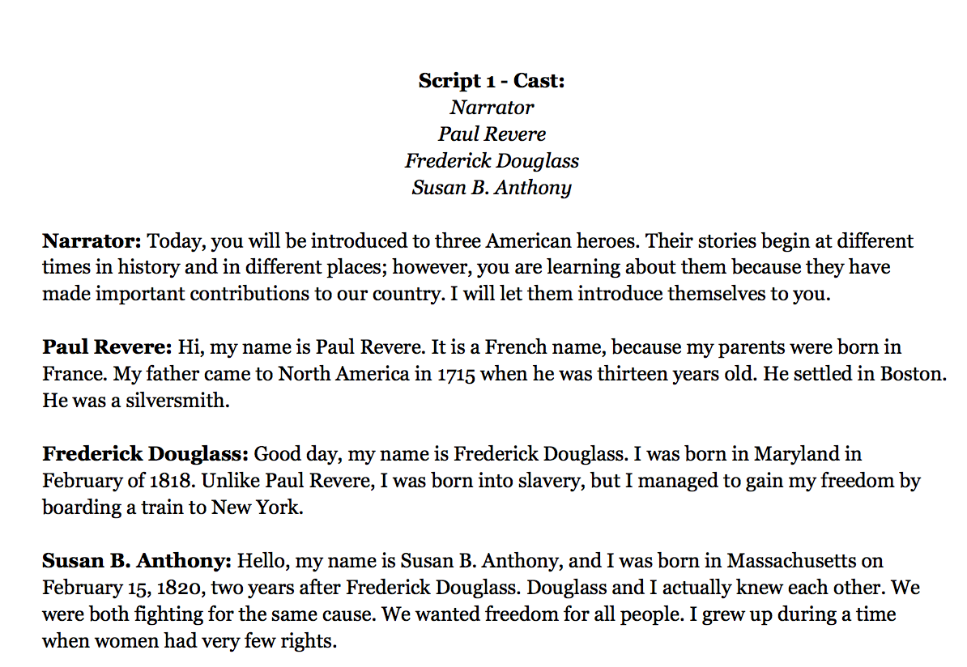
I Notice/I Wonder Anchor Chart
Take a moment to look over the script.
Turn to a partner and talk about what you notice about the script.
What do you wonder about the scripts?

Slide 11
Work Time
Defining Readers Theater by Reading Information Texts (15 min)

Slide 12
You just got to look quickly at the narrative script called “American Heroes.” Later today, we will actually get to participate in a Readers Theater using this script. First, you will need to understand what Readers Theater is.
Think about and share with a partner what you predict what the definition will include.

Slide 13
Let’s read the following definition together.
Readers Theater is really basic theater.
The goal is to support reading and performing literature.
There are many styles of Readers Theater.
Here are some basic features of Readers Theater:

Slide 14
There is a narrator to help frame the dramatic presentation
No full stage sets. If used at all, sets are simple
No full costumes. If used at all, costumes just suggest the feel of the characters or the costumes are really basic or all the same.
No full memorization. Scripts are used openly in performance.

Slide 15
Readers Theater was developed as an easy and good way to present literature in dramatic form. Most scripts are adapted from literature.

Slide 16
Think-Pair-Share
Add to the I Notice/I Wonder anchor chart having seen the definition of Readers Theater.

Slide 17
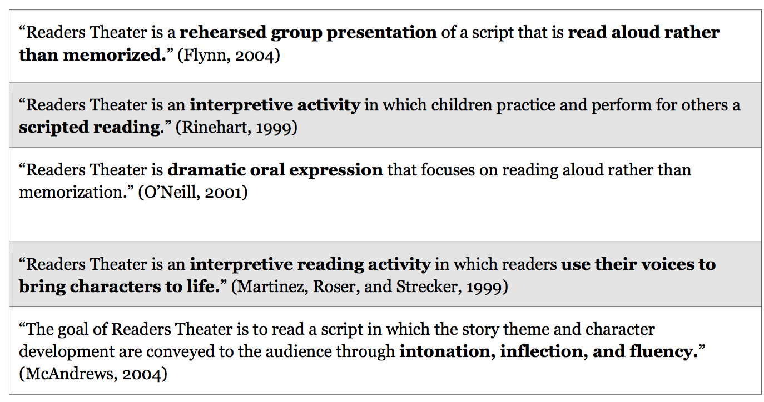
Think and talk with a partner about how you can restate the definition in your own words.

Slide 18
Are there any additional thoughts that we can record on the I Notice/I Wonder anchor chart that you have about Readers Theater, based on the definition we just read?

Slide 19
B. Participate in a Readers Theater: “American Heroes” (25 mins)

Slide 20
Today you are just going to try Readers Theater a bit. The goal today is to just give you a feel for how to read the script, how speaking roles alternate, etc. This is not in any way supposed to be a polished performance, and you are not being evaluated on your speaking or acting skills. You’re just getting your feet wet.

Slide 21
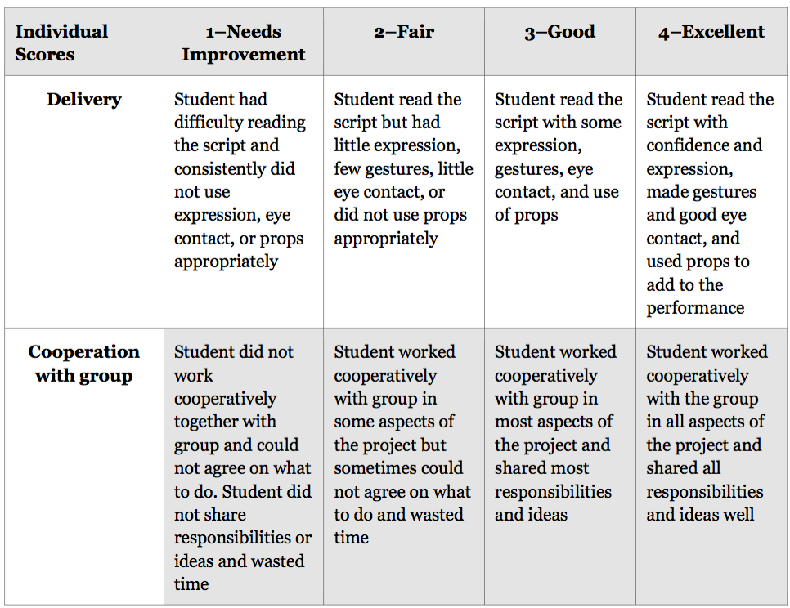
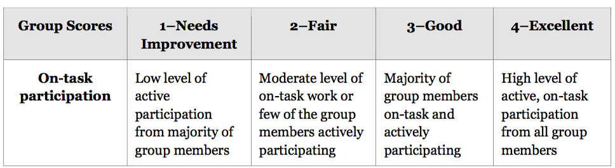
You’re going to be placed in groups of 4 and you will receive a copy of your script

Slide 22
Prepare
Each student in the group must decide who will perform which role.
Once you have your roll, highlight your lines.

Slide 23
Practice
You will have several minutes to practice your scripts.
Pay attention to when it is your turn to speak.
Refer to the rubric for your expectations.

Slide 24
Perform
Remember, the purpose of today’s lesson is just to get a “feel” for Readers Theater.
Are there any groups that are willing to perform for the class?

Slide 25
Closing and Assessment
Revisit the Readers Theater: I Notice/I Wonder Anchor Chart (5 mins)

Slide 26
Now that you have participated in a Readers Theater, what would you like to add to the I Notice side of our anchor chart?
Can we cross out any of the “I Wonder” statements, because we have answers to those questions?
What needs to be added to the “I Wonder” column?

Slide 27
