Slide 1
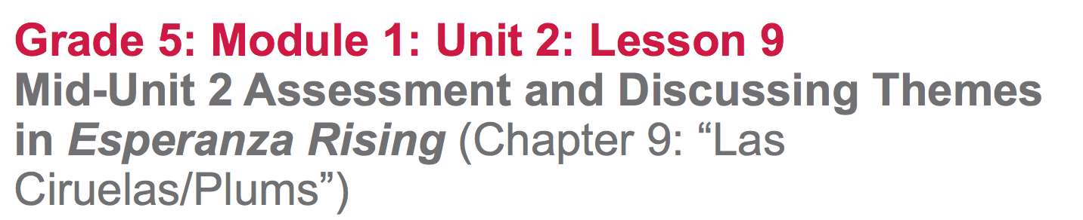

Slide 2
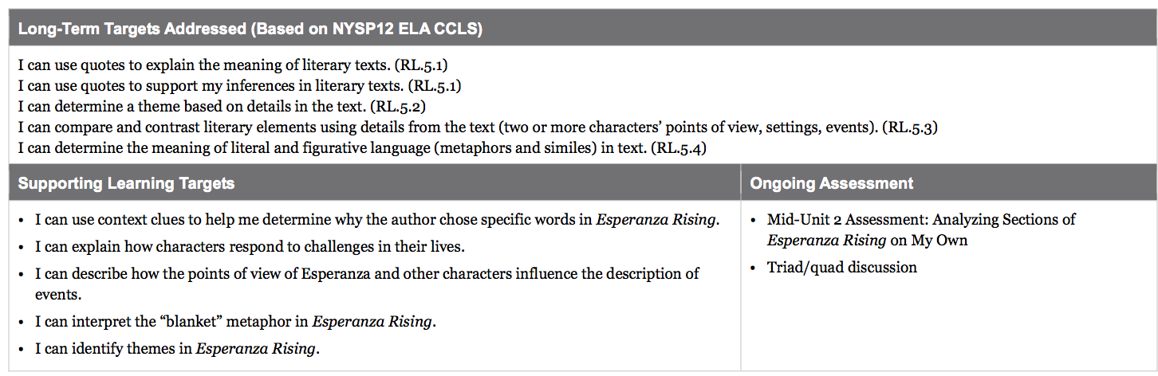

Slide 3
Opening
Engaging the Reader: Revisiting the Reading Esperanza Rising Anchor Chart (5 mins)

Slide 4
You will be taking the Mid-Unit 2 Assessment today and it will check your progress on the learning targets that you’ve been working towards during this unit/

Slide 5
Learning Targets
I can use context clues to help me determine why the author chose specific words in Esperanza Rising
I can explain how characters respond to challenges in their lives.
I can identify themes in Esperanza Rising

Slide 6
You are ready for this assessment because you’ve been practicing all of the skills that are needed to show success.

Slide 7
Work Time
Mid-Unit 2 Assessment: Analyzing Sections of Esperanza Rising on My Own (30 mins)

Slide 8
Today you get to show off what you know about how to read Esperanza Rising.

Slide 9
During this assessment, you may use your novel, notes, and evidence flags. You may also refer to the anchor charts in the room if you find them helpful.

Slide 10
B. Final Word Seminar on Metaphors and Themes (20 min)
Sit with your triads

Slide 11
Today you are going to continue to work on the learning target of finding the big metaphors that help you understand the themes in Esperanza Rising. Yesterday, you studied two examples of figurative language in the book: that life in like a rosebush and that the poor workers are kittens. You also briefly revisited the metaphors about the earth’s heartbeat and the river between Esperanza and Miguel.

Slide 12
Today you will practice working with another “big metaphor” that runs through the book: Abuelita’s blanket.

Slide 13
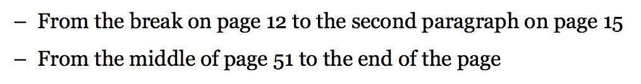
Independently reread the following sections:
Consider:
Is Abuelita’s blanket a metaphor? For what?
What big idea (theme) of the book is related to the blanket?
Use your evidence flags and take notes to prepare for a discussion

Slide 14
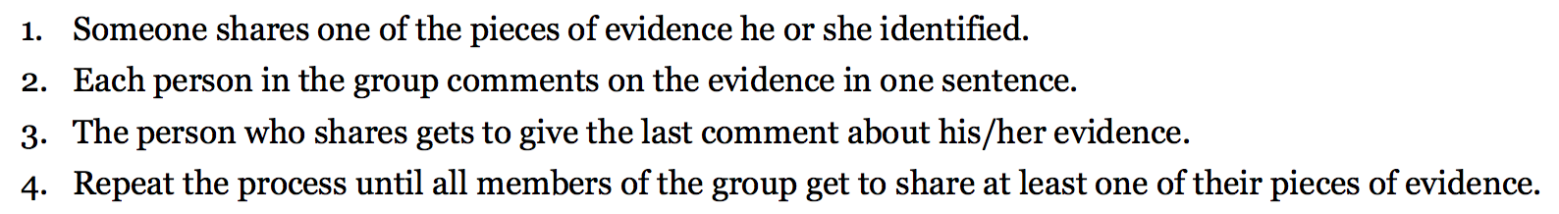
Final Word Protocol

Slide 15
C. Optional: Review of Using Context Clues (if time permits)

Slide 16
What do the following words mean? How do you know?
crochet (13)
Lopsided (15)
bunched up (15)
zigzag (51)

Slide 17
Closing and Assessment
Debrief (5 mins)

Slide 18
We are continuing to work on the learning targets:
“I can interpret big metaphors in Esperanza Rising”
“I can identify the themes in Esperanza Rising”

Slide 19
Revisit the Big Metaphors and Themes in Esperanza Rising Anchor chart. Can we add any new metaphors?

Slide 20
