Slide 1
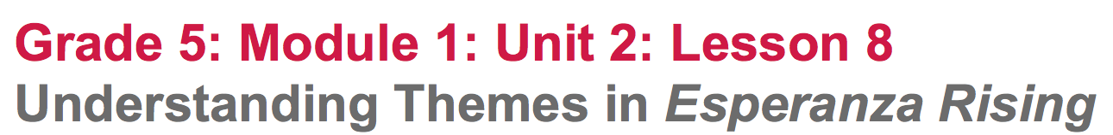

Slide 2
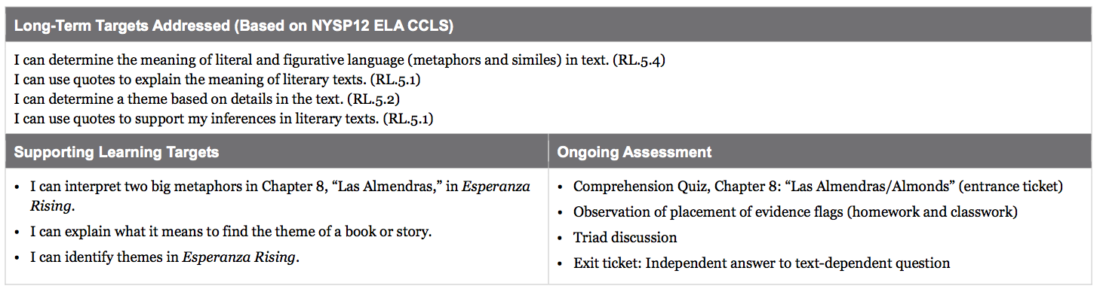

Slide 3
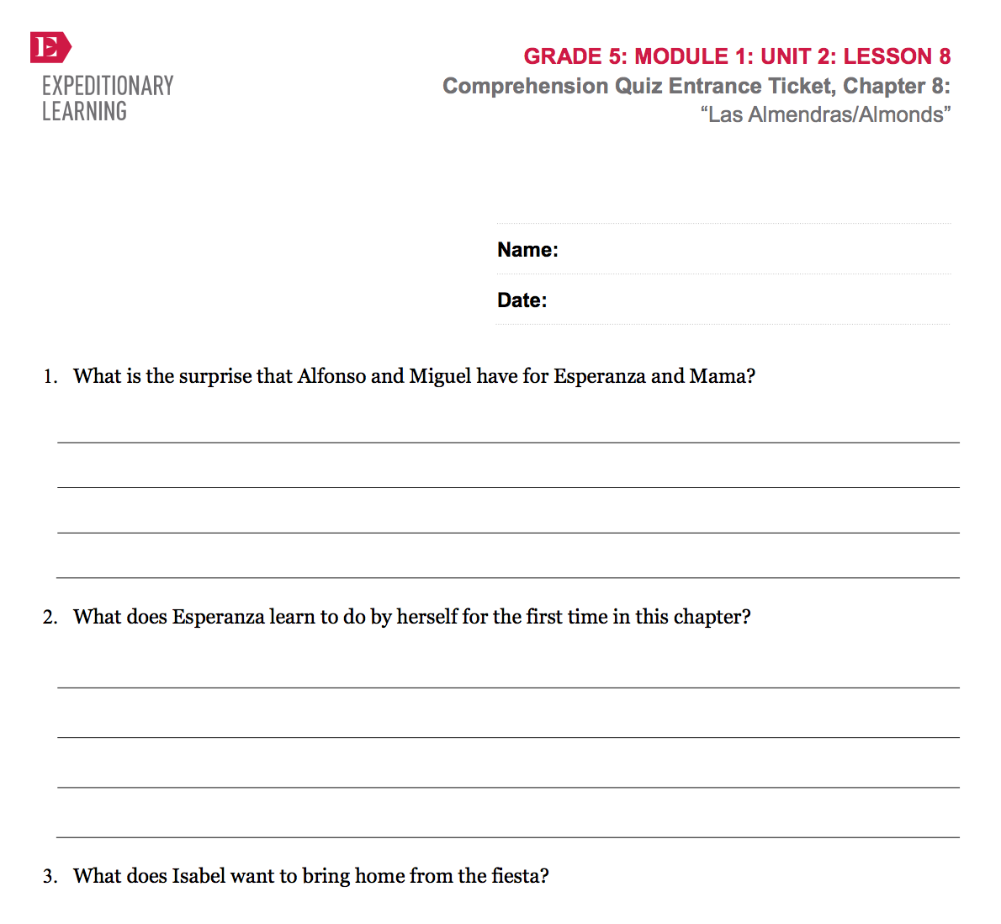
Opening
Entrance Ticket: Comprehension Quiz, Chapter 8: “Las Almendras/Almonds”

Slide 4
B. Engaging the Reader: Oral Chapter Review
What happened in this chapter?
What was this chapter mostly about?

Slide 5
Can you guess what question I will ask next?
Why is chapter 8 titled “Las Almendras/Almonds”?
Add an evidence flag to the first page of chapter 8. Write a phrase that will help you summarize the main events in this chapter and help you remember why it was titled “Almonds”

Slide 6
C. Adding to Anchor Chart: Reading Esperanza Rising (5 mins)
You’ve been building a strong routine during your study of the first half of the novel.
What are some of the things you’ve been doing as readers to make sense of this novel?

Slide 7
Work Time
Big Metaphors: Answering Questions in Triads (15 mins)

Slide 8
Learning Target
I can interpret two big metaphors in Chapter 8: “Las Almendras” in Esperanza Rising.
You already identified some metaphors in the novel in previous lessons.
What is a metaphor?
Figurative language that authors use to make a direct comparison between two things, in order to show something important.

Slide 9
Read aloud pages 122-124
Follow along in your text
1:04-4:23
https://drive.google.com/open?id=0B49Fw8lbut5zdFc0STVYMHVyOE0

Slide 10
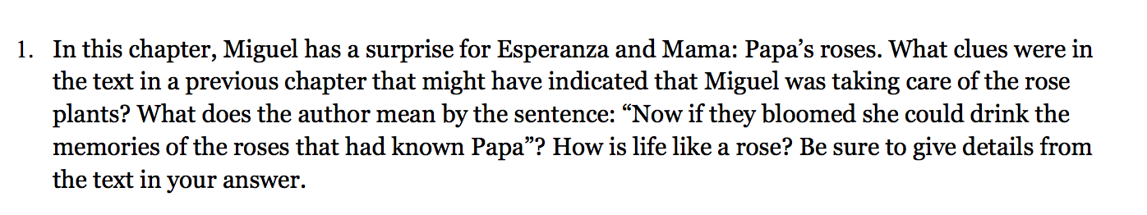
Refer to pages 72-73 to help you with this question. Think on your own, and then talk with your triad. Use your evidence flags to mark evidence that supports your answer.

Slide 11
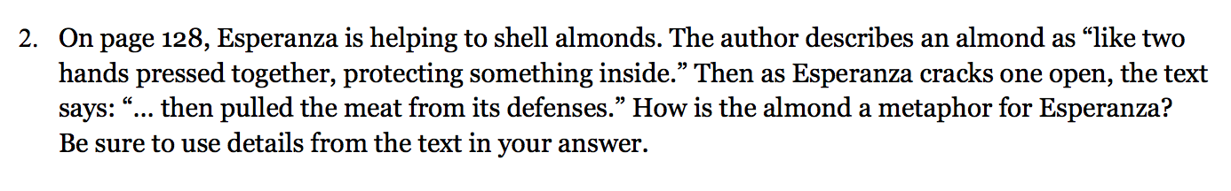
Follow along as I read the paragraph beginning with “I know…” and be thinking about this question.
Discuss your answers with your triad, rereading if necessary.
Continue with the 3rd question in your triad.

Slide 12
B. Inferring Themes in Esperanza Rising
(25 mins)
Vote with your feet!
-Back left corner if you think life is like a rose
- By the door if you agree with Marta that the poor workers are like kittens
-Center of the room if you’re unsure.
Discuss why you made the choice you did.

Slide 13
Literature contains both “little metaphors,” which might show up in a sentence, and “big metaphors” (often symbols), such as the metaphors about the rose and the kitten that you just talked about. The big metaphors can point the way towards a book’s big ideas, or themes.

Slide 14
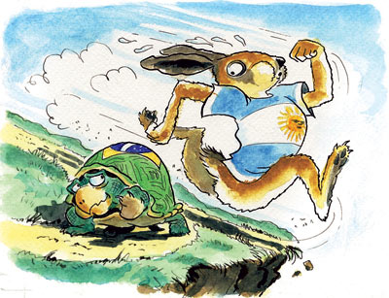
Think about the story of the Tortoise and the Hare.

Slide 15
Today, you will briefly begin to think about themes in Esperanza Rising, using the big metaphors to help you find them.

Slide 16
Learning Target
“I can identify the themes in Esperanza Rising.
One metaphor that runs through the book is that life is a rose. What does this mean?

Slide 17
What are some BIG Metaphors/Symbols?
Read excerpts to guide thinking
Earth’s heartbeat (page 2)
River between Esperanza and Miguel (page 18)
Roses (bottom of page 8 and top of page 9)
The kitten (page 132)

Slide 18
Closing and Assessment
Exit Ticket: Independent Writing (5 min)
Choose to write about either the rose or the kitten. Why is this “big metaphor” so important in the story? What message is the author trying to give us as a reader?

Slide 19
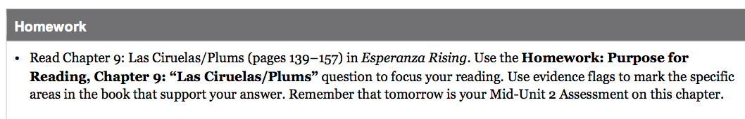
MID-UNIT ASSESSMENT TOMORROW!

