Slide 1
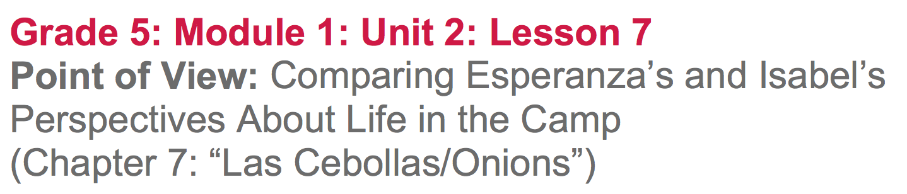

Slide 2
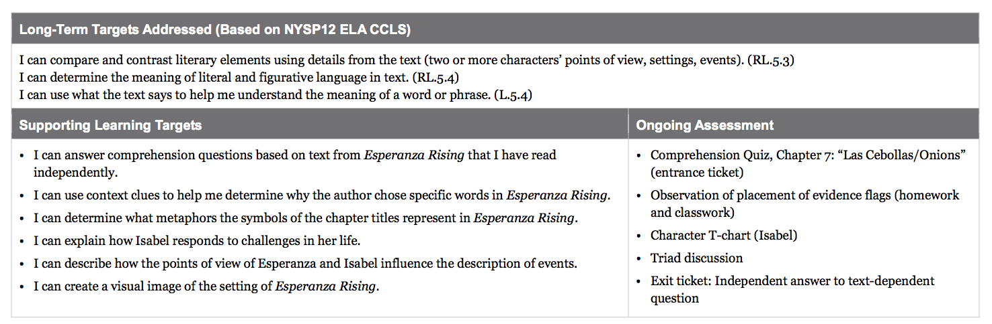

Slide 3
Opening
Entrance Ticket: Comprehension Quiz, Chapter 7: “Las Cebollas/Onions”

Slide 4
B. Engaging the Reader: Oral Chapter Review (5 mins)
What was this chapter mostly about?
What happened in this chapter?
During our work time, we will think more about the chapter title.

Slide 5
Work Time
The Onion: Close Reading of Pages 116-117 (20 mins)

Slide 6
Why do you think the author, Pam Muñoz Ryan, titled this chapter “Onions”?

Slide 7
Learning Targets
“I can use context clues to help me determine why the author chose specific words in Esperanza Rising.”
What do you know about context clues?

Slide 8
Learning Targets
“I can determine what metaphors the symbols of the chapter titles represent in Esperanza Rising.”
What do you know about metaphors?

Slide 9
You’ve been doing good work discussing the text in triads, but today, we are going to discuss one key passage as a group.

Slide 10
Turn to page 116 and follow along in your text
17:26-19:24
Chapter 7

Slide 11
Text-Dependent Questions
What is Esperanza’s job in the camp?
What does visualize the memory mean?
What is Esperanza doing with her mind in order to help her figure out how to sweep?

Slide 12
Looking at page 117
What does tittering mean? How can we figure it out based on the context?
How does Esperanza feel after Marta calls her Cinderella? What does she do?
What specific words in the text help you know what Esperanza is feeling?

Slide 13
The author is making very careful choices about what words to use, in order to help readers understand what Esperanza is feeling.
Think about the work you’ve been doing, drawing inferences about characters based on how they respond to challenges. What have we been able to infer about Esperanza?

Slide 14
Add an evidence flag to the first page of chapter 7, summarizing why it’s titled “Onions”

Slide 15
B. Isabel: Answering Questions in Triads
(8 min)
Begin a new page in your reading journal about Isabel. Write at the top of the page any basic descriptions of Isabel.
Create a T-chart for Isabel’s challenges and responses.

Slide 16
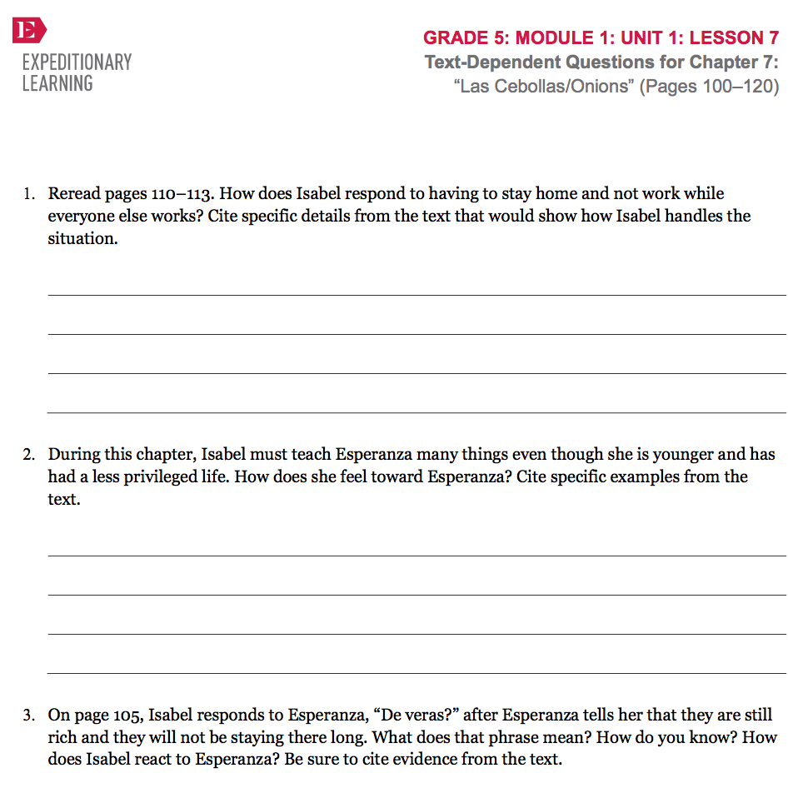
Text-Dependent Questions

Slide 17
C. Understanding Point of View by Visualizing (15 min)
Learning Target:
“I can describe how the points of view of Esperanza and other characters influence the description of events.”

Slide 18
How would it be different if you were describing it?

Slide 19
½ of the triads will pretend to be Esperanza and the other ½ will pretend you are Isabel. You will have 5 minutes to think, reread, and use your evidence flags to mark important passages.
One “Esperanza” will pair with an “Isabel” and you will talk about what the camp looks like from each other’s point of view. Use evidence from the text.

Slide 20
Closing and Assessment
Exit Ticket: Independent Writing (5 mins)
How does Esperanza respond differently to the challenges of life in the camp than Isabel does? Based on these differences, what do you think the author wants us to infer about Esperanza’s character? Use specific details from the text in your answer.

Slide 21
B. Debrief (2 min)
Review Learning Targets

Slide 22
