Slide 1
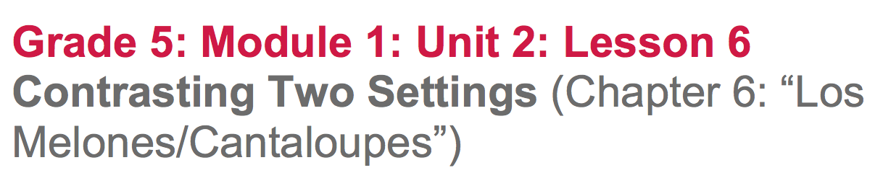

Slide 2
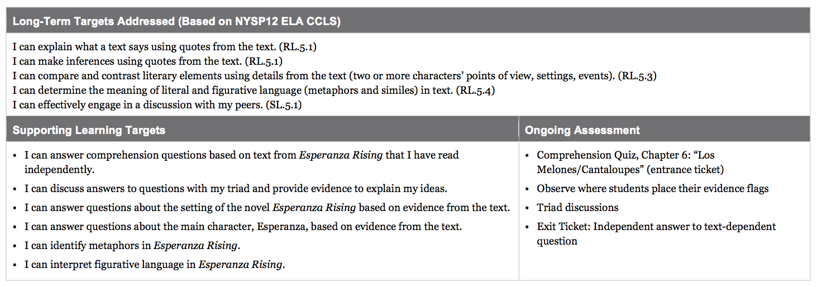

Slide 3
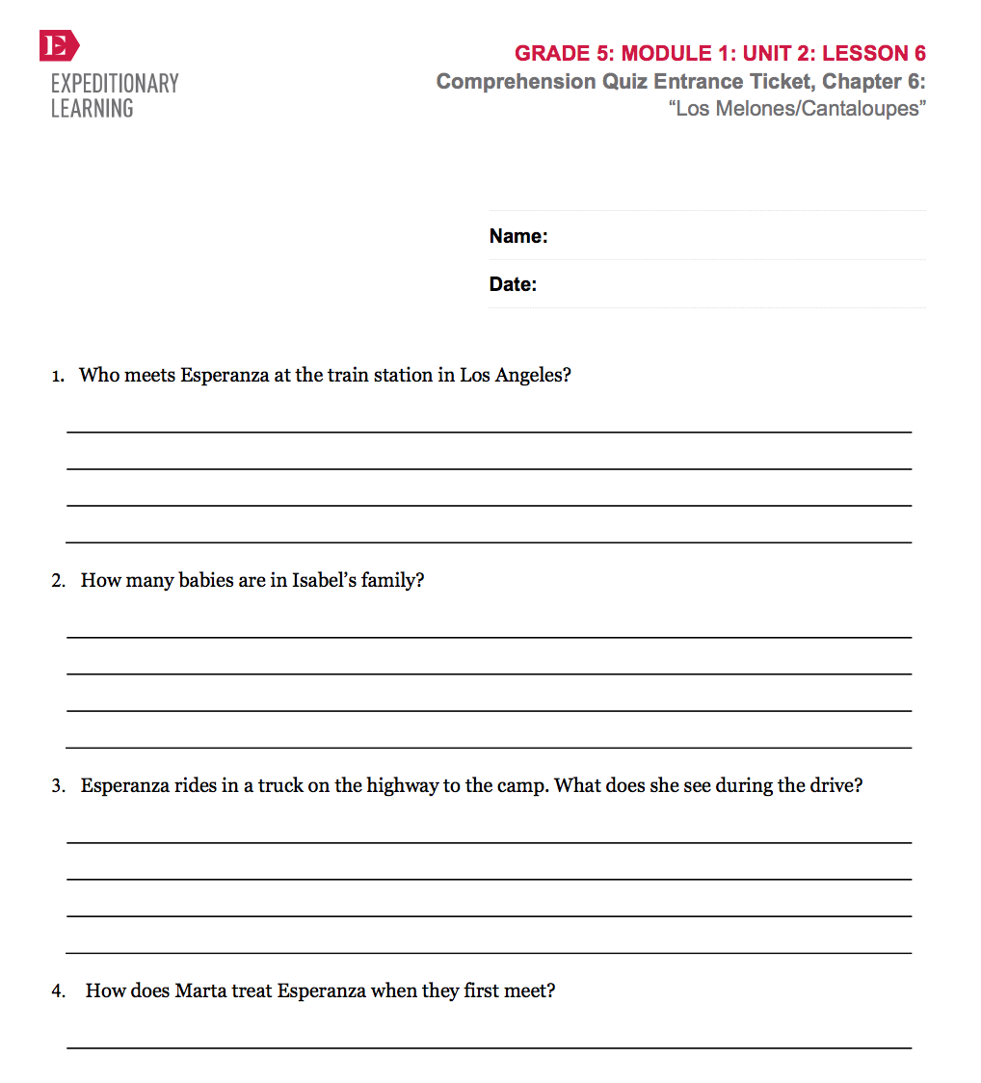
Opening
Entrance Ticket: Comprehension Quiz, Chapter 6: “Los Melones/Cantaloupes”

Slide 4
B. Engaging the Reader: Oral Chapter Review
(5 min)
What was this chapter mostly about?
What happened in this chapter?
What does the term campesino mean?

Slide 6
Notice the title of the chapter: “Los Melones/Cantaloupes.”
What pattern have you noticed with the chapter titles?
Remember, authors choose titles to help readers understand some key idea or event in the chapter

Slide 7
Why do you think Pam Muñoz Ryan titled this chapter “Los Melones”?
Place an evidence flag on the first page of Chapter 6, with the phrase “melon crop in California”

Slide 8
Work Time
Answering Questions in Triads: Comparing California to Mexico (15 mins)

Slide 9
Learning Targets
I can answer questions about the setting of the novel Esperanza Rising based on evidence from the text.
I can answer questions about the main character, Esperanza, based on evidence from the text.

Slide 10
Esperanza Rising is historical fiction: The author draws upon real events, real settings, and some real people, but also made up many events and characters. In lesson 5, you read informational text to learn about what it was like in California in the 1930s. In chapter 6, you get to see the new setting through Esperanza’s eyes.

Slide 11
Have our your text and your Exit Tickets from lesson 5. Discuss in your triads:
How do you think Esperanza’s life will be different in California? Support your thinking with at least one piece of information you learned today and one detail from Esperanza’s train journey described in chapter 5

Slide 12
Discuss the Purpose for Reading homework question you were given for chapter 6.
“Describe the geographical setting of Esperanza Rising. What is it like in California? Use details from the text to support your answer.

Slide 13
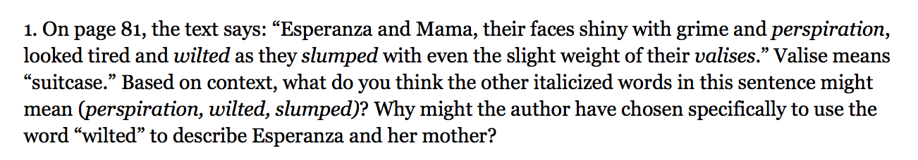
Turn to page 81. Follow along as I read the first question
Reread the sentence, then discuss with your triad what you think each of the italicized words means and how you determined the meaning from context.

Slide 14
Now discuss the second part of the first questions: “Why might the author have chosen specifically to use the word ‘wilted’ to describe Esperanza and her mother?”

Slide 15
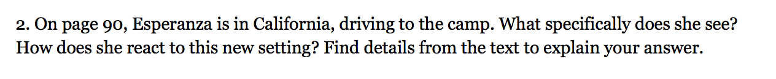
Turn to page 90. Follow along in your text.
Chapter 6
Reread this section again, on your own, with this question in mind, then talk with your triad. Use your evidence flags to mark evidence that supports your answer.

Slide 16
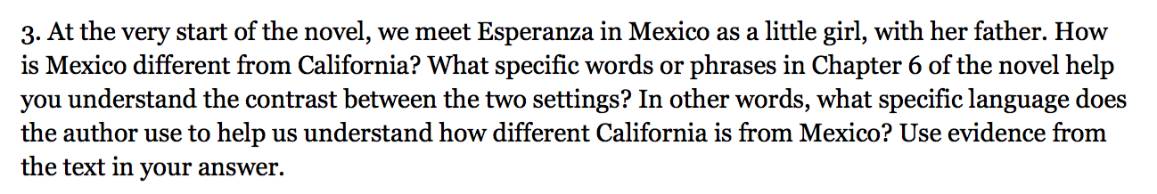
Listen again to the first paragraph of the novel to refresh your memory of the way Mexico is described.
Chapter 1

Slide 17
Next, turn back to chapter 6, “Los Melones). Work with your triad to skim and scan to locate portions of the chapter that describe California. Remember to use your evidence flags to mark your text.
Discuss the evidence you marked.
How is it different from Mexico?

Slide 18
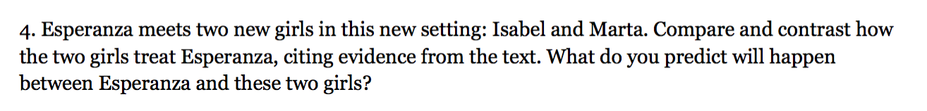
Think on your own about this question marking your answers with evidence flags before discussing it with your triad.

Slide 19
B. Guided Practice: Setting and Metaphor
(20 min)
We are going to look a bit deeper at how Esperanza is responding to her new setting of California by analyzing the language that Pam Muñoz Ryan uses in her writing.

Slide 20
Learning Targets
“I can identify metaphors in Esperanza Rising”
“I can interpret figurative language in Esperanza Rising
Notice the word “figure” in figurative. This is another word for picture. Authors use figurative language to paint a picture that allows them to show, not tell, their ideas.

Slide 21
Metaphor
One form of figurative language that authors use is the metaphor. Metaphors make a direct comparison between two or more things. Pam Muñoz Ryan uses many of these in her writing. You may be familiar with some metaphors already.

Slide 22
Ex: “I’m a rock” “The baby is an angel”
What do these mean? Why would an author choose to use language such as this instead of literal language in their writing?

Slide 23
Reread pages 1-3 and 90-93 in your books looking for metaphors.
Share with your triad what you think one of the metaphors is that the author has used in these two sections of the book.

Slide 24
What is the author trying to get the reader to understand by using this metaphor?

Slide 25
Big Metaphors and Themes in Esperanza Rising
The heartbeat of the land and Esperanza
  This idea is a central theme of the book
Theme: The message or central idea of a story
You will use this chart to keep track of other metaphors as you keep reading and you will talk more about theme in future lessons

Slide 26
Let’s look at another “big metaphor” in the novel.
Reread the first paragraph on page 18, the second paragraph on page 87, and all of page 93.
Identify the big metaphor in the excerpt.

Slide 27
Discuss with your triads what you think the author means by this metaphor and why she chose to write it this way.
add “the river and Esperanza and Miguel’s relationship” to our chart.
Discuss how Esperanza responds differently in the different settings.

Slide 28
Closing and Assessment
Exit Ticket: Independent Writing (10 mins)
Respond:
On page 99, Marta tells Esperanza, “Just so you know, this isn’t Mexico. No one will be waiting on you here.” What does she mean? How is Esperanza’s life different in California? Cite details from the text to support your answer.

Slide 29
Begin a page in your journal for the character “Marta” and record what you know about her so far.

Slide 30
B. Debrief (5 min)
Review learning targets

Slide 31
What could we add to the Reading Esperanza Rising Anchor Chart?

Slide 32
