Slide 1


Slide 2
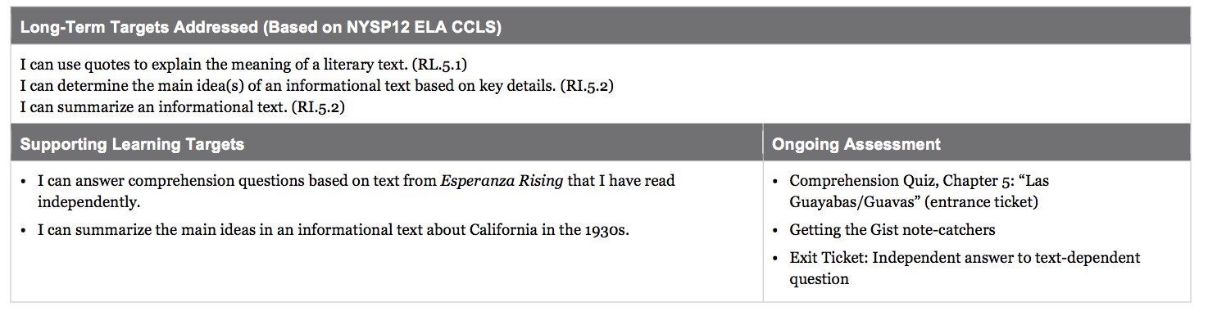

Slide 3
Opening
Entrance Ticket: Comprehension Quiz and Chapter Title: Chapter 5 “Las Guayabas/Guavas”

Slide 4
Comprehension Quiz
You will have 10 minutes to independently complete your comprehension quiz-no books or notes.

Slide 5
Human Rights Challenge
Who found an example of a human rights challenge in your reading last night that we can add to our anchor chart?

Slide 6
Chapter Discussion
What was the chapter mostly about?
What happened in this chapter?

Slide 7
Chapter titles
This chapter was titled “LAs Guayabas/Guavas.” What pattern have you noticed in the chapter titles?
Authors choose titles for very important reasons, to help readers understand some key idea about the chapter.

Slide 8
Why do you think Pam Muñoz Ryan titled this chapter “Guayabas?”
Pay attention to the chapter titles in your future reading of the novel.

Slide 9
Work Time
Engaging the Reader: What Do We Already Know about California in the 1930s? (10 min)

Slide 10
Chapter 5 marks a transition in the setting of the novel: Esperanza has left Mexico and is traveling to the United States, specifically to California.

Slide 11
Remember how we built background knowledge about Mexico in our first lesson of this unit? Today, you will build background knowledge about California.

Slide 12
Learning Target
“I can summarize the main ideas in an informational text about California in the 1930s.”
The 1930s were before World War II and just 10 years after the end of the Mexican Revolution

Slide 13
Notice the 3 charts I’ve put up: California, Immigrating from Mexico, and The Great Depression.
Each of you will have a marker of the same color. You are to SILENTLY go up to the chart and write down anything you know about these topics.

Slide 14
Work Time
B. Building Background Knowledge: Hosted Gallery Walk (30 mins)

Slide 15
Hosted Gallery Walk Protocol
You will not start this activity with your triad, but you will end with them.
In your triad, assign each person a topic:California, immigration, or the Great Depression

Slide 16
Leave your triad and form new groups with 2 other students who were assigned the same topic. You should be in new groups of 3.
Each of you will receive a “Getting the Gist” note-catcher and a folder of resources on your assigned topic.

Slide 17
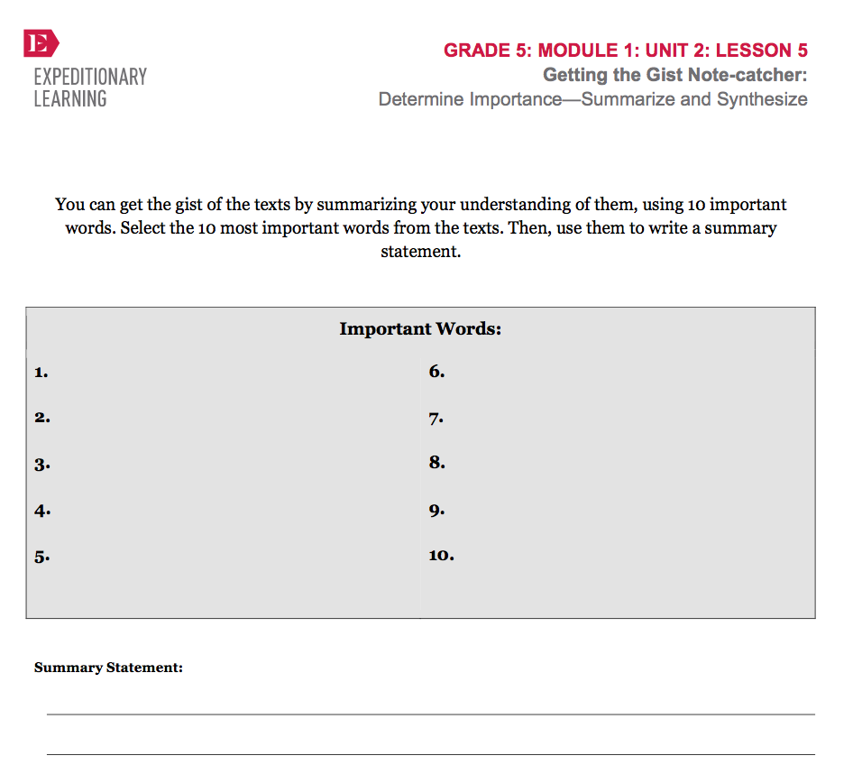
Stay with this new group, but work silently and independently for 15 minutes to read some of the resource materials and record the main ideas on your note catchers.

Slide 18
Poster
Each group will receive a piece of chart paper for your poster. You are to work together for 10 minutes to create a poster that captures the main ideas from your note-catchers in words and a visuals

Slide 19
Hosted Gallery Walk
We will now take a hosted gallery walk of the three topics. At each poster, members of the group that prepared it will explain the topic and you will have a chance to ask questions.

Slide 20
Closing and Assessment
Independent Writing (5 mins)

Slide 21
Writing
Respond to the prompt:
How do you think Esperanza’s life will be different in California? Support your thinking with at least one piece of information you learned today AND one detail from Esperanza’s train journey described in Chapter 5

Slide 22
B. Debrief (5 min)
Fist-To-Five

Slide 23
What was your biggest “aha” or new learning during the gallery walk?
How did working with others help you be successful

Slide 24
