Slide 1
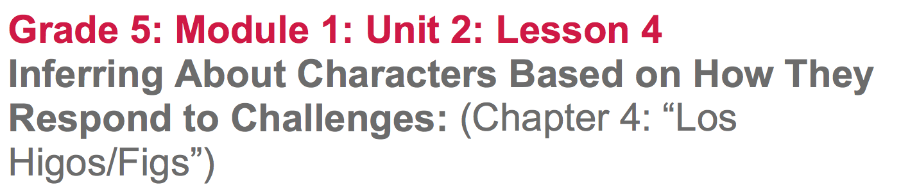

Slide 2
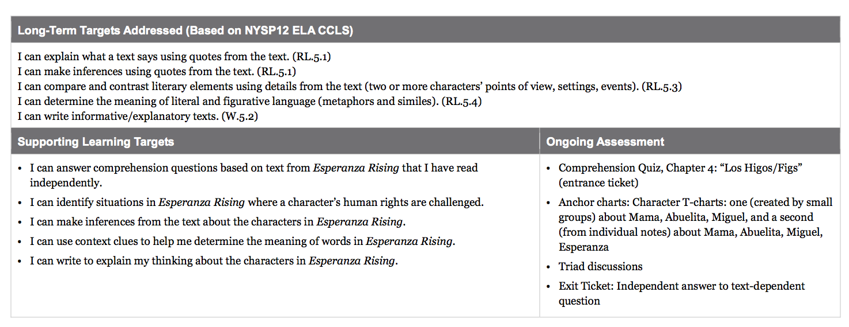

Slide 3
Opening
Entrance Ticket: Comprehension Quiz, Chapter 4: “Los Higos/Figs” (5 min)

Slide 4
Purpose
Remember that the purpose of the comprehension quiz exit ticket routine is designed to assess if you read and understood the text assigned for homework.

Slide 5
B. Engaging the Reader: Oral Chapter Review
(5 min)
What was this chapter mostly about?
What happened in this chapter?
**Cite evidence or point to specific passages to support your answer**

Slide 6
What could you write on an evidence flag on the first page of Chapter 4 to help you remember what this chapter was mostly about?
Where do Mama, Abuelita, and Esperanza decide to go?

Slide 7
Work Time
Jigsaw, Part 1: How Mama, Abuelita, and Miguel Respond to Challenges (20 mins)

Slide 8
Learning Targets
I can identify situations in Esperanza Rising where a character’s human rights are challenged
I can make inferences from the text about the characters in Esperanza Rising.

Slide 9
Join your triads. Remember, you will be working in these groups of three almost every day throughout this unit.
Turn to the page in your journal where you began to record some information about the characters in the book. Reread what you wrote and share with your triad adding any new information.

Slide 10
Think back to the jigsaw protocol that we’ve done previously, in which each person becomes an expert on something and then teaches that to the rest of the group.
Each student in each triad will study a different character: Mama, Abuelita, or Miguel

Slide 11
You will have approximately 10 minutes to work on your own to complete your jigsaw task card, making sure to mark evidence with flags in the text.

Slide 12
You’re now going to gather into new groups with others who read about the same character.
Discuss the evidence you flagged.
Create an anchor chart in your journal like the one on the board...a T-chart with CHALLENGES on one side and RESPONSES on the other.
Record your thinking on that character’s page.

Slide 13
B. Jigsaw, Part 2: Comparing Esperanza’s Response to the Response of these Other Characters. (15 mins)
Return to your original triads

Slide 14
Each of you will have 4 minutes to share about your character. The other two students should take notes on the corresponding pages in your reading journal about that character.

Slide 15
Triad Discussion
How is Esperanza’s response to challenges like the response of the other characters? How is her response different?

Slide 16
Closing and Assessment
A. Exit ticket: Independent Writing (10 mins)

Slide 17
Respond to the prompt:
Compare/contrast Esperanza to the character you became an expert on today. How is Esperanza’s response to challenges like the response of the other character? How is her response different? Use specific details from the text to support your answer.

Slide 18
B. Debrief (5 min)

Slide 19
Let’s look at our Human Rights Challenges in Esperanza Rising anchor chart that we created in lesson 3. Talk with your triad, are there any challenges that we should add to the list?

Slide 20
