Slide 1
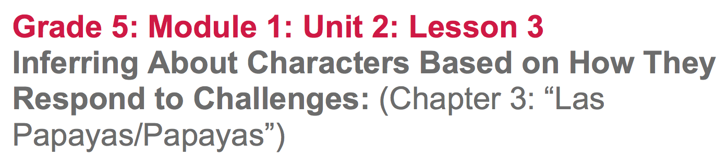

Slide 2
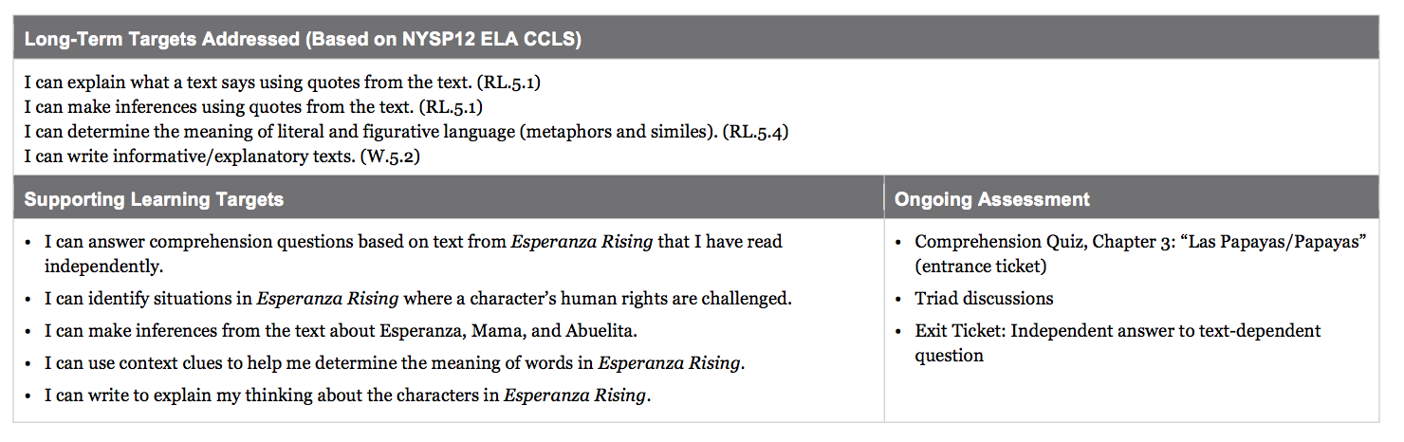

Slide 3
Opening
Entrance Ticket: Comprehension Quiz, Chapter 3: “Las Papayas/Papayas” (5 min)

Slide 4
Entrance Ticket
Our 1st learning target is:
“I can answer comprehension questions based on text from Esperanza Rising that I have read independently.”
This quiz will be a daily practice as we move through Esperanza Rising, designed to assess if you read and understood the text assigned for homework.

Slide 5
Your homework reading is a “1st draft” read. I don’t expect you to understand everything, but it is important that you are held accountable for the reading and that you try your best.
You will have 5 mins to complete the quiz

Slide 6
B. Engaging the Reader: Oral Chapter Review (5 min)
What was the chapter mostly about?
At the start of chapter 3, what does Esperanza dream about?

Slide 7
Work Time
Revisiting Papa’s Death: Close Reading of Pages 22-23 (15 mins)

Slide 8
Think back to the text-dependent questions we discussed about chapter 2: “Las Uvas/Grapes.”
Many of you may not have had time to fully discuss the 5th question:
“At the end of the chapter, why does Esperanza feel her heart drop and that she has sunk into a ‘dark hole of despair and disbelief?”
In your triads remind each other what happened at the end of chapter 2.

Slide 9
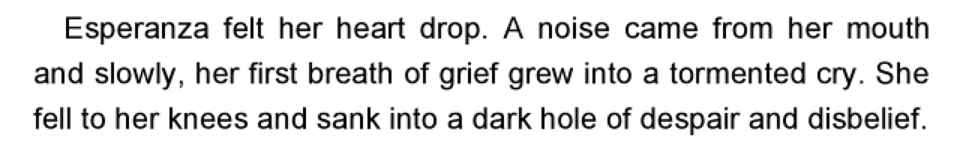
Did Esperanza really sink into a hole?
What does the word despair mean?
“complete loss or absence of hope”
Why does Esperanza feel despair?

Slide 10
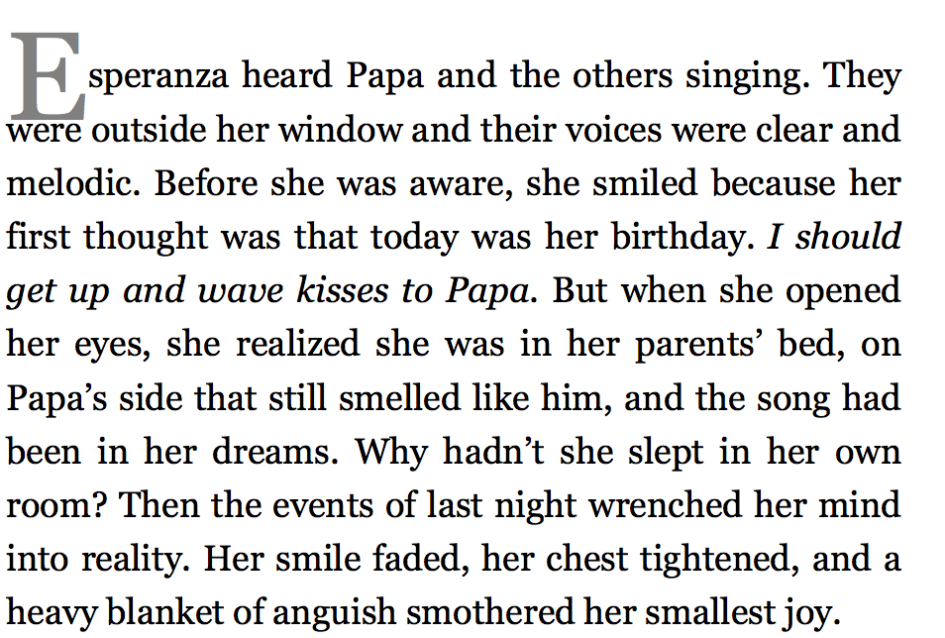
Turn to page 23. Let’s look at the last 2 sentences.
What are the ‘events of last night’?
Based on context clues, what might the word wrenched mean?
The author “Her smile faded, her chest tightened, and a heavy blanket of anguish smothered her smallest joy.” What might anguish mean?

Slide 11
The author, Pam Muñoz Ryan, is using language in very interesting ways to help readers understand what Esperanza is feeling. We’ll explore this some more in future lessons.

Slide 12
The author never directly tells readers that Papa died.
How were you able to figure out what happened?
Add an evidence flag to the opening of Chapter 3 “Esperanza grieving”

Slide 13
B. Challenges to Human Rights in Chapters 2 and 3 (15 mins(
Learning Target:
I can identify situations in Esperanza Rising where a character’s human rights are challenged.

Slide 14
Talk in your triads about the human rights you remember from your study of the UDHR.
Use your Unit 1 note-catchers and the anchor chart to help.

Slide 15
Where did you place your evidence flags as you read chapter 3: “Las Papayas” on your homework.
What challenges did the characters in this chapter face?
Where are there examples specifically of human rights challenges?

Slide 16
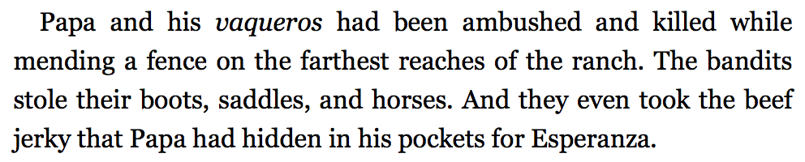
Challenge to the right to life, liberty, and personal security. (p. 24)

Slide 17
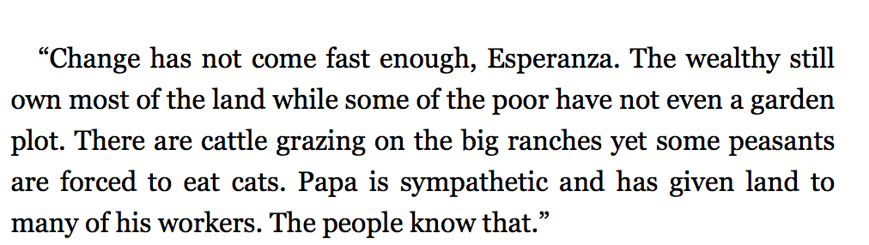
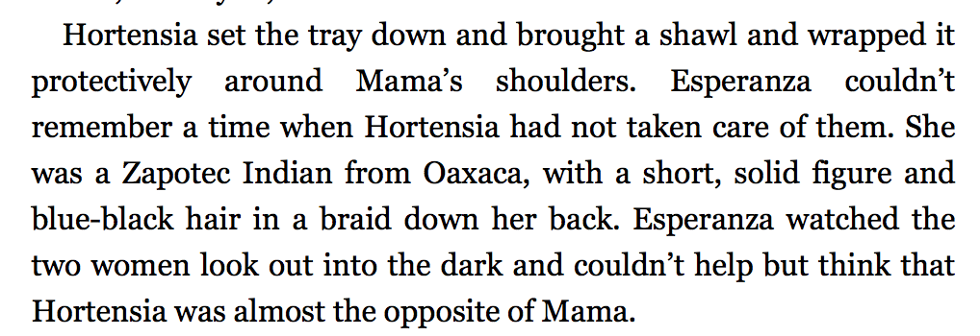
Discriminatory treatment of Indians compared to people of Spanish descent
page 12
page 15

Slide 18
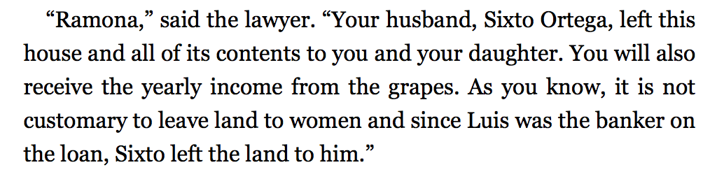
Denial of property rights to women (p. 30)

Slide 19
C. How characters Respond to Challenges: Answering Questions in Triads (15 mins)

Slide 20
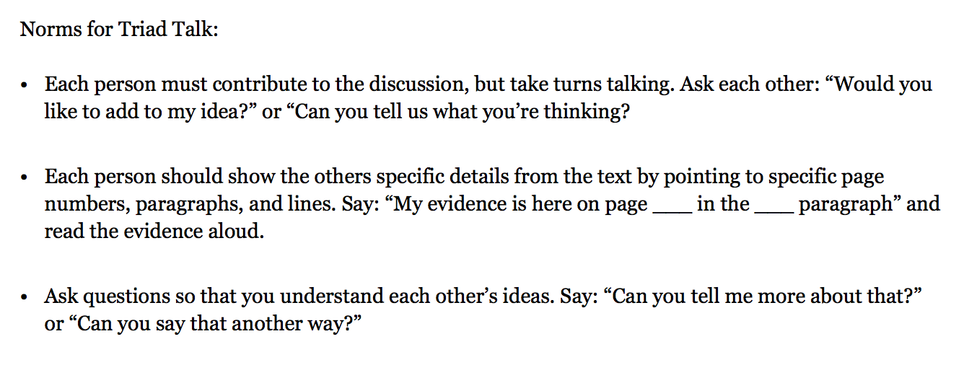
Let’s review our norms for Triad Talks:

Slide 21
Learning Target
“I can make inferences from the text about the characters in Esperanza Rising.
Earlier we made inferences about papa’s death. We are going to learn more about inferences and practice drawing inferences from clues in the text.

Slide 22
The way someone responds to a challenge tells us a lot about who they are. Talk in your groups about an example of this from a text, or from real life.

Slide 23
Learning Target
I can write to explain my thinking about the characters in Esperanza Rising.
Throughout our study of this novel, you will be thinking about the challenges Esperanza and other characters face, how those characters respond, and what that tells us about those characters. You did something similar with your end of unit 1 assessment.

Slide 24
Reading Journal
Make one new page per character:
Esperanza, Mama, Abuelita, and Miguel
Jot down your response for each character about this question:
What do you already know about this character?

Slide 25
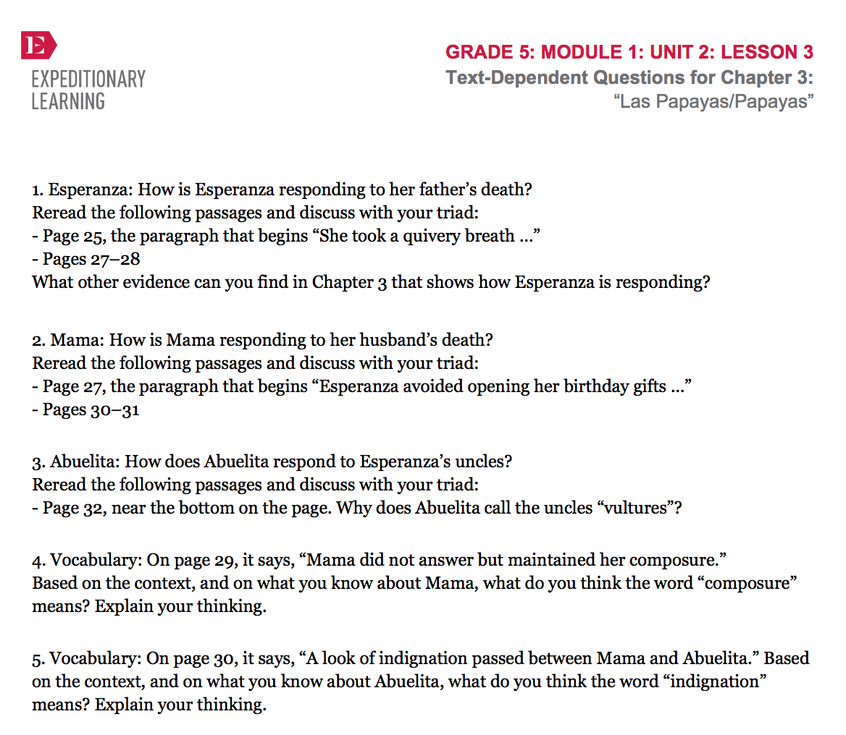
In our next lesson, we will focus more on Miguel; today we will focus only on Esperanza’s family.
In your triads, you will read aloud one text-dependent question at a time, and clarify any terms. You should then think on your own, then talk together to answer the question, marking your answers with evidence flags.
You do not need to write complete answers to the questions at this point.

Slide 26
Closing and Assessment
Independent Answer (5 min)

Slide 27
What could we add to the Reading Esperanza Rising Anchor Chart?

Slide 28
You are to independently select ONE of the questions from you Triad Talk discussion for which you feel you have a complete answer.
Write the number of the question and your answer using specific details from the text.

Slide 29
B. Debrief (5 min)
Write a definition of inferring in your glossary.
Share your definition with your triad.
Share an inference you made about Esperanza, Mama, or Abuelita during class today.

Slide 30
