Slide 1
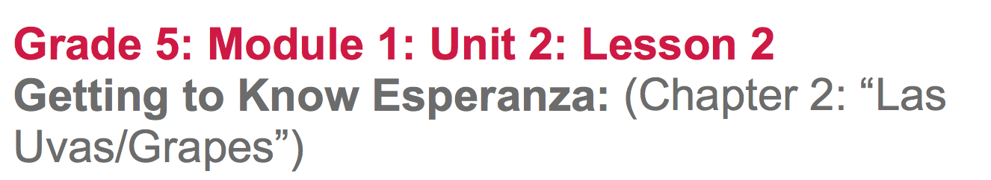

Slide 2
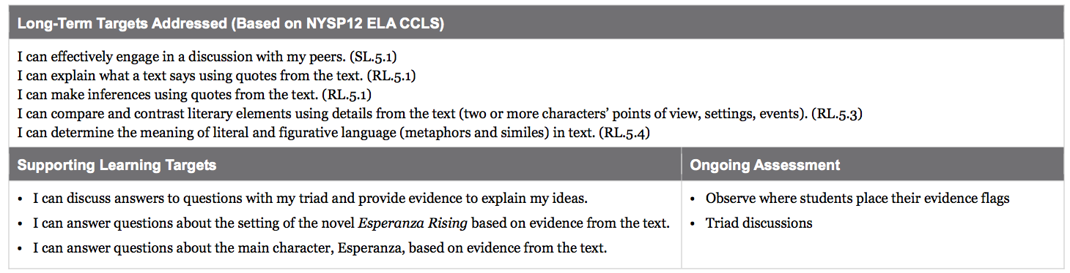

Slide 3
Opening
Introduction of Triad Structure (5min.)

Slide 4
Learning Targets
“I can discuss answers to questions with my triad and provide evidence to explain my ideas.”
Today we will be working on this novel in triads, or groups of three.

Slide 5
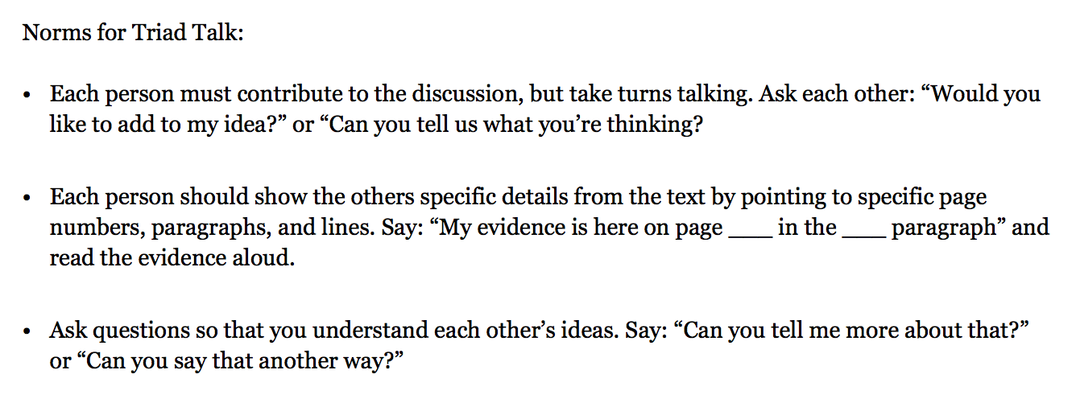
Norms of triad Talks

Slide 6
Work Time
Triad Discussion: Setting and Character in Chapter 1 (10 mins)

Slide 7
Learning Targets
“I can answer questions about the setting of the novel Esperanza Rising based on evidence from the text.”
“I can answer questions about the main character, Esperanza, based on evidence from the text.”
What do you notice?

Slide 8
Genre
Esperanza Rising is historical fiction. What does that mean?
The story is based on real events, real settings, and some real people, but also includes many imagined events and characters.

Slide 9
Pair-Share Review
*What did you learn about yesterday?
*Where does Esperanza Rising take place?
*What characters have been introduced so far?

Slide 10
In triads discuss the 3 questions that were given for homework..the rereading of Ch.1: “Aguascalientes, Mexico, 1924.”

Slide 11
Describe the geographical setting of Esperanza Rising.What is it like where Esperanza lives? Use details from the text to support your answer.
What is Esperanza’s relationship with her papa like? How do you know?
What is Esperanza’s life like in Mexico?

Slide 12
B. Read-aloud, Independent Reading, and Text-Dependent Questions:Pages 4-8 (20 min.)

Slide 13
Take out your text as well as your evidence flags.
We will be using these sticky notes throughout the novel to help you keep track of important passages.

Slide 14
For homework, you did a “first draft” read of Chapter 2: “Las Uvas/Grapes” for your homework.
This is a challenging novel and you will often need to read sections multiple times in order to understand the ideas in the text.
As we read this book, we are going to be thinking a lot about the characters--what they are like, the challenges they face (including human rights), and how they change over time.

Slide 15
Follow along as we read chapter 2
Think about what these first few pages of chapter 2 are mostly about.
Share with your group.
Notice the titles of the chapters. What do they tell the reader?
https://drive.google.com/open?id=0B49Fw8lbut5zOXQ0djUwYzdQS3c

Slide 16
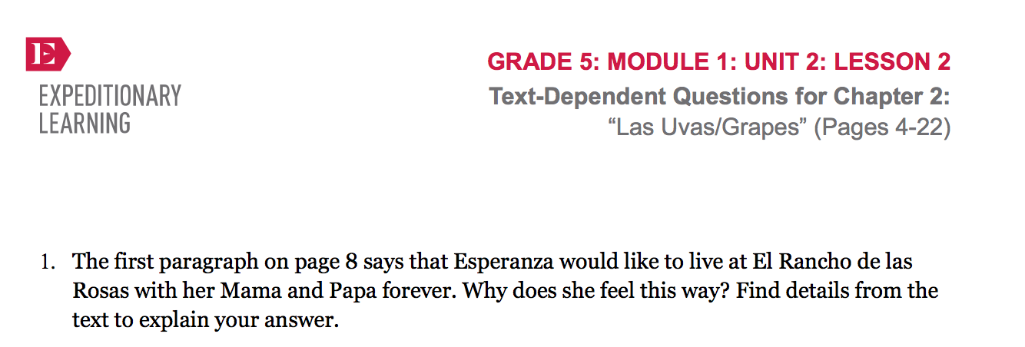
Independently read from page 4 through the break on page 8. Rereading is an important strategy to help you make sense of difficult text. Keep this question in mind as you read.

Slide 17
Use the Triad Talk anchor chart to remind yourselves about how to talk to each other while developing the answer to the question in your triad.
Each person should mark the evidence in the book that supports the group’s answer by placing an evidence flag on the specific information.

Slide 18
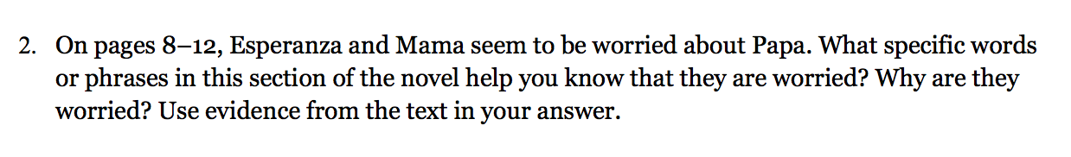
C. Guided Practice:
Triad Work (10 mins)
Listen and mark evidence that answers the question as we read from the break on page 8 to the break on page 12.
Discuss with your triad, rereading
if necessary
4:37-9:05
https://drive.google.com/open?id=0B49Fw8lbut5zOXQ0djUwYzdQS3c

Slide 19
D. Answering Question in Triads (10 mins)
In your triads, read aloud on text-dependent question at a time, and clarify any terms. You should then think on your own, then talk together to answer the question, marking your answers with evidence flags.
You do not need to write answers to the questions right now.

Slide 20
Debrief: Rereading Esperanza Rising Anchor Chart (5 min)

Slide 21
Review Learning Targets

Slide 22
In order to really understand what the author is writing about, we must read the text carefully, such as when reading informational text closely.
Think back to our close reading of the UDHR and our anchor chart on how to read closely.

Slide 23
Reading Esperanza Rising
Making inferences about Esperanza’s character.
We did this one today. We will continue to add to this chart as we read this novel.

Slide 24
Remember the homework routine:
You are expected to do a “first draft” read of a new chapter, using the Purpose for Reading questions to focus your attention. You should use your evidence flags to mark passages that relate to the question. I don’t expect you to fully understand the chapter, but to give it your best effort.

Slide 25
