Slide 1
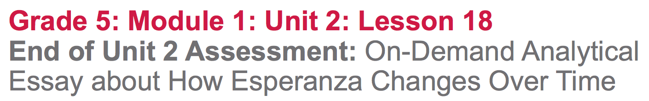

Slide 2
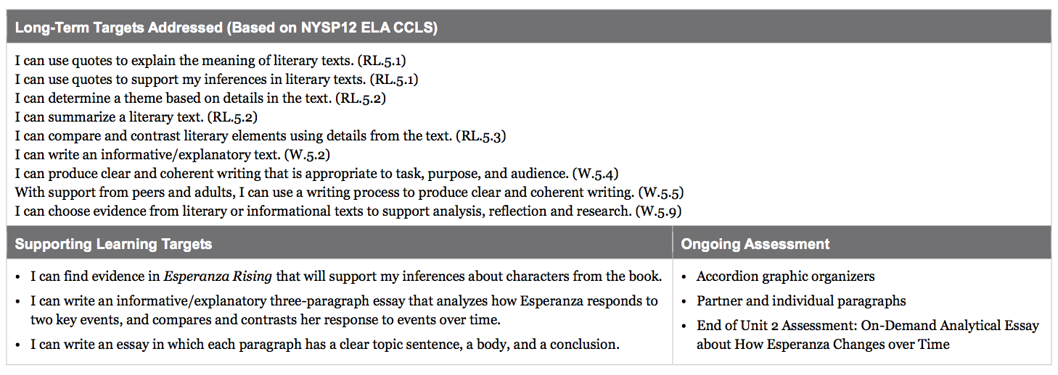

Slide 3
Opening
Review of Learning Targets and Success Criteria (10 mins)

Slide 4
Learning Targets
I can find evidence in Esperanza Rising that will support my inferences about characters from the book.
I can write an informative/explanatory three-paragraph essay that analyzes how Esperanza responds to two key events, and compares and contrasts her response to events over time.
I can write an essay in which each paragraph has a clear topic sentence, a body, and a conclusion.

Slide 5
Compare/Contrast Essay Success Criteria
Cite evidence
Make inferences
key events from the beginning and end of the novel
All paragraphs have topic sentences
All paragraphs have supporting details
All paragraphs have a concluding sentence

Slide 6
Work Time
Engaging the Writer: Esperanza from Beginning to End (10 mins)

Slide 7
Think about our discussion of the phoenix at the end of lesson 17…
Do you think Esperanza grew and developed as a person throughout novel? Support your answer with evidence from the novel.
Compare: In what ways does Esperanza still behave the same at the end of the novel as she did in the beginning? Give examples.

Slide 8
Contrast: In what ways is Esperanza different at the end of the story that she was in the beginning? Give examples.
What is your opinion of Esperanza at the end of the novel?

Slide 9
B. End of Unit 2 Assessment: Revising Paragraphs 1 and 2, Writing Paragraph 3
(35 mins)

Slide 10
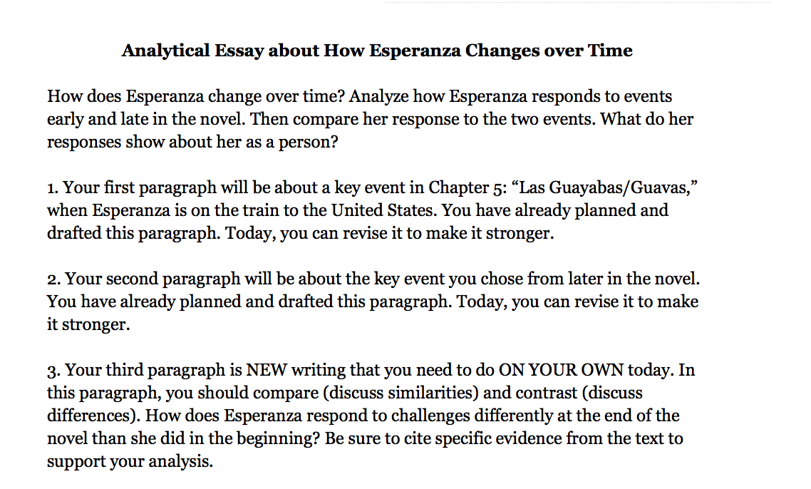

Slide 11
While you are revising and writing your final paragraphs comparing and contrasting Esperanza’s character development over time, you will want to consider the peer critique you received during the previous lesson. You should also refer to the success criteria for writing, anchor charts, and evidence flags.

Slide 12
Closing and Assessment
Self-Assessment (5 min)

Slide 13
Turn to the End of Unit 2 Assessment (Self-Assessment). Complete this self-assessment then hand it in with your complete essay.
Share what you celebrated about your essays on the self-assessment.
In unit 3, you will get to write and perform scenes based on some of the key events in Esperanza Rising.

Slide 14
Homework
None :)

