Slide 1
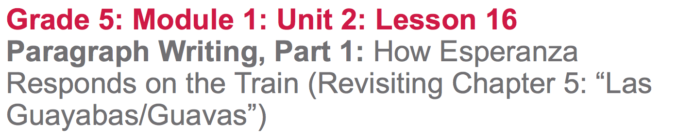

Slide 2
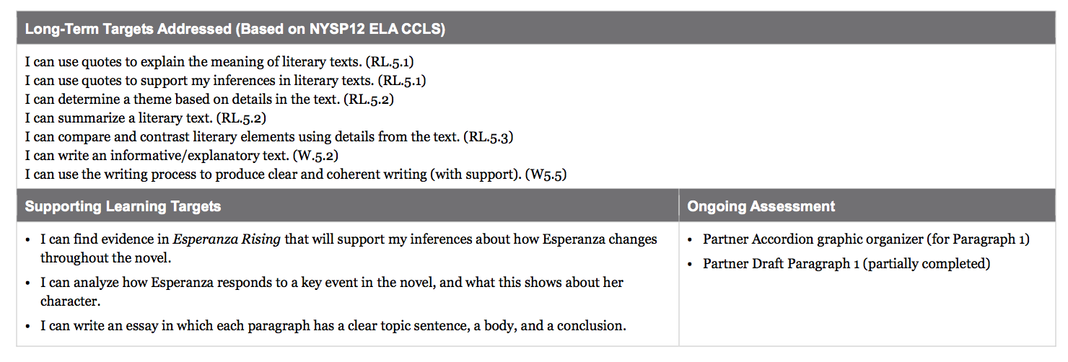

Slide 3
Opening
Celebration of Two-Voice Poems (5 min)
Students who haven’t yet shared their poem, may do so now.

Slide 4
Work Time
How Esperanza Responded on the Train: Answering Questions in Triads (10 mins)

Slide 5
Today you are going to dig back into Chapter 5: “Las Guayabas/Guavas” of Esperanza Rising, in order to answer some questions about the human rights challenges Esperanza faces or witnesses in the novel and how she responds to those challenges.

Slide 6
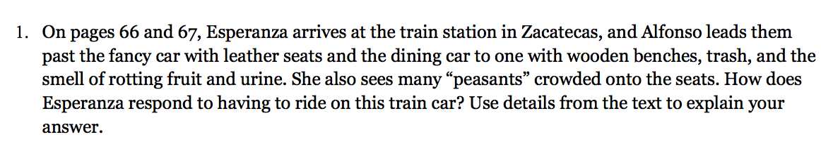
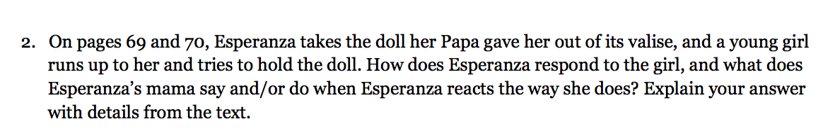
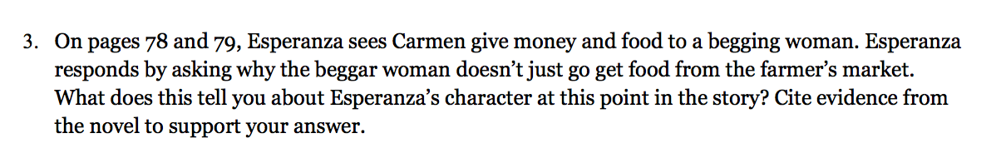

Slide 7
B. Guided Practice: Introduction to Accordion Graphic Organizer (25 min)
Learning Target:
“I can analyze how Esperanza responds to a key event in the novel, and what this shows about her character.”

Slide 8
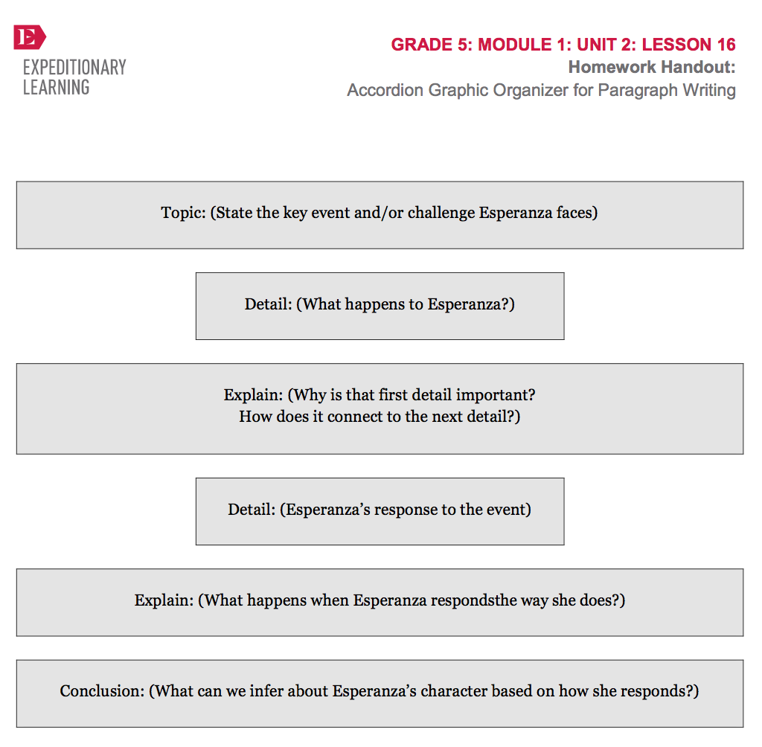
You are going to start organizing a paragraph, using the Accordion graphic organizer as a tool to gather all of the important information and details you will need in order to write a complete paragraph.

Slide 9
I’m going to model by writing about when the ranch is set on fire from chapter 4: “Los Higos/Figs.”
You will do the same thing about a different event.

Slide 10

Ranch set on fire
You will now choose your topic from chapter 5. Think about the text-dependent questions you just discussed with your triads. Your topic doesn’t need to be really specific at this time. You will add more detail later.
In chapter 5, what is a specific event when Esperanza faces a challenge?

Slide 11
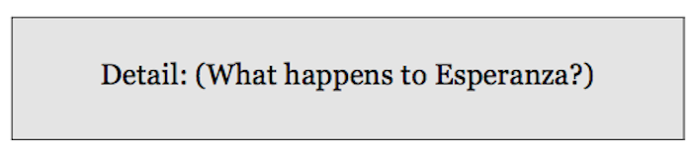
Esperanza escapes fire; loses everything.
In the detail box, you give more information about the topic. Since the topic I am writing about is the ranch catching fire, the detail I will add shows what happened to Esperanza when the ranch caught fire.
You will now do the same on your graphic organizer.

Slide 12

Esperanza needs clothes from the poor box
The “explain” box is used to make a clear connection between the first detail and the next detail, more specifically what challenge Esperanza faces because of the event/detail.
Do the same on your graphic organizer about the event and detail you are writing about.

Slide 13
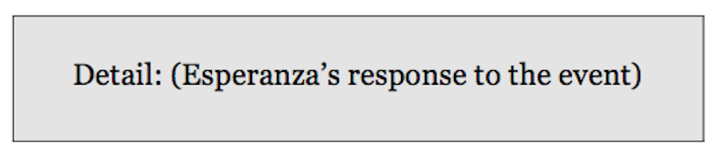

p. 52 poor box
Here we will write about how Esperanza responds to the event using text directly from the book. Turn to page 52
Discuss the second detail with your triad, then fill out the next detail box on your graphic organizer.

Slide 14
Mama says they are poor
This is where you will write what happens when Esperanza responds the way she does.
Do the same on your graphic organizer for your topic

Slide 15
Remember, the target we are working on is “to analyze how Esperanza responds to a key event in the novel,” which is what you’ve just done by filling in your topic, details, and explains. Now, we need to meet the second part of the target which is to analyze “what it shows about her character.

Slide 16
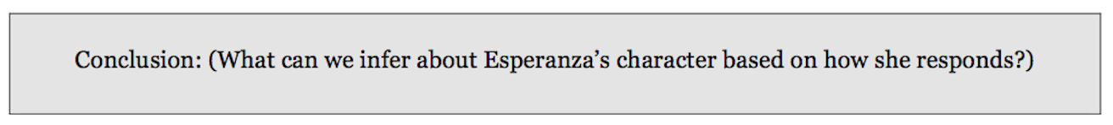
Esperanza had everything; now poor; can’t understand
I am going to look back at my notes about the topic, details, and explains on my graphic organizer. What does this information make me think about Esperanza’s character?
You will now do the same thing for your topic. What can you infer?

Slide 17
C. Introduction to Paragraph Writing (10 min)
Learning Target:
I can write an essay in which each paragraph has a clear topic sentence, a body, and a conclusion.

Slide 18
Sample Paragraph for Chapter 3
*See paragraph and lesson plans
What do you notice about how the notes are different from the sample paragraph?

Slide 19
D. Triad Group Writing: Beginning
Paragraph 1 (7 mins)
You will now start to draft your first paragraphs based on your graphic organizers about an event in chapter 5

Slide 20
Ink-Pair-Share
Independently write a sentence that conveys the main idea of your first paragraph (from the topic box). Make sure to indent your first sentence.
Share your sentence with your triad.
Underline the topic sentence in green.

Slide 21
Ink-Pair-Share
Write two sentences for the body of your paragraph using the supporting details that you noted in the first detail and explain boxes of your graphic organizers.
Share with your triad
Underline the detail in red and the explain in yellow.

Slide 22
Closing and Assessment
Sharing (3 min)
Would anyone like to share out the first 3 sentences of your paragraphs?

Slide 23
