Slide 1
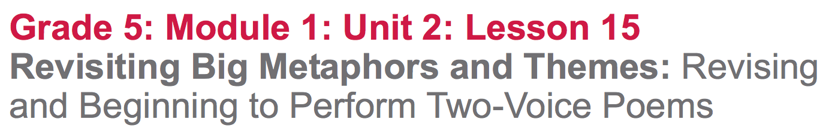

Slide 2
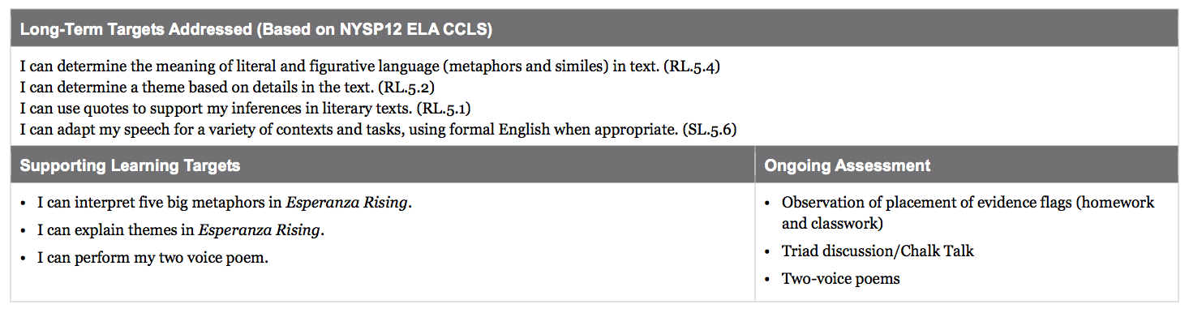

Slide 3
Opening
Reviewing the Anchor Chart: Big Metaphors and Themes in Esperanza Rising (2 mins)

Slide 4
Big Metaphors and Themes Anchor Chart
Talk with your triad about what big metaphors or themes you noticed in the last two chapters.

Slide 5
B. Engaging the Reader: Preparing for Chalk Talk (8 min)
Throughout your study of the novel, you’ve had time to reread key passages, think on your own, and then talk with your triads. Today, you will do the same.

Slide 6
Learning Target
“I can interpret five big metaphors in Esperanza Rising.”

Slide 7
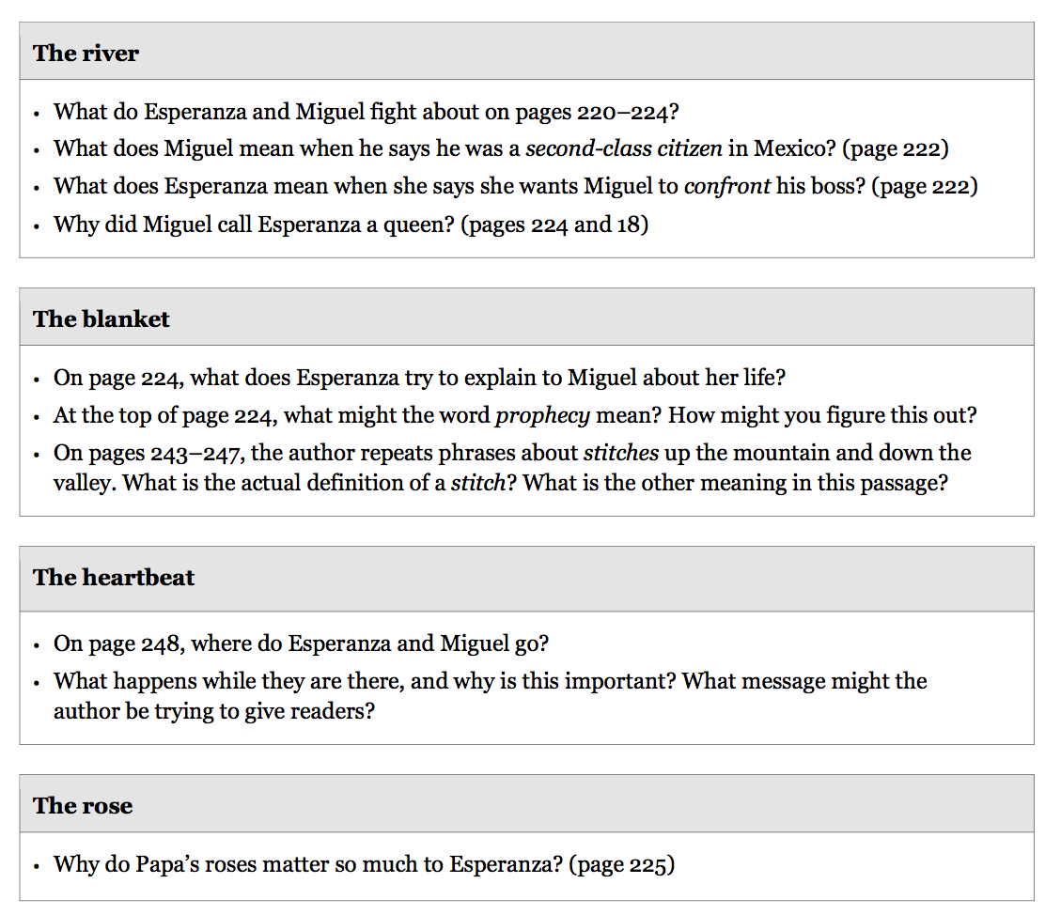
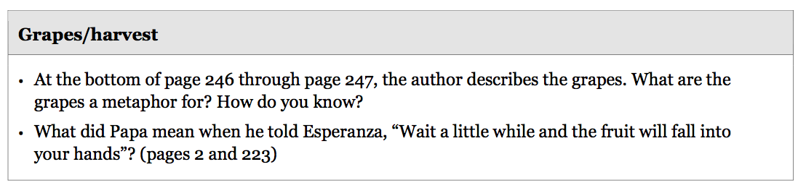
Text Dependent Questions
Mark evidence on your own to prepare for the Chalk Talk. It’s okay if you don’t get to every question, you’ll have more time to discuss with your triad.

Slide 8
Work Time
Chalk Talk: Big Metaphors and Themes in Esperanza Rising (15 mins)

Slide 9
Purpose for Reading Review
How do the “big metaphors’” in this novel show up again in these last two chapters? Why do you think Pam Muñoz Ryan did this?
Review your evidence flags from your hw and your independent work to prepare for our Chalk Talk.

Slide 10
Chalk Talk Protocol
This is a silent activity...no one may talk at all
Each triad will have a different color marker
Start writing at the top of the chart
Take turns writing, so everyone has a chance to share their ideas

Slide 11
You are going to go with your triad to each of the five Chalk Talk charts and discuss the following two questions:
How does this big metaphor show up again in the last 2 chapters?
Why did the author do this? How does this “big metaphor” help us understand an important message or theme in the novel?

Slide 12
B. The Grapes Metaphor: Whole Class Discussion (15 mins)
What can we say about the grapes metaphor?
What did Papa mean when he told Esperanza, “Wait a little while and the fruit will fall into your hands?” (p. 2 and 223)

Slide 13
C. Finalizing and Performing Two-Voice Poems (15 mins)
You will have 10 minutes to revisit your two-voice poems with your writing partners. Make any final revisions and practice delivering your poem together. Groups that are ready will perform today.

Slide 14
Closing and Assessment
Celebration (5 min)

Slide 15
