Slide 1
Norms for Giving Feedback
Be kind
Be helpful
Be specific

Slide 2
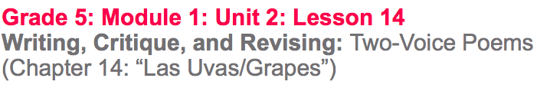

Slide 3
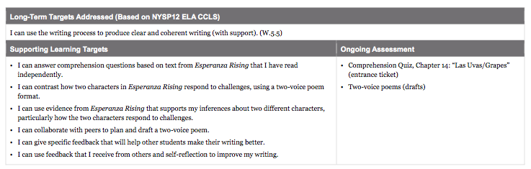

Slide 4
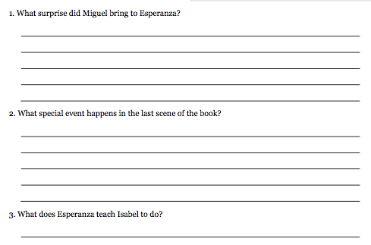
Entrance Ticket: Comprehension Quiz, Chapter 14: “Las Uvas/Grapes”

Slide 5
B. Engaging the Reader: Oral Chapter Review
What was the chapter mostly about?
Why was it titled “Grapes”?
We will continue to talk about the last two chapters in the next lesson, but our main purpose for today is to keep working on our two-voice poem.

Slide 6
Work Time
Collaborative Work: Drafting a Two-Voice Poem (10 mins)

Slide 7
Learning Targets
I can contrast how two characters in Esperanza Rising respond to challenges, using a two-voice poem format.
I can use evidence to support my inferences about two different characters.

Slide 8
Success Criteria
two voices speak together for things that are similar.
each voice is clear, distinct, and consistent
the writer balances the lines said separately and those read together
the writer uses figurative language to make the writing engaging.

Slide 9
You’ll have 5-6 mins with your partner to continue working on the draft of your poem.
Remember, our purpose isn’t to write a perfect poem, but to think about how the characters are similar and different, and what that tells us about themes in the novel.

Slide 10
B. Peer Critique: Praise-Question-Suggest Protocol (20 min)
“I can give specific feedback that will help other students make their writing better.”
“I can use feedback that I receive from others to improve my writing.”

Slide 11
You will now critique another group’s poem. Remember to give:
1 praise (positive)
1 question
1 suggestion.
Be specific to the learning targets so they can revise.

Slide 12
C. Revising Two-Voice Poem (15 min)
You will now have time to revise your poem based on the feedback you just received.
Tomorrow, you will have more time to finish your poem, and then you’ll get to perform them in front of the class.

Slide 13
Closing and Assessment
Debrief (5 min)
You will get to finalize and perform during our next lesson. How is the process going? Are there questions?

Slide 14


Slide 15
