Slide 1
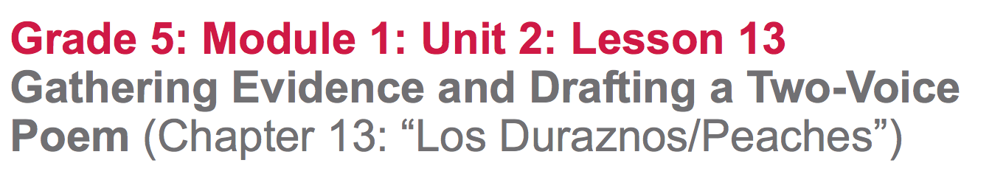

Slide 2
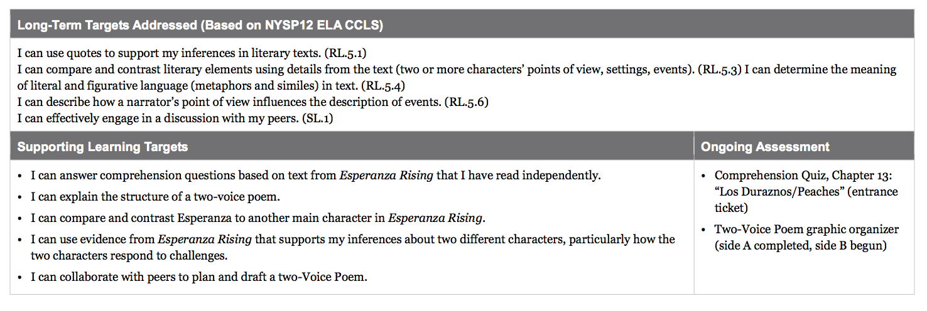

Slide 3
Opening
Entrance Ticket: Comprehension Quiz, Chapter 13: “Los Duraznos/Peaches”

Slide 4
B. Engaging the Reader: Oral Chapter Review
What was this chapter mostly about?
What happened in this chapter?
Why do you think Miguel left the camp?
What could you write on your evidence flag to help you remember what this chapter was mostly about?

Slide 5
At the end of the chapter, Esperanza experiences two surprises. What are they?

Slide 6
Work Time
Mini Lesson: Two-Voice Poem (15 mins)

Slide 7
Learning Target
I can compare and contrast Esperanza to another main character in Esperanza Rising.”
What do the words compare and contrast mean?

Slide 8
Today, we are going to get to be creative as you compare and contrast your characters. You will be working with a partner to write a two-voice poem.

Slide 9
Learning Target
I can explain the structure of a two-voice poem.
What does the word “structure” mean?

Slide 10
A two-voice poem is written for two people to perform. The poetry usually has two columns--one for each person who is reading the poem. Each person reading the poem reads the text in one of the columns. Sometimes, the poet wants the two readers to say something at the same time, so the poet writes the words on the same line in each column. These poems often sound like dialogue.

Slide 11
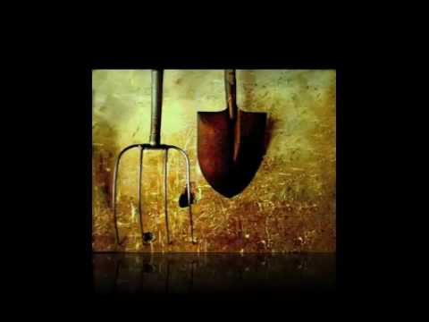

Slide 12
What did you learn about two-voice poems from the video?
Success criteria:
two voices speak together for things that are similar.
each voice is clear, distinct, and consistent
the writer balances the lines said separately and those read together
the writer uses figurative language to make the writing engaging.

Slide 13
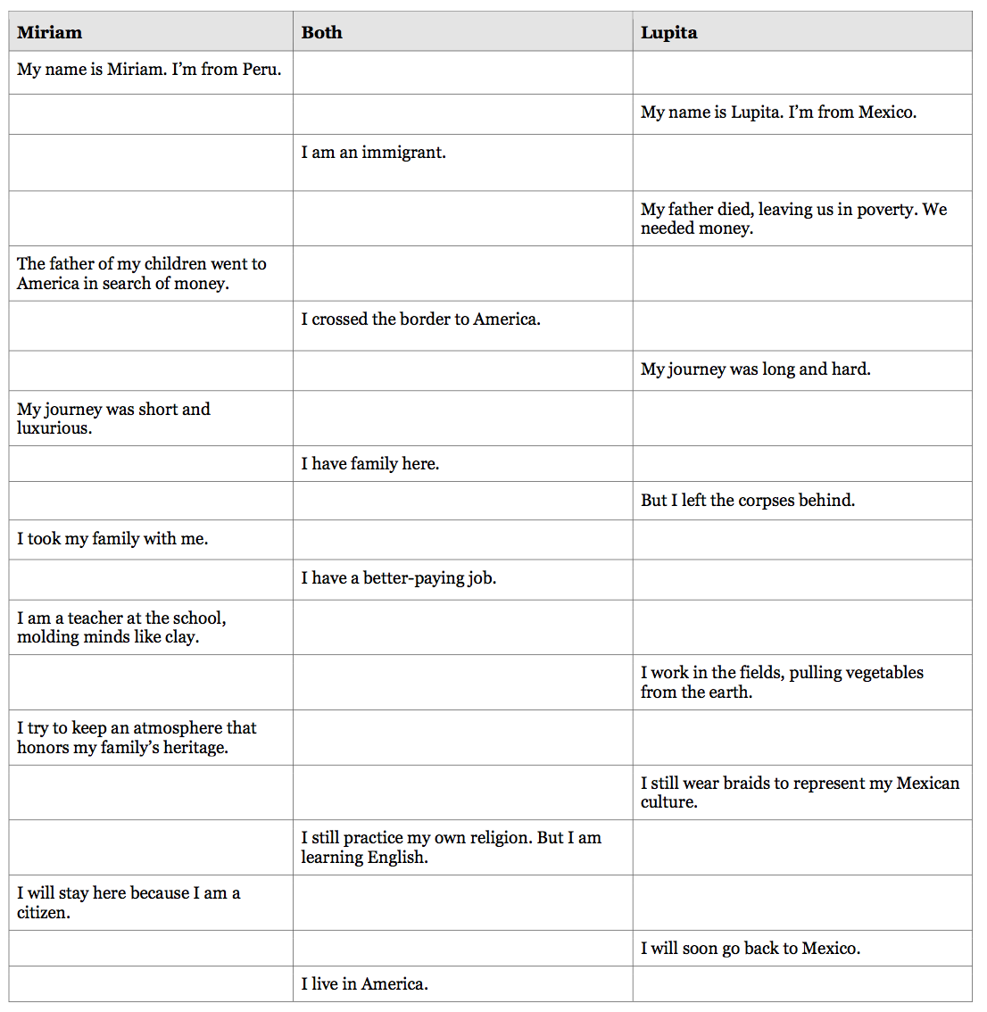
Turn and talk about what you notice about the structure of the poem.

Slide 14
B. Reviewing Character Notes/T-Charts
(15 mins)
Learning Target:
I can use evidence from Esperanza Rising that supports my inferences about two different characters, particularly how the two characters respond to challenges.

Slide 15
Today you will need to choose which character you want to compare and contrast to Esperanza in your two-voice poem. Our purpose is to have a creative way to think more carefully about Esperanza and the other characters, in order to understand important events and ideas in the novel.

Slide 16
Planning My Writing Anchor Chart
Review your notes in your reading journal
Review your evidence flags
Add new evidence flags if you find new evidence.

Slide 17
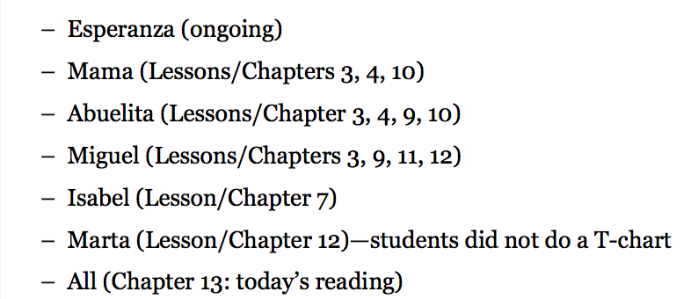
Use this as a guide:
2- Grapes
3- Papayas
4-Figs
5-Guavas
6-Melons
7-Onions
8-Almonds
9-Plums
10-Potatoes
11-Avocados
12-Asparagus
13-Peaches
You’re welcome to review other chapters as well, this is just to get you started.

Slide 18
Decide on which character you want to compare/contrast with Esperanza and review your evidence flags and notes.
On one sticky note, write how your character is similar to Esperanza, citing a page number with evidence. On the other, write how your character is different from Esperanza citing a page for evidence.

Slide 19
C. Collaborative Work: Planning a Two-Voice Poem (15 min)
Rearrange so you are with someone who chose the same character.

Slide 20
Share:
How is this character similar to Esperanza? What is your evidence?
How is this character different from Esperanza? What is your evidence?
*Focus on how they respond to challenges*

Slide 21
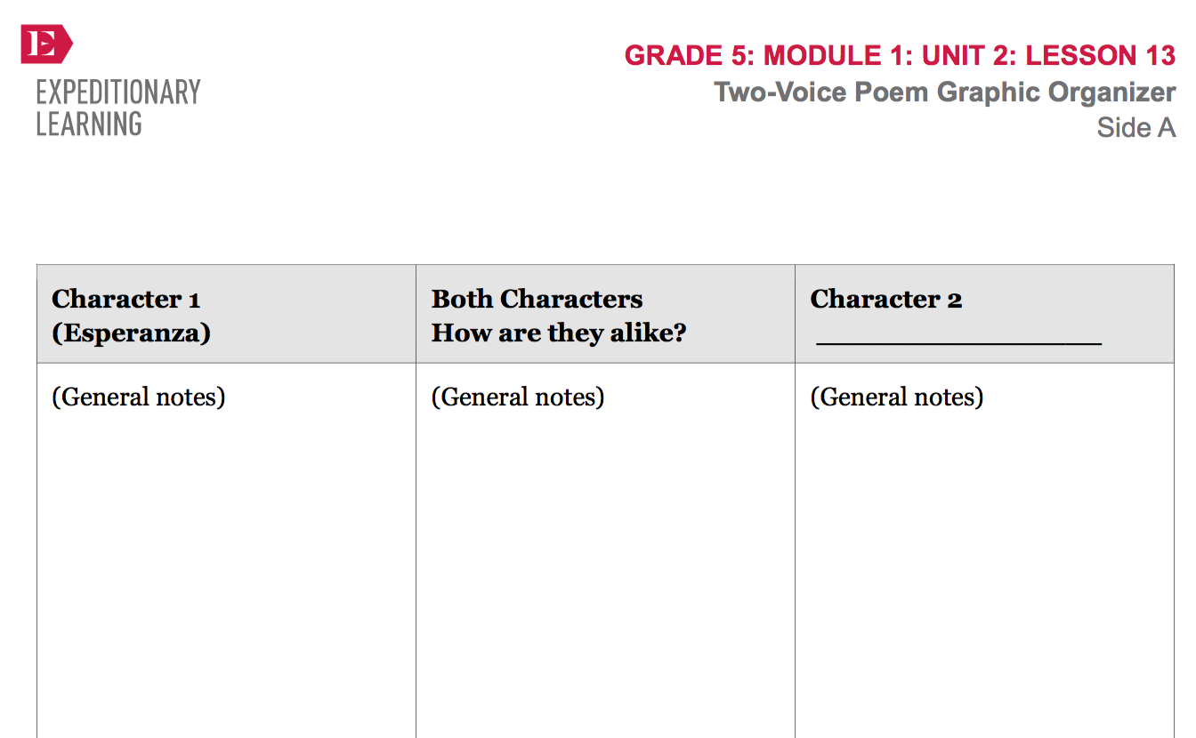
Remember the modeling you saw after watching the YouTube video.
Complete side A of the graphic organizer. I need to sign off on it before
you are able to continue.

Slide 22
After you have collected a rich set of evidence about both characters, you may begin creating your rough drafts (side B). Your poem should include direct quotes from the novel, as well as paraphrases and your own inferences.

Slide 23
You will have a bit more time in the next lesson to work on your draft poem before you get some feedback from your peers. Remember that the poem doesn’t have to be perfect or polished. Our purpose is to think more carefully about Esperanza and the other characters, in order to understand important events and ideas in the novel.

Slide 24
Closing and Assessment
Sharing (5 min)
Share out lines from your draft poem.
peers offer one piece of specific praise: “I like how you _____”.

Slide 25
