Slide 1
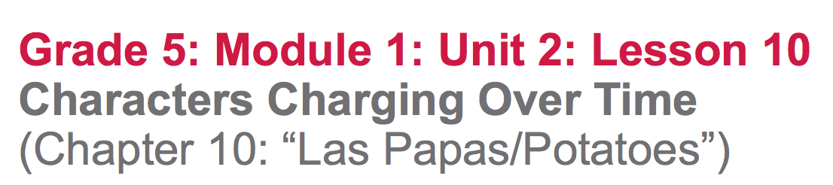
changing

Slide 2
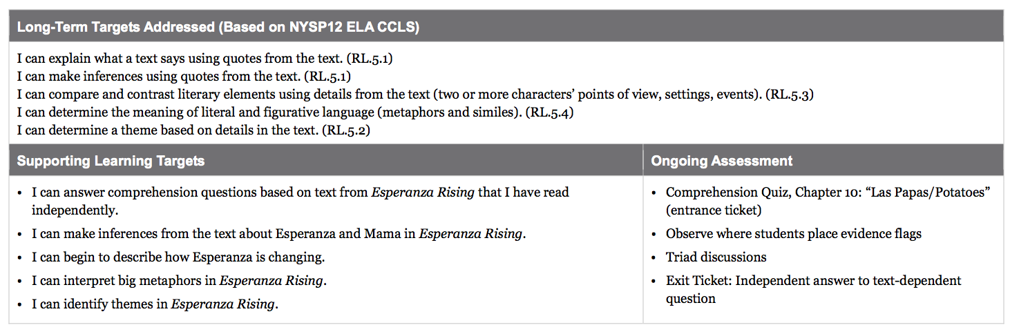

Slide 3
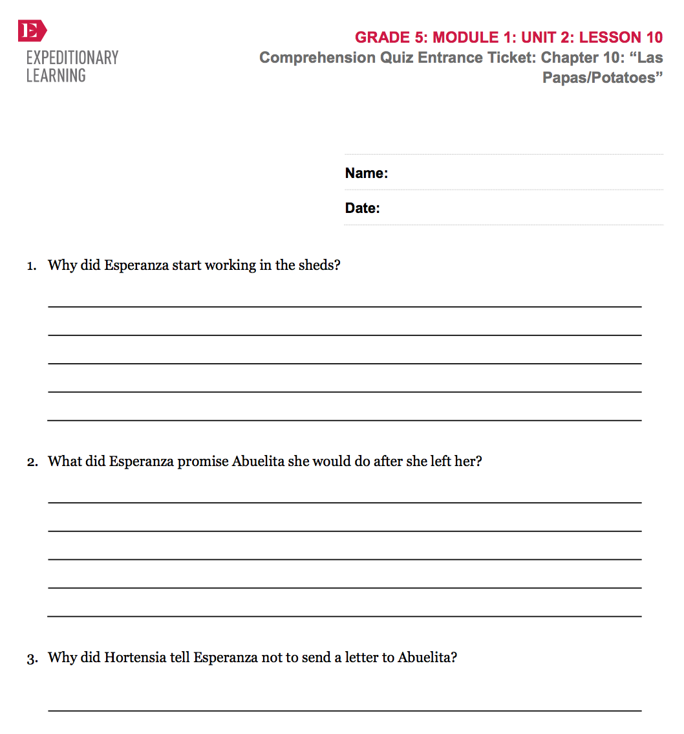
Opening
Entrance Ticket: Comprehension Quiz, Chapter 10: “Las Papas/Potatoes”

Slide 4
B. Engaging the Reader: Oral Chapter Review (5 mins)
What happened in this chapter?
Any questions about parts of the chapter that you didn’t understand?

Slide 5
Can you predict my next question?
Why is this chapter titles “Potatoes”?
Add an evidence flag to the first page of chapter 10 summarizing what the chapter was mostly about.

Slide 6
Learning Targets
“I can begin to describe how Esperanza is changing.”
Remember our “Inferring by using Text Clues” anchor chart that we created together. Use this as a reference as your work during the lesson.

Slide 7
Work Time
Esperanza and Mama: Answering Questions in Triads (15 mins)

Slide 8
Remember, that it’s important that you don’t rush through the questions. The purpose is to have a rich discussion based on evidence. It’s fine if you only get to a few questions, you’ll revisit many of these ideas in future lessons.

Slide 9
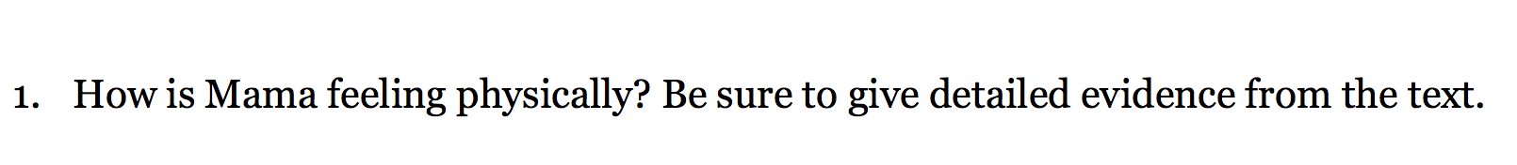
Read pages 158-161 on your own, with this question in mind. Use evidence flags to mark evidence that supports your answer.
Talk with your triad.

Slide 10
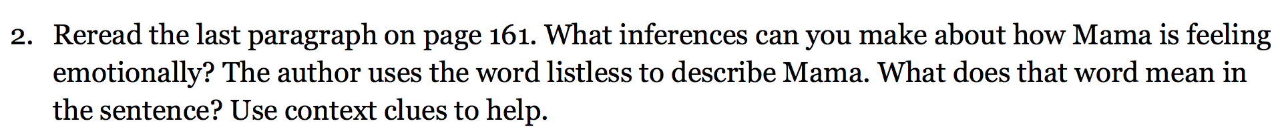
Follow along as I read the last paragraph of page 161 aloud.
Discuss your answers with your triad, rereading as necessary.

Slide 11
Work on the remaining questions within your triad. Remember to:
read the questions aloud
clarify any terms
think on your own
mark evidence with evidence flags.

Slide 12
Take a few minutes to add new thinking to your T-Chart in your reading journals about Esperanza and Mama.

Slide 13
Stand, find a partner, and discuss the following prompt from your homework last night:
“How is Esperanza Changing? Be sure to share evidence from the text with your partners.”
CITE TEXT TO SUPPORT YOUR OPINION

Slide 14
C. Revisiting the Metaphor of Abuelita’s Blanket: Close Reading of Pages 159-161
(15 mins)

Slide 15
Learning Target
“I can determine the metaphors and themes in Esperanza Rising.”
Turn and talk about how you worked with metaphors and theme during lesson 9. Did you notice any of these metaphors again in your reading of chapter 10?

Slide 16
Big Metaphors and Themes in
Esperanza Rising
What metaphors have we already discussed in terms of Abuelita’s blanket? (lesson 9)
Follow along as I read page 159

Slide 17
Text-Dependent Questions
At the bottom of page 159, the text says “Esperanza looked at Mama, breathing uneasily, her eyes closed. It was clear Mama needed Abuelita.”
What does the word uneasily mean? How did you figure that out?
How is it clear that Mama needs Abuelita?

Slide 18
Follow along as I read page 160, from “They both needed her” through “This valley of Mama being sick.”
What metaphor does the author use to describe Mama being sick?
Why do you think the author chose this metaphor?

Slide 19
Notice the phrase in the middle of page 160: “Esperanza picked up the needlework and began where Abuelita had left off.”
Think about what you read yesterday about the blanket, on page 15. What seems important about Esperanza “beginning” the blanket “where Abuelita left off”?

Slide 20
Closing and Assessment
Independent Writing (10 mins)

Slide 21
Review Learning Targets

Slide 22
Writing prompt:
How is Esperanza changing? Cite evidence from chapter 10: “Las Papas/Potatoes” to support your opinion.

Slide 23
B. Debrief (5 mins)
Let’s look at our Big Metaphors and Themes in Esperanza Rising anchor chart.
Do you have any suggestions for new ones we could add?

Slide 24
