Slide 1
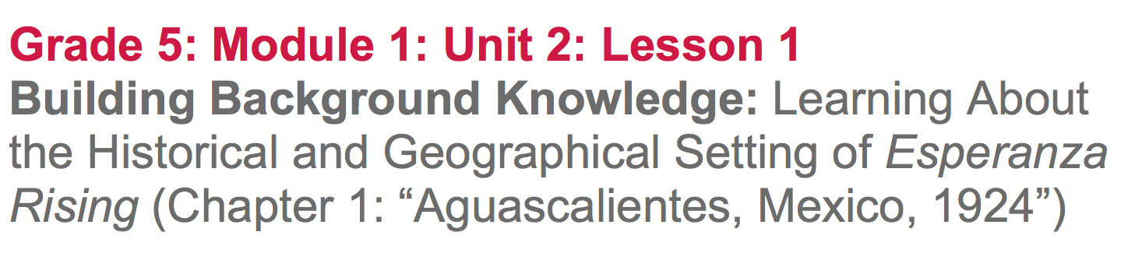

Slide 2
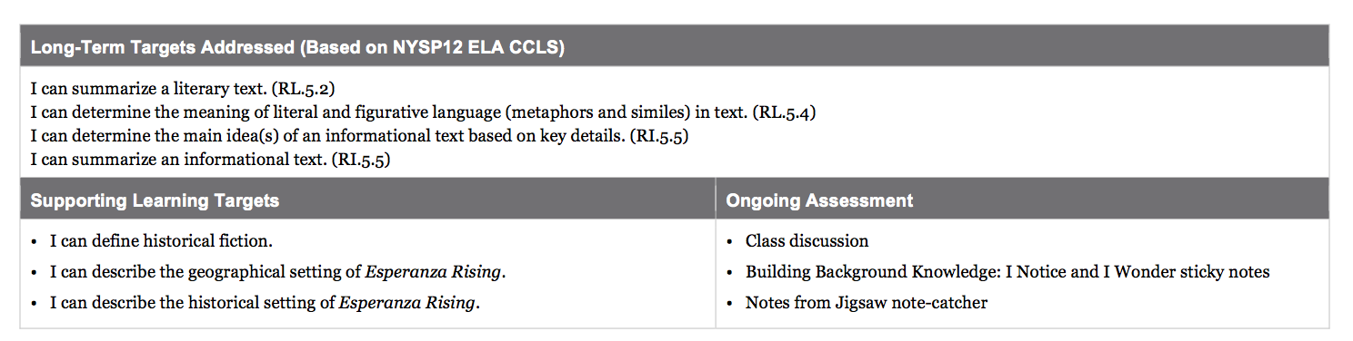

Slide 3
Opening
Engaging the Reader: Read-aloud of Pages 1-3 of Esperanza Rising (10 min)

Slide 4
Learning Targets
I can describe the geographical setting of Esperanza Rising.
What do you know about Mexico?
Today we will begin reading a novel titled Esperanza Rising

Slide 5
Genre
Esperanza Rising is historical fiction. What does that mean?
The story is based on real events, real settings, and some real people, but also includes many imagined events and characters.

Slide 6

As I pass out your books, I want you to examine the image on the cover. What do you notice What do you wonder?
Think-pair-share

Slide 7
Notice the image of the land at the bottom of the cover.
Today, you will begin to get a feel for the setting: the place and time where the events in this novel occur.

Slide 8
Follow along in chapter 1
https://drive.google.com/open?id=0B49Fw8lbut5zWVkxOWt6LTdjNFE
Turn and talk with a partner:
What is this short chapter mostly about?

Slide 9
Work Time
Visualizing the Geographical Setting (15 mins)

Slide 10
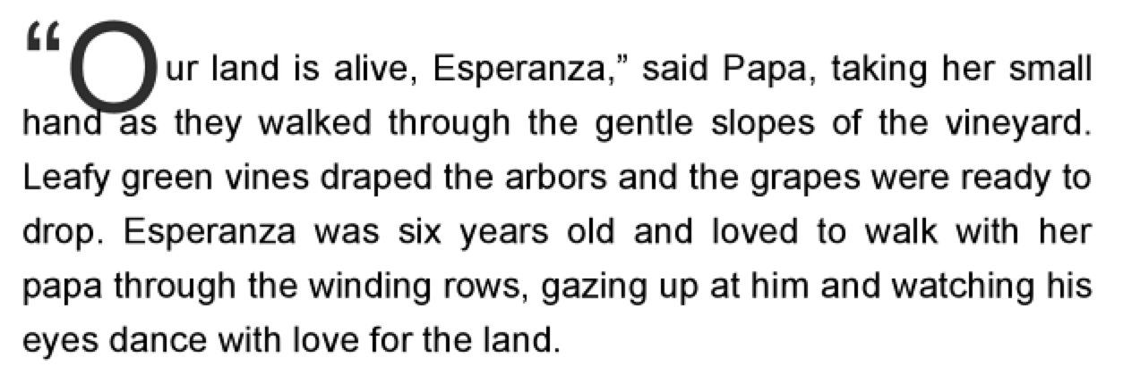
Reread the first paragraph on page 1 silently, trying to picture in their minds what it is like where Esperanza lives

Slide 11
What is it like where Esperanza lives?
What is a vineyard?
What are gentle slopes?
What might Papa mean when he says, “Our land is alive”?

Slide 12
These are evidence flags and we will be using them throughout the unit. Place one titled “Geographical Setting: Mexico” on page 1.

Slide 13
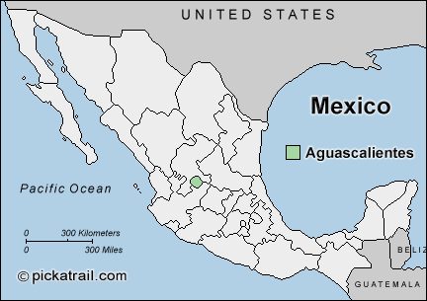
Where is Aguascalientes relative to California?

Slide 14
You’re going to reread Chapter 1 as part of your homework and should continue to focus on details that help you understand what it is like where Esperanza lives.

Slide 15
B. Jigsaw Protocol:
Understanding the Historical Setting (30 min)

Slide 16
In order to fully understand the setting--both the geographical place and historical time period--of the novel, you will spend a little time today building background knowledge about Mexico.

Slide 17
I’m going to place you in triads (groups of 3) and each member is going to focus on a different topic.
Government and Revolution
Neighbor to the North
Rich versus Poor
*Make sure to notice the accompanying pictures.*

Slide 18
You will each read about one topic, and then will share with the other members of your triad. You are not expected to understand everything about your excerpt or pictures. The goal is simply to begin to build basic background knowledge about Mexico. You will keep learning more throughout this unit.

Slide 19
Jigsaw, Part 1:
You will have 15 minutes to independently read your assigned topic, review the pictures, and take notes about your assigned topic on your Jigsaw note-catcher.
Look for key points and new information as you read your section and examine the pictures.

Slide 20
Jigsaw, Part 2:
You will have 10 minutes to share with each other what you learned. Each member in turn shares the important points and summary from the pictures and text they read. As each group member shares, the other students in the group should take notes.

Slide 21
Closing and Assessment
Go-Round Oral Debrief (5 min)

Slide 22
Consider what you know about Mexico and anything you might already know about the novel Esperanza Rising.

Slide 23
Learning Targets
I can describe the geographical setting of Esperanza Rising
I can describe the historical setting of Esperanza Rising

Slide 24
Lets share our ideas in a go-round.

Slide 25
Homework Routine
You will do a “first draft” reading of a new chapter each night. You will always be given a purpose for reading: a question to think about as you read. You should keep track of your thinking with evidence flags. You will practice this each day, but the basic idea is to mark passages that relate to the homework question. You DO NOT need to write out answers to the homework question, but you will need to be prepared for a discussion about the question.

Slide 26
You will practice using evidence flags throughout the unit, and you will get better at finding and citing evidence over time.
For homework tonight, you should just “have a go” trying to mark evidence that relates to the homework question.

Slide 27
