Slide 1
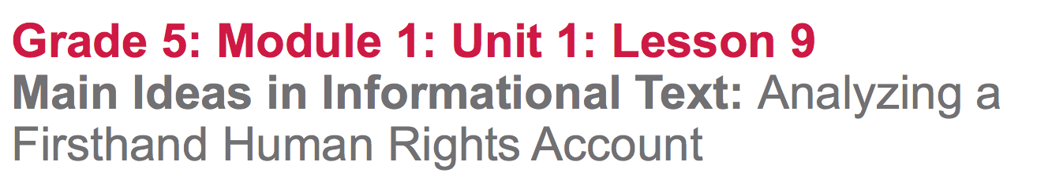

Slide 2
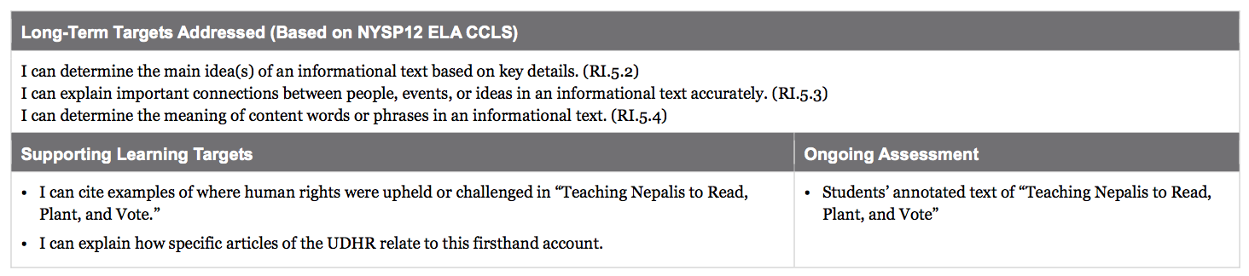

Slide 3
Opening
Engaging the Reader (5 mins)

Slide 4
Learning Targets
I can explain how specific articles of the UDHR relate to this firsthand account.
Today you will be reading a different type of informational text, and one of your first goals will be simply to understand and explain who is involved and what happened.

Slide 5
Learning Targets
I can cite examples of where human rights were upheld or challenged in “Teaching Nepalis to Read, Plant, and Vote.”

Slide 6
Turn and talk to a partner:
What are some of the human rights you remember from the UDHR?

Slide 7
Work Time
First Read of Paragraphs 1-4: What is This Firsthand Account About? (15 mins)

Slide 8
Today, you are going to “chunk” this longer text, reading it in shorter sections and thinking about each section.
Until now, you’ve been reading UDHR articles: short, difficult bits of text. Today, you will read longer text.

Slide 9
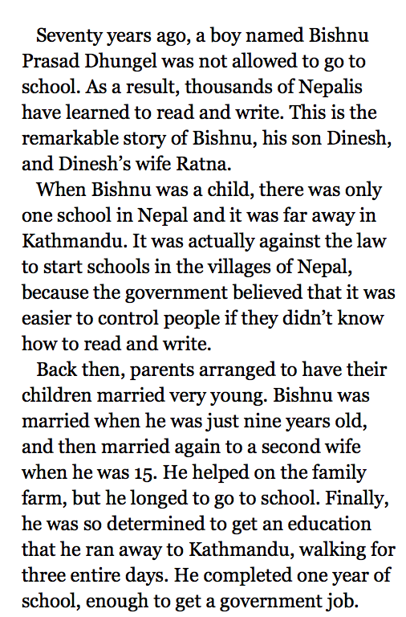
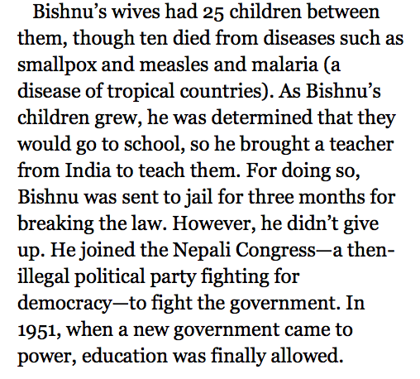
Follow along as I read the first 4 paragraphs aloud

Slide 10
Remember that we’ve been learning to read text closely. Let’s review our anchor chart from lesson 1 of what close readers do.
Read the text slowly at least twice
Circle words you aren’t sure of and try to figure them out
Reread, annotate, and underline key vocabulary
Talk to each other about what you think it means.
Read to summarize or answer specific questions.

Slide 11
You’re going to follow the same sort of process today with this text, although it is longer and may require some different approaches. These steps aren’t a “formula.” Our main goal is to pay careful attention to text, rereading and continuing to think about it more precisely.

Slide 12
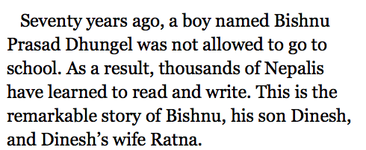
Give the 1st paragraph a try. Reread it on your own annotating for gist and writing clarifying questions in the margins as you need to. Think:
What is this first paragraph mostly about?

Slide 13
Turn and talk with a partner about your annotations and questions

Slide 14
Repeat the same process with paragraphs 2-4:
Reread
Annotate for gist and ask clarifying questions
Return to the text to find answers

Slide 15
We will return to some of the important ideas in the text--like why a government would want its people not to be able to read--during additional read-throughs. For now, we are simply reading for gist and to ask clarifying questions.

Slide 16
B. Second Read of Paragraphs 1-4: Annotating for Vocabulary Related to Human Rights (10 mins)

Slide 17
Remember that annotating is reading and marking text for a specific purpose.
On your first read, you annotated for the gist and to ask clarifying questions. Now, you will reread to look for words or phrases in this first-hand account that relate to human rights, based on your knowledge of the UDHR.

Slide 18
In the next lesson, you will reread the UDHR and connect it to the article.
Today, the goal is to work with just the vocabulary in the context of this firsthand account and think about which words connect to human rights.

Slide 19
Beginning with paragraph 1, circle words that relate to a specific human right.

Slide 20
Continue the task with paragraphs 2-4. Remember to focus on words or phrases that relate to human rights. As before, you should do this first individually, then talk with a partner about what you found.

Slide 21
C. First and Second Read of Remaining Three Chunks of Text (25 mins)

Slide 22
Paragraphs 5-7
Repeat this cycle with the second section of text:
Read aloud as students follow along
Students read for the gist, ask clarifying questions, annotate, and then talk with a partner
Students reread, underlining words related to human rights, then talk with a partner

Slide 23
Repeat for section 3: Paragraphs 8-10
Section 4: paragraph 11-end

Slide 24
What is the article mostly about?
What are you realizing about human rights around the world?

Slide 25
Closing and Assessment
Debrief (5 mins)

Slide 26
Think on your own:
How did certain words in the text help you understand the human rights issues in this first hand account? Be sure to give evidence from the text in your explanation.
Turn and share with your partner

Slide 27
Homework
Go back through the text and add 3-5 new vocabulary words to your glossary.
Answer in writing:
How does something that happened 70 years ago in a country on the other side of the world relate to me? Why should I care?

