Slide 1
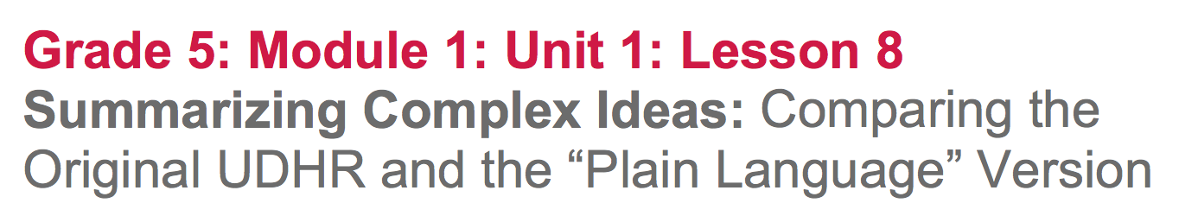

Slide 2
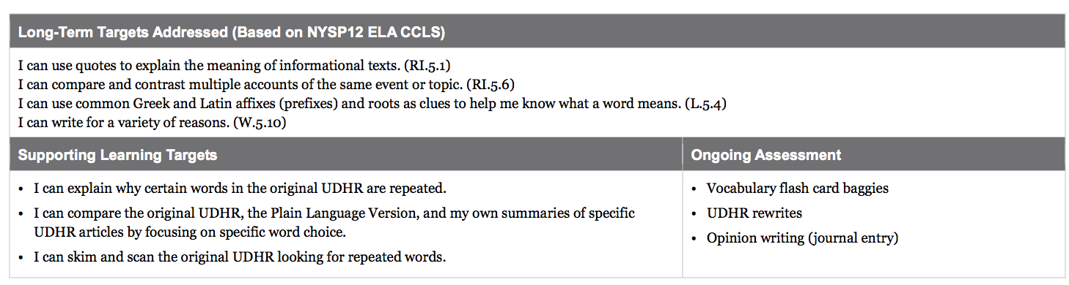

Slide 3
Opening
Engaging the Reader (5 mins)

Slide 4
Share with a partner how it went explaining the complex Universal Declaration of Human Rights to someone at home.

Slide 5
Learning Target
I can explain why certain words of the UDHR are repeated.
What is the meaning of the word “repeated?”

Slide 6
Learning Target
I can compare the original UDHR , the plain language version, and my own summaries of specific UDHR articles.

Slide 7
The original UDHR is a very challenging text and you all have been working really hard to understand the big words and ideas.
After reading closely, annotating some of the articles in the UDHR, and trying to explain an article at home, why might we want to rewrite it in simpler language?

Slide 8
B. Interactive Words (10 mins)
We are going to do a brief activity to continue to build your knowledge about vocabulary in the UDHR.

Slide 9
Take out your glossaries and find a partner
Using the Interactive Words symbols, arrange your words in a way that shows their relationship. ex: fundamental+rights=dignity
You should use all of the words.
Once completed, share with another group and explain your arrangement of the words

Slide 10
Work Time
Repeated Words and Phrases in the UDHR: Why Do They Matter? (15 mins)
You will need your original copies of the UDHR as well as your note-catchers.

Slide 11
Purpose
Readers approach text differently depending on their purpose for reading. During most of this unit, we have been reading very slowly, closely, and deliberately, taking time to try to understand every single word. Today, I am going to ask you to do something else: skim and scan.

Slide 12
Skim & Scan
To “skim and scan” is to read the text very quickly looking for something specific.
Individually, skim all 30 articles, looking for repeated words or phrases.
The purpose here isn’t to understand everything, but to find words that show up over and over.

Slide 13
Talk with your partner about the repeated words or phrases you found.
Share with the class
everyone, no one, without limitation, without discrimination
WRITE-Pair-Share:
What was the purpose of including these words and phrases and repeating them so often?

Slide 14
The authors crafted the document to emphasize the idea of “universal.”
What does ‘universal’ mean?
do you recognize any words within ‘universal’?
In the UDHR, when the authors use the word universal, what meaning do they intend? Are they referring to the physical universe, planets, galaxies, etc?

Slide 15
Turn and talk with your partner about what meaning was intended.
The authors sought to emphasize that human rights have no exceptions.
Notice the ending of universal. This is a common way to signal an adjective, so universal is describing human rights.

Slide 16
B. Word Choice and Meaning: Comparing the Original UDHR to the Plain Language Version (20 mins)

Slide 17
The authors of the UDHR wanted everyone on the planet to know, understand, and honor the rights described in the document.
Consider the importance of being able to explain the ideas embodied in this document in simple language that anyone could understand and embrace.

Slide 18
Many organizations have simplified the UDHR to make it easier to understand.
Today, we will look at one of those simplified versions, called the Plain Language Version. Plain, means simple in this context.

Slide 19
Take a moment to skim the document looking for repeated words or phrases, as we did with the original.
Turn and talk about what words and phrases you notice being repeated.

Slide 20
Remember how we “chunked” the UDHR by putting boxes around specific articles that we would focus on? Let’s do the same with the Plain Language Version.
Draw one box per article around Articles 1, 2, 3, 6, 14, 16, 17, 20, 23, 25, and 26

Slide 21
Focus on the one or two articles that you became experts on in lesson 7.
Talk with a partner about the comparisons.
What words are the same?
What words are different?

Slide 22
Do you think this Plain Language Version is better or worse than the original? Why?
Simplified versions serve a purpose, making harder things easier to understand. Authors must choose words carefully, because anything changed from one version to another runs the risk of losing some of the original meaning.

Slide 23
With your partner, choose one or two specific articles to focus on for the next task.
Consider:
What is gained in the Plain Language Version? In other words, how is it better?
What is lost in the Plain Language Version? In other words, how is it worse?

Slide 24
On your UDHR note catcher, take a few moments to revise or add in new understanding that you have after reading the Plain Language Version today.

Slide 25
Closing and Assessment
Opinion Writing: What is Lost and Gained in the Plain Language Version? (10 mins)

Slide 26
Journal Write
What is gained in the Plain Language Version of the UDHR? What is lost?
You may focus on one article or the whole document. Either way, you should use quotes from the original UDHR as well as the Plain Language Version as evidence for your answer.

Slide 27
