Slide 1


Slide 2
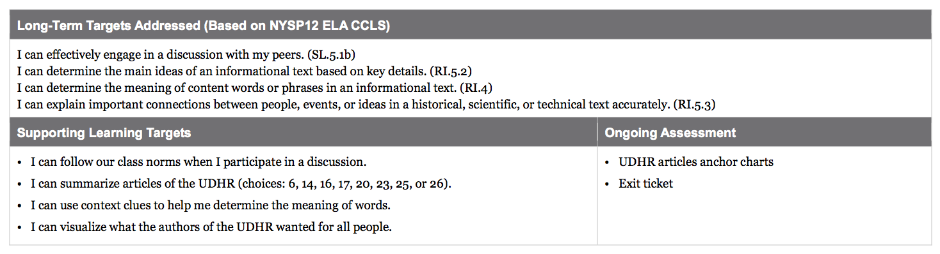

Slide 3
Opening
Engaging the Reader and Reviewing Key Vocabulary (5 mins)

Slide 4
When we left off yesterday, you had read closely and made charts about Articles 2 and 3 of the UDHR. Today, you will continue this process in groups, becoming experts on more articles.

Slide 5
Learning Targets
I can follow our class norms when I participate in a discussion
I can summarize articles of the UDHR
I can use context clues to help me determine the meaning of words
I can visualize what the authors of the UDHR wanted for all people

Slide 6
Recommended Rights Anchor Chart
I made this chart after looking at the work you did at the start of the lesson yesterday when you were talking with partners about what we thought should be included in the UDHR. Which rights from our list did we find in the UDHR articles we read yesterday?

Slide 7
What words did we find that helped us to understand those articles?
endowed
entitled
distinction

Slide 8
Work Time
Jigsaw Protocol, Part 1: Expert Groups on Articles 6, 14, 16, 17, 20, 23, 25, and 26 of the UDHR (25 mins)

Slide 9
I am going to place you in Article Expert groups.
You will need your copies of the UDHR and the UDHR note-catcher, both from lesson 1.
I’m going to pass out your expert group sheets. Each person is responsible for becoming an expert on their assigned article(s)

Slide 10
Close Readers Do These Things
Read the articles slowly at least twice
Reread, annotate, and underline key vocabulary
Read again to summarize: “What right is this article referring to?”
Read again to answer the specific questions
Sketch the right kept and broken

Slide 11
When you come to words that you don’t know, use the strategies that we’ve learned:
Use context clues
Use prefixes and roots
If you’re still unsure, look up in the dictionary.

Slide 12
You will have approximately 20 minutes to work independently. After that time, I will give you about 5 minutes to share and compare answers with your group.

Slide 13
B. Jigsaw Protocol, Part 2: Mixed Article Groups Sharing our Expertise (10 mins)

Slide 14
I’m now going to rearrange you into mixed article groups.
You will have 10 minutes for each person to share with the whole group what they learned about their assigned articles.

Slide 15
As your peers explain each article, you should fill in the UDHR note-catcher with a summary only. You do not have to write out the answers to other groups’ questions or copy the other person’s sketches.

Slide 16
C. Anchor Charts (10 mins)
Notice the charts for these 11 articles around the room.
Remember, you have already summarized and sketched on the charts for Articles 1, 2, and 3. Now, you will do the same for the articles you read today.

Slide 17
Go and stand by one of the articles that you became an expert on today.
How would you describe this article in a phrase?
What would it look like when the right is kept?
Choose one image you all agree on and sketch it on the anchor chart
List 2-3 words from the article that seem important

Slide 18
Closing and Assessment
Debrief (5 mins)

Slide 19
Exit Ticket
I used to think that human rights_______________ but now I know that ____________________.

Slide 20
