Slide 1


Slide 2
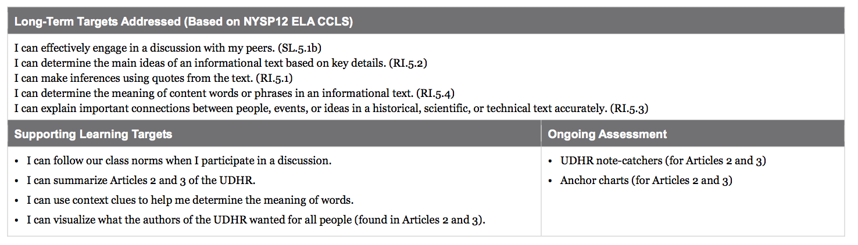

Slide 3
Engaging the Reader: Give One, Get One (10 min)

Slide 4
On our mid-unit assessment, you used all of your new vocabulary words to explain human rights to someone else. Now, we are going to dig back in to the UDHR to think about the specific rights that are included in this primary source document.

Slide 5
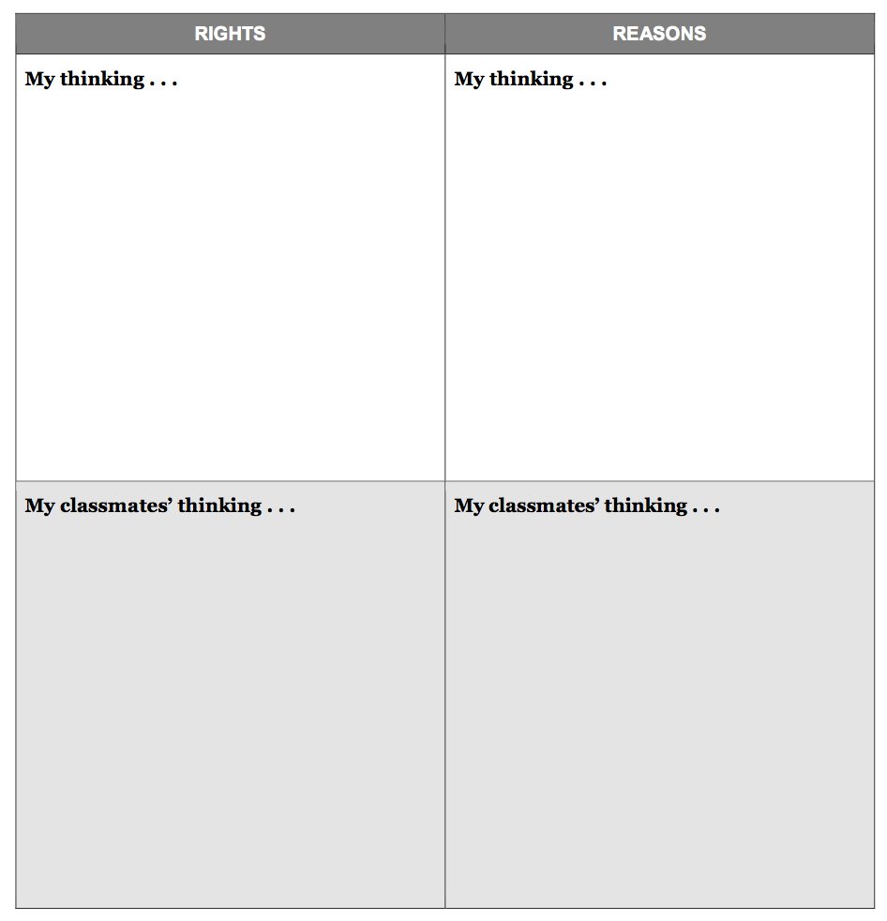
In the top left box, list some rights that you think should be human rights and in the box on the right, explain why.

Slide 6
Give One, Get One
When instructed, stand with your note-catcher
Circulate around the room, talking to at least 3 people.
With each classmate, tell one right that you put and the reason for including it.
Your classmate will then share with you.
If your lists are the same, move on
If your partner has something different, write it down in the bottom section.

Slide 7
Learning Target
I can follow our class norms when I participate in a conversation.
How did you do on following the class norms during this activity?

Slide 8
Learning Targets
I can summarize Articles 2 and 3 of the UDHR
I can use context clues to help me determine the meaning of words
I can visualize what the authors of the UDHR wanted for all people

Slide 9
Text Structure: Reorienting to the UDHR (5 min)
Take out your copies of the UDHR and your lesson 1 note catchers.

Slide 10
During lesson 1, we spent some time noticing how the document is structured.
Turn and talk with a partner about what you remember or what you notice now.

Slide 11
For the next few days, you will focus on some of the specific numbered articles.
Locate that part of the document.

Slide 12
Remember that each article, or section, identifies a right that the authors of the UDHR believed should be afforded all human beings.

Slide 13
Look back at what you wrote and drew in lesson 1 for Article 1.
Turn and talk about what Article 1 is about and about the sketches you made.

Slide 14
Draw a box around Article 1.
Now, do the same around Articles 2, 3, 6, 14, 16, 17, 20, 23, 25, and 26 (1 box per article)

Slide 15
Readers often break long or hard text into smaller chunks. We are just going to focus on these 11 articles and get really smart about them.
We will keep coming back to these articles in the coming weeks, as we think about how real and fictional characters respond when they face challenges.

Slide 16
B. Close Reading: Articles 2 and 3 of the UDHR (30 mins)
You will be working in groups of 4 during this lesson and the next.

Slide 17
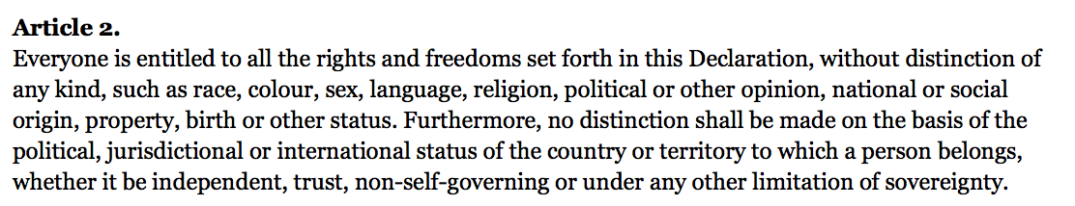
Teacher, read aloud 2x (do not discuss content)
Think, pair, share, write:
Which right(s) do you think this article is referring to?
Write your thoughts next to Article 2 in the UDHR.

Slide 18
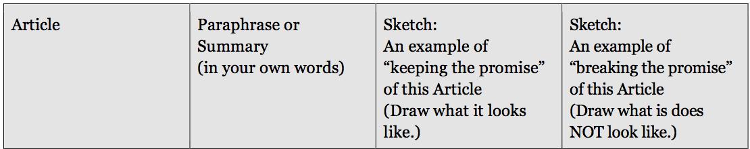


Slide 19
Reread just the 1st sentence of Article 2 focusing on words or phrases that might help you determine what right it’s referring to.
“Everyone is entitled to all the rights and freedoms set forth in this Declaration, without distinction of any kind, such as race, colour, sex, language, religion, political or other opinion, national or social origin, property, birth or other status.”
Underline 2-3 words

Slide 20
For today’s lesson, we will be focusing on just this first sentence.
REREAD:
“Everyone is entitled to all the rights and freedoms set forth in this Declaration, without distinction of any kind, such as race, colour, sex, language, religion, political or other opinion, national or social origin, property, birth or other status.”

Slide 21
What rights is this article referring to?
What specific words help you know that?

Slide 22
Text Dependent Questions
What features of human beings does Article 2 list?
What is property?
Based on the fact that there is a list of human qualities here, what do you think “without distinction of any kind” means?
The word “origin” here means “where someone comes from.” What does national or social origin mean?

Slide 23
Can anyone share a brief paraphrase or summary of Article 2?
Let’s record our paraphrase in column 2 of our note-catcher

Slide 24
Remember how you imagined what Article 1 would look like?
Do the same with Article 2:
Imagine what Article 2 would look like
As you make your sketch, remember, it doesn’t matter how good it is, it’s just to help you remember the main idea.

Slide 25
What would it look like if Article 2 weren’t being upheld?
Sketch that image in the fourth column.

Slide 26
For now, we are going to move on to Article 3.
We just completed another close read. Notice just how much time we spent on just one sentence!

Slide 27

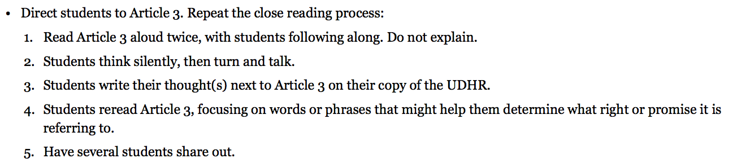
Article 3

Slide 28
Security
Who selected this word?
What root does the word security have in it?

Slide 29
What right or promise is Article 3 referring to?
What specific words help you know that?

Slide 30
Text Dependent Questions
What does it mean to have the “right to life”?
What is the difference between liberty and security?

Slide 31
Paraphrase
Work with a partner to paraphrase article 3.
Sketch:
What does it look like? What does it look like when this right is not being upheld?

Slide 32
Anchor Charts: Summarizing and Sketching: Articles 2 and 3 (10 mins)

Slide 33
Module Article 1 Anchor Chart (teacher)

Slide 34
Notice the multiple charts around the room for Articles 2 and 3.
Choose one article and go stand by that chart.

Slide 35
How would you put this article in your own words?
Write them on the chart

Slide 36
B. Debrief (5 mins)
Using the Fist to Five protocol, rate yourselves on meeting our learning targets.

Slide 37
Exit ticket
Complete the sentence:
“One human right I learned more about today is…”

Slide 38
