Slide 1


Slide 4
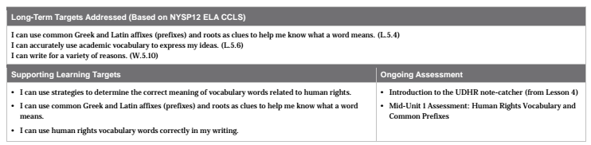

Slide 5
Opening
Engaging the Reader: Review of Introduction to the UDHR Note-catcher (10 mins)

Slide 6
Learning Targets
I can use strategies to determine the correct meaning of vocabulary words related to human rights.
I can use common Greek and Latin affixes (prefixes) and roots as clues to help me know what a word means
I can use human rights vocabulary words correctly in my writing.

Slide 7
Take out your Introductions to the UDHR note-catchers that you completed for homework.
I’m going to partner you up for this review...it won’t be free choice this time.

Slide 8
Share the work you did on your Introduction to the UDHR note-catcher, comparing the main ideas and important words that you found. You can change or add to your note-catchers as you wish based on this discussion.
Early finishers review vocabulary words.

Slide 9
What strategies did you use to identify important words?
What strategies did you use to figure out the meaning of important words?

Slide 10
Work Time
Visualizing Word Meanings: Group Tableaus (20 mins)

Slide 11
Human Rights
We have talked for the last several days about this phrase. What are human rights?
Human rights are the things that the authors of the UDHR believe should be true for all people.

Slide 12
What are some rights that you or the authors of the UDHR think that all people should have?

Slide 13
Human Rights

Slide 14
We have just thought of a picture that you can make using people. This is sometimes called a tableau. I am going to ask you to work in groups of 2 or 3 to think about a picture of people, or tableau, that would represent one of the vocabulary words on our flash cards. Remember that tableaus are like pictures--no talking or acting out. Everyone is frozen in a scene.

Slide 15
Each group will now present their tableau to the whole class. The audience will attempt to guess which word each tableau represents.

Slide 16
How does visualizing and acting out difficult words help you remember what texts are about?
Use this skill to visualize the vocabulary words as you are taking your assessment today.

Slide 17
B. Mid-Unit 1 Assessment:
Human Rights Vocabulary and Common Prefixes.

Slide 18
Today you will meet the learning targets by showing what you know on a vocabulary quiz.
Early finishers may continue annotating the introduction to the UDHR, make new flash cards, or add to your definition of human rights in your notes.

Slide 19
Closing and Assessment
Debrief (10 mins)

Slide 20
Fist-to-Five
Rate yourselves on your success with the vocabulary quiz.

Slide 21
Think...
“I used to think human rights were _______. Now I know human rights are _______”

Slide 22
Homework
None :)

