Slide 1


Slide 2
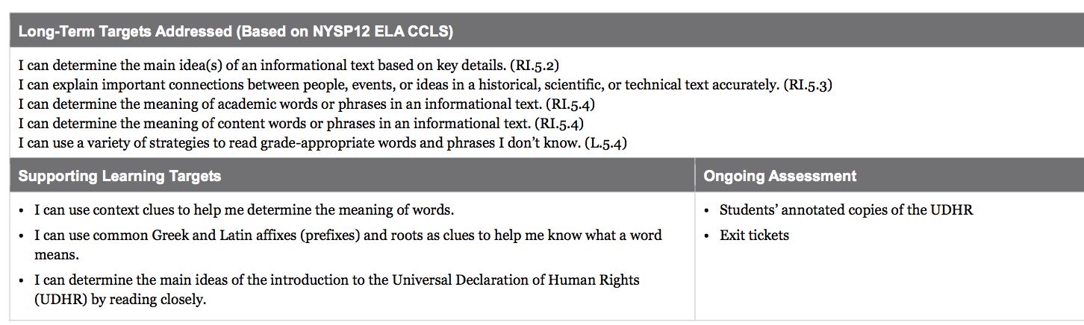

Slide 3
Opening
Engaging the Reader: Revisiting Article 1 of the UDHR (10 mins)

Slide 4
Take out your copy of the Universal Declaration of Human Rights from lesson 1. Remember, in lesson 1 we looked at this entire document for the way it was structured and then focused on Article 1 in your note catcher. You also looked at Article 1 again briefly in Lesson 3 when you made your flash cards.

Slide 5
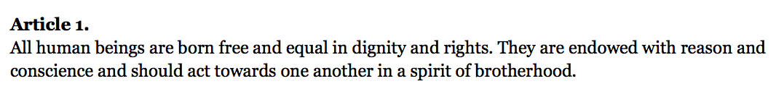
Follow along as I read Article 1 aloud again.
What words have we learned from this article? Why are they important?

Slide 6
Learning Targets
I can use context clues to help me determine the meaning of words.
Yesterday we focused on vocabulary related to human rights, particularly how to figure out important words from context. Today, we will continue practicing that as we read the introduction to the UDHR

Slide 7
I can use common Greek and Latin affixes (prefixes) and roots as clues to help me know what a word means.
I can read the UDHR closely.

Slide 8
Close Readers Do These Things
Read the text slowly at least twice
Circle words you aren’t sure of and try to figure them out
Reread, annotate, and underline key vocabulary
Talk to each other about what you think it means.
Read to summarize or answer specific questions.
When do you think you focus on vocabulary?

Slide 9
Work Time
Modeling and Practicing Closely Reading Paragraph 1 of the Introduction to the UDHR (10 mins)

Slide 10
Remember that in lesson 1 you spent a lot of time looking at the UDHR to notice how it is set up, or structured.
Turn and talk with a partner about something you remember or noticed.

Slide 11
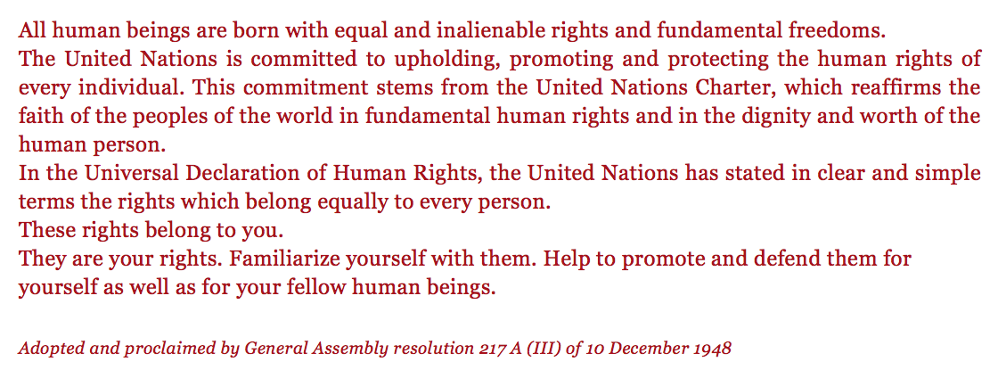

Slide 12
The Introduction
This part is called the introduction. Intro means “the first part.” These short paragraphs are at the very beginning of the document and set up many of the main ideas.
We will read the 1st paragraph closely, which is just one sentence.

Slide 13
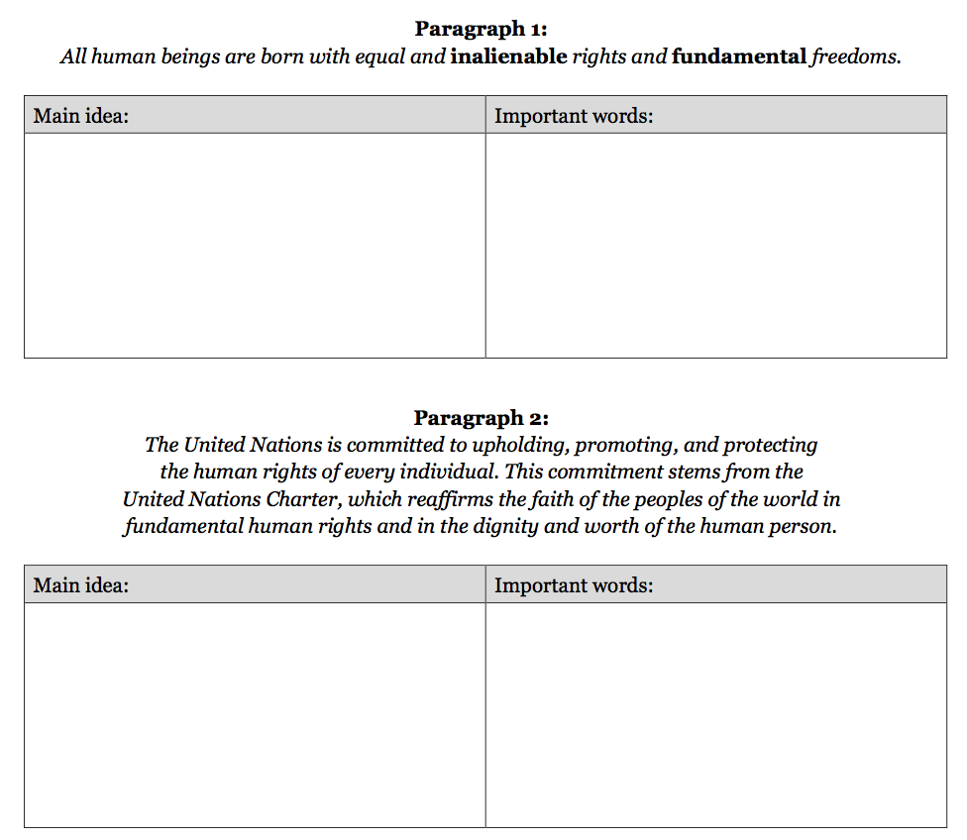
You’re going to use this note-catcher to take notes after you have read and annotated the introduction to the UDHR.

Slide 14
Follow along as I read the 1st paragraph aloud (x2).
“All human beings are born with equal and inalienable rights and fundamental freedoms.”
Now, you read it silently and independently focusing on words or phrases that might help you determine the meaning of this first sentence. Annotate the text by circling unknown words and underlining words you feel are important

Slide 15
Think about what some of the words mean based on the context, or what the entire sentence means.
Share with a partner.
Share with the class.

Slide 16
Reread the 1st paragraph for a third time, focusing on just two or three words that you underlined or circled.
“All human beings are born with equal and inalienable rights and fundamental freedoms.”
fundamental=basic
in=not
alien=separate
inalienable=not separate; can’t be taken away

Slide 17
You’re going to get a lot more practice figure out words from context and using word roots and prefixes as you read the rest of the introduction.
It’s difficult, but you can do it!

Slide 18
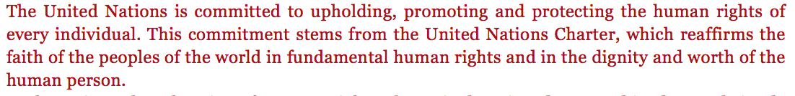
B. Guided Practice Closely Reading Paragraph 2 of the Introduction to the UDHR (15 min)
Draw a slash at the end of the first sentence so we can focus our attention on just the first sentence.

Slide 19
Reread the 1st sentence of paragraph 2.
“The United Nations is committed to upholding, promoting, and protecting the human rights of every individual.”
Focus on the words and phrases that might help you determine the meaning of this sentence (underline). Annotate your text.

Slide 20
Reread this sentence a third time, focusing on just the two or three words you underlined.
“The United Nations is committed to upholding, promoting, and protecting the human rights of every individual.”
What words did you underline?

Slide 21
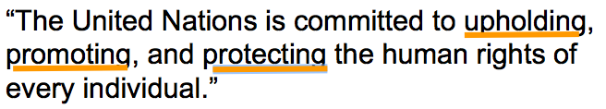
Can we figure out the meaning of these words using context clues?
Let’s look at the morphology (structure) of these words, beginning with the word roots.

Slide 22
What words that you already know do you see in the word upholding?
up=to lift
hold=to keep
uphold=to support or defend something

Slide 23
promoting
pro=prefix meaning “to put forward”
mot=word root that relates to motion
promoting=to move ideas forward to other people

Slide 24
protecting
Do you recognize any familiar words?
pro=prefix meaning “to put forward”
tect=word root that means “to cover”
protecting=moving forward to cover or keep safe

Slide 25
What do you notice about all three of these words?
-ing-they are all verbs

Slide 26
Now that you have worked very closely with the words in this sentence, you may have more of an idea about what the main idea is.
Turn and talk about the main idea of this sentence.
Add to your note catcher

Slide 27
Now, you will repeat this same process with the second sentence of paragraph 2. It’s a difficult text...don’t give up!
(teacher read aloud 2x)
“This commitment stems from the United Nations Charter, which reaffirms the faith of the peoples of the world in fundamental human rights and in the dignity and worth of the human person.”
Think-Pair-Share to discuss the meaning.

Slide 28
“This commitment stems from the United Nations Charter, which reaffirms the faith of the peoples of the word in fundamental human rights and in the dignity and worth of the human person.”
charter=an agreement granting rights and privileges

Slide 29
“This commitment stems from the United Nations Charter, which reaffirms the faith of the peoples of the word in fundamental human rights and in the dignity and worth of the human person.”
reaffirms
re=prefix meaning to do again
affirm=state as a fact
reaffirm=state again as a fact

Slide 30
What is the United Nations committed to doing, and why?
Add to your notes for paragraph 2

Slide 31
C. Independent Practice
Closely Reading Paragraphs 3-5 of the Introduction to the UDHR (10 mins)

Slide 32
You will have just 10 minutes to continue with paragraphs 3-5. I do not expect you to finish in that time, and the remaining portion will be done for homework.

Slide 33
For paragraphs 3-5:
Teacher reads aloud twice, with students following along
Think-Pair-Share the meaning
Focus on words or phrases you think are particularly important
Share out words

Slide 34
Paragraph 3:
“In the Universal Declaration of Human Rights, the United Nations has stated in clear and simple terms the rights which belong equally to every person.”
Stated= clearly expressed or identified
Terms= conditions under which an action may be undertaken or agreement reached

Slide 35
Paragraph 5:
“They are your rights. Familiarize yourself with them. Help to promote and defend them for yourself as well as for your fellow human beings.
familiarize= give (someone) knowledge or understanding of something
defend= resist an attack made on (someone or something); protect from harm or danger

Slide 36
Closing and Assessment
Adding to Our Human Rights Vocabulary Flash Cards (15 mins)

Slide 37
Make flash cards based on the words we’ve learned in this lesson:
fundamental, inalienable, charter, reaffirms, dignity, upholding, promoting, and protecting.
Include prefix and root meaning

Slide 38
Learning Targets
Fist to Five

Slide 39
Homework
Finish your Introduction to the UDHR note catcher for paragraphs 3-5.
Review new vocabulary for the mid-unit 1 assessment.

