Slide 1
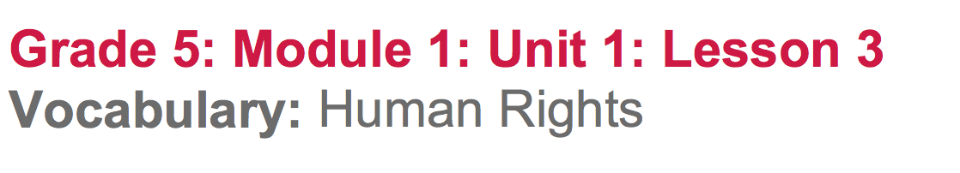

Slide 2
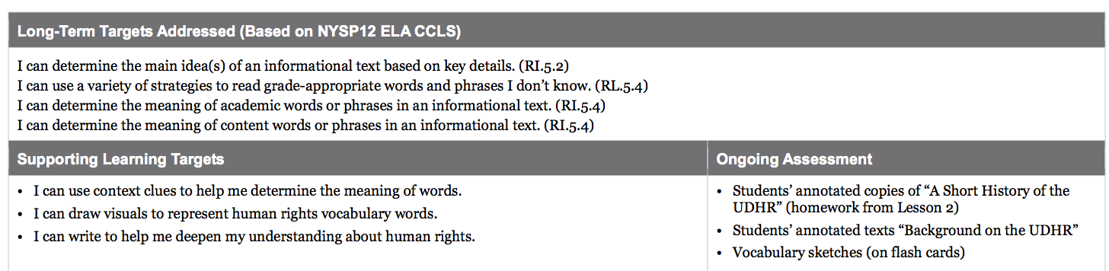

Slide 3
Opening
Reviewing the Learning Targets (5 min)

Slide 4
Human rights is a big idea. There are a lot of words and concepts we don’t know or understand associated with this concept.
Today we will take a deeper look at words that will help us understand more about human rights. We will do this by practicing ways to figure out what new words mean.

Slide 5
Learning Targets
I can use context clues to help me determine the meaning of words
I can draw visuals to represent human rights vocabulary words
I can write to help me deepen my understanding about human rights.
What do these 3 targets have in common?

Slide 6
Words about human rights are what today is all about! Let’s identify the verbs in our targets.
I can use context clues to help me determine the meaning of words
I can draw visuals to represent human rights vocabulary words
I can write to help me deepen my understanding about human rights.

Slide 7
B. Engaging the Reader: Background on the UDHR (10 min)
Remember that during lesson 2, you learned some basic information about when the UDHR was written and why.
Take out your copies of “A Short History of the UDHR” and share with a partner one thing you remember reading or talking about yesterday.

Slide 8
Today we are going to look at another short text about the history of the UDHR. You will work hard to figure out what it means, focusing on important words.

Slide 9
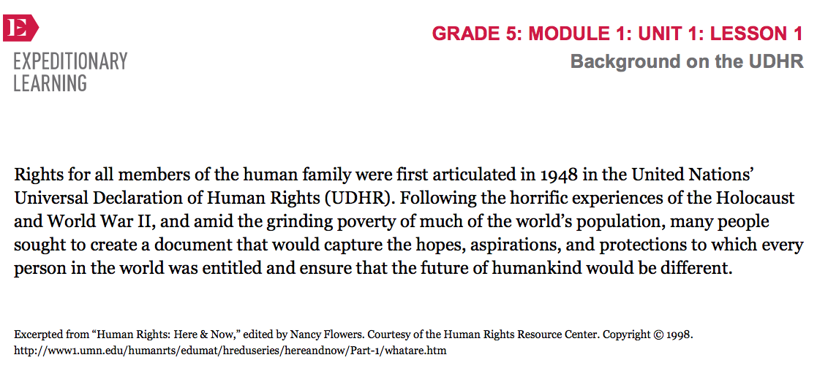

Slide 10
Main Idea
As you re-read the text on your own, think about what the main idea of the text is.
Turn and talk with a partner about what you understand and what words or phrases are still confusing.

Slide 11
Today you will focus on some ways to learn and figure out hard vocabulary. This will help you not only as you are learning about human rights, but any time you read a challenging text.

Slide 12
Work Time
Rereading, using Context Clues to Determine Word Meaning, and Making Vocabulary Flashcards (35 mins)
Take out your note catcher from lesson 1, you will need them about halfway through our work time.

Slide 13
There are a lot of really hard words in the very short piece of text I just read out loud. We are going to practice finding the meaning of new vocabulary words just from what’s around them or from the meaning of what you are reading about, or the “context.” It’s important to be able to figure out words from context because it slows you down a lot as a reader if you have to stop and look up everything in a dictionary.

Slide 14
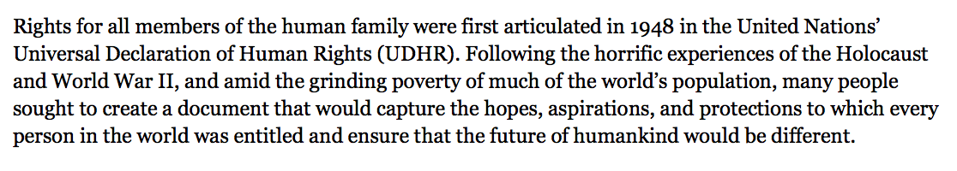
Read the excerpt for a third time, silently looking for new words that help you understand what human rights are or that might help you if you knew what they meant. Underline them in your text.

Slide 15
Share a word that you underlined in this sentence.
Sometimes we are able to find the meaning of new words from the clues around the word. Sometimes you have to read the sentences before and after the one where the new word is.

Slide 16
Figure out what part of speech the word is
  articulated is a verb, a doing word. What thing was articulated?
Write articulated on an index card and the synonym “clearly stated” on the back
Visualize the word articulated and draw a picture of your visualization on the same side as the synonym

Slide 17
Which other words in this text would be most important to help us know more about human rights and the UDHR?

Slide 18
horrific
    terrible
amid
    with or in
grinding
    really bad or intense
sought
    (past tense of “to seek”) looked, wanted to
aspirations
    positive wishes for the future; positive goals
entitled
    deserves

Slide 19
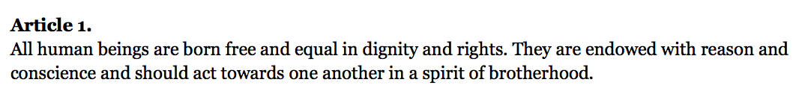
Introduction to the UDHR
Some words are very difficult to figure out from context. Sometimes, you just need to be told the definition, or look it up in a dictionary.
On one side of a new index card, write dignity.
Think and then talk to a partner about the word and what you think it means from lesson 1.
definition: the state of being valued and worthy of respect
Write the definition and draw a picture to represent the word
Working together, do the same thing with endowed and conscience

Slide 20
Closing and Assessment
Routine Writing (10 mins)
You’re going to rank yourselves on the learning targets using the Fist to Five strategy

Slide 21
I can use context clues to help me determine the meaning of words
I can draw visuals to represent human rights vocabulary words
I can write to help me deepen my understanding of human rights

Slide 22
On your “Background on the UDHR” text, complete this thought.
The first time I read this, I thought...But now I know...

Slide 23
Homework
Finish your vocabulary flashcards and review the words we learned today.

