Slide 1


Slide 2
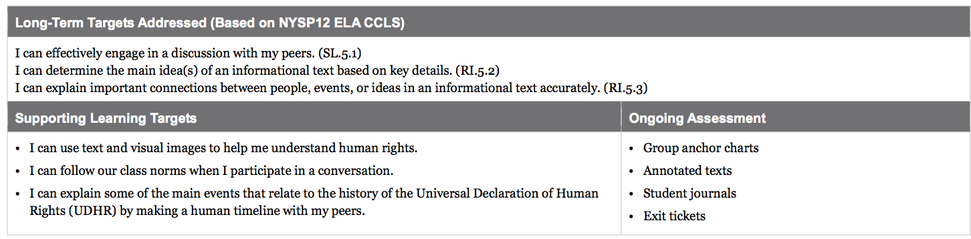
Human Rights

Slide 3
Opening
Engaging the Reader: Revisiting the Meaning of Human Rights (5 mins)

Slide 4
Today we are going to continue our discussion of human rights that we started yesterday.

Slide 5
Learning Target
“I can follow our class norms when I participate in a conversation”
What something that helps a conversation go well?

Slide 6
Learning Target
“I can use text and visual images to help me understand human rights.”
Does the word visual remind you of any other word you know?
Do you think vision and visual are similar in meaning? If so, what’s a visual image?

Slide 7
Learning Target
“I can explain some of the main events that relate to the history of the Universal Declaration of Human Rights (UDHR) by making a human timeline with my peers.”
Does the word relate remind you of any words you know?
Do you think relate and relationship are similar in meaning?

Slide 8
Let’s revisit the charts that we wrote at the end of lesson 1.
Remember that your understanding of this important concept will continue to grow the more you read, talk, and write about it over the course of the next several weeks.

Slide 9
Consider this...
What additional human rights might the authors of the UDHR want all people to have?
Discuss with a partner.

Slide 10
Work Time
Viewing and Discussing UNICEF Video “For Every Child” (10 min)
You will need a piece of scrap paper and a pencil (8 small groups of students)

Slide 11
Listen as I read the first sentence of the UDHR aloud:
“All humans are born free in dignity and rights.”
Today, you will keep thinking about what this sentence means and also learn more about the history of the UDHR.

Slide 12
Video
We are now going to watch a 4 minute video made by UNICEF. Has anyone heard of this organization?
UNICEF was created after World War II by the United Nations to take care of children who were sick or hungry. Today, you will learn more about the United Nations (UN).

Slide 13
Purpose of Video
Yesterday, you tried to visualize what it might look like for Article 1 to be true for all human beings.
Pay careful attention to the images, thinking about one specific image that you think really conveys the meaning of Article 1 that the authors of the UDHR intended.

Slide 14
There are few words on this video, and they go by quickly. For our purpose, focus on the images and how they relate to Article 1 of the UDHR or to the bigger idea of human rights.

Slide 15
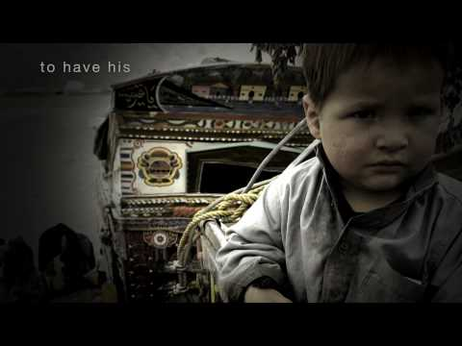
Think silently about what image you thought best represented the meaning of Article 1. Write your response on your scrap of paper.

Slide 16
B. Short History of Human Rights: Key Events (15 mins)
You probably have many questions about the UDHR.
Think-Pair-Share about some of the questions you have.

Slide 17
Today we will focus on:
Where did this document come from?
Why was it written?
Who wrote it?
When?

Slide 18
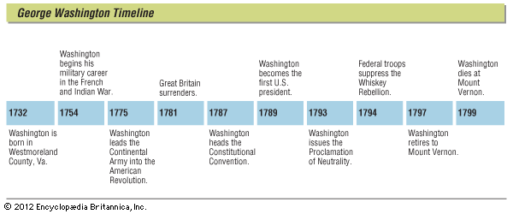
“I can explain some of the main events that relate to the history of the UDHR by making a human timeline with my peers.
Write down your understanding of the word timeline.
Share your ideas with a partner.
Timeline: A visual to show the order in which things happened, which is also called chronological order.

Slide 19
When readers study a historical document, it is often important to understand when it was written and what events led up to it. That is what you will do today with the UDHR

Slide 20
You will now work with your small group on one short piece of text. Your job will be to help each other understand each piece of text and figure out as a class how they all go together to help us understand the history of the UDHR.
In your groups, you should do things that close readers do. Let’s review our anchor chart.

Slide 21
Read the text slowly at least twice
Circle words you aren’t sure of and try to figure them out
Reread, annotate, and underline key vocabulary
Talk to each other about what you think it means.
Read to summarize or answer specific questions.

Slide 22
Each group is going to get “A Short History of the UDHR” sentence strip. You will need to read it closely with your group and try to put the words on your strip into your own words (as a group, not individuals). Each group should have their own words written down on a scrap paper so you can share later.

Slide 23
C. Constructing a Human Timeline (20 mins)
Everyone needs to stand up, but stay with your group.
You are now going to create a human timeline to show the order of events that led up to the UDHR being written, and some events that happened after it was written.

Slide 24
Notice the two pieces of paper I’ve places on the walls, “A Long Time Ago” and “Now”.
Your job will be to figure out where to stand based on the information you read.

Slide 25
Who read information about events that happened a long time ago?
Read your sentence aloud to the class.
Bring your sentence strip and the version you wrote in your own words and stand by the paper that says “A Long Time Ago”

Slide 26
You will now work to locate yourselves physically into 8 clumps based on the sequence of the 8 events that you have information about. Remember to be respectful as you move about the room keeping your voices down.
*You will need to talk to other groups to help figure out the correct order*

Slide 27
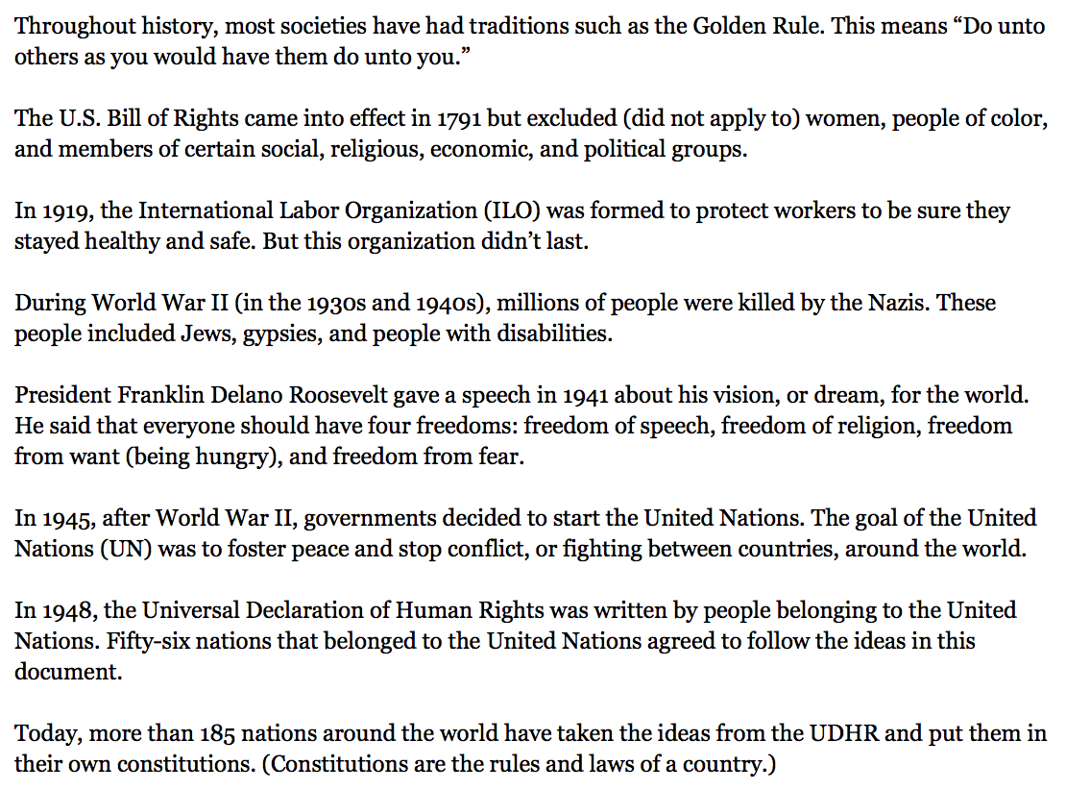


Slide 28
Beginning with the group that had the passage about the Golden Rule, someone from each group will read your passage aloud and then say the version you wrote in your own words.

Slide 29
What words helped you figure out the order of events?
Underline these words in your text
throughout
in
during
after
*It’s very important for readers to pay attention to these signals especially when reading about history

Slide 30
Closing and Assessment
Routine Writing: What did the Authors of the UDHR believe? (10 mins)

Slide 31
Write:
The authors of the Universal Declaration of Human Rights wanted to be sure that some events never happened again. Which events? Why? Use specific details from the text in your answer (5 mins)
Share your writing with a neighbor

Slide 32
