Slide 1
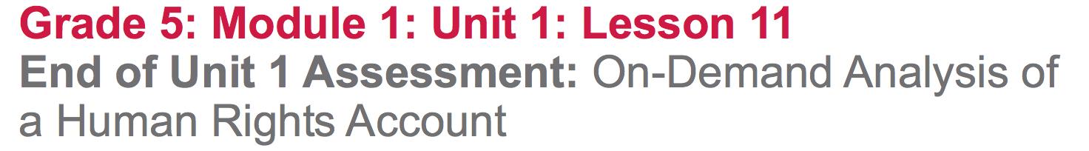

Slide 3
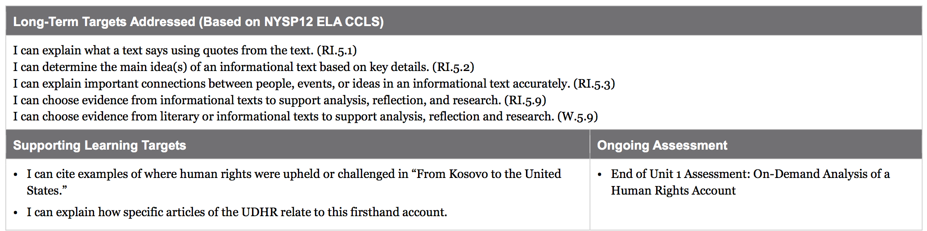

Slide 4
Opening
Engaging the Reader (5 mins)

Slide 5
For the past several weeks, we have been studying human rights. We learned new vocabulary words and practiced close reading of the UDHR and firsthand accounts of human rights stories from around the world. Now we are going to put all of that new knowledge to use by writing an essay about human rights.

Slide 6
Learning Targets
I can cite examples of where human rights were upheld or challenged in “From Kosovo to the United States.”
I can explain how specific articles of the UDHR relate to this firsthand account.

Slide 7
Work Time
End of Unit 1 Assessment: On-Demand Analysis of a Human Rights Account (45 mins)

Slide 8
You have been building background knowledge about human rights and about how real people still face human rights challenges and work to uphold human rights for themselves and others. You have also been practicing reading and analyzing text. Today is an opportunity for you to show what you know.

Slide 9
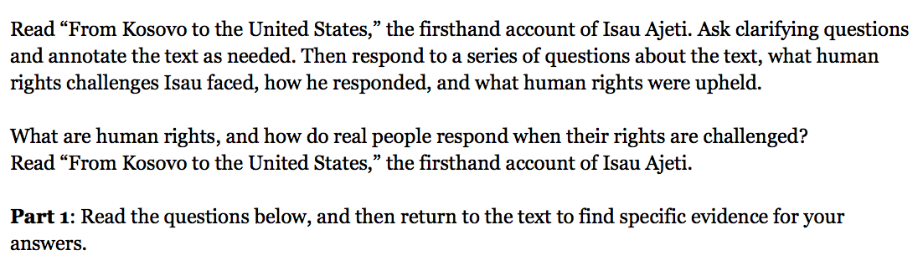
Let’s take a look at the instructions and success criteria for this assessment.

Slide 10

Follow along as I read the text, “From Kosovo to the United States” out loud
Reread the text independently and highlight examples where human rights were CHALLENGED
Using your UDHR note catcher, and your pencil, write in which article of the UDHR was challenged
Use your red pen to put a next to how they responded to the challenge.

Slide 11
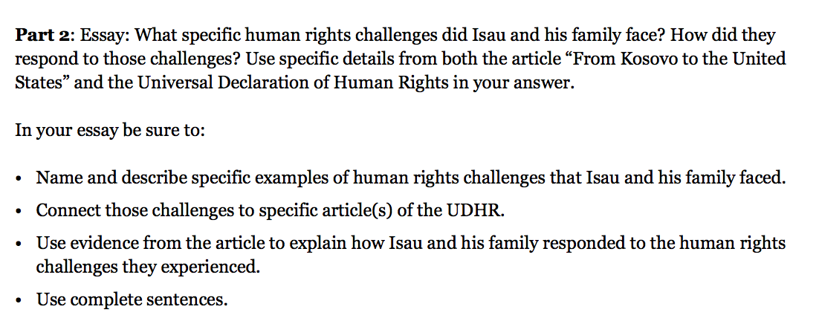

Slide 12
During the assessment you may use:
UDHR
UDHR note catcher
Unit 1 Glossary
The sample text that we wrote together in class

Slide 13
Closing and Assessment
Debrief (10 min)
“I used to think human rights were _______. Now I know human rights are _______.”

