Slide 1


Slide 2
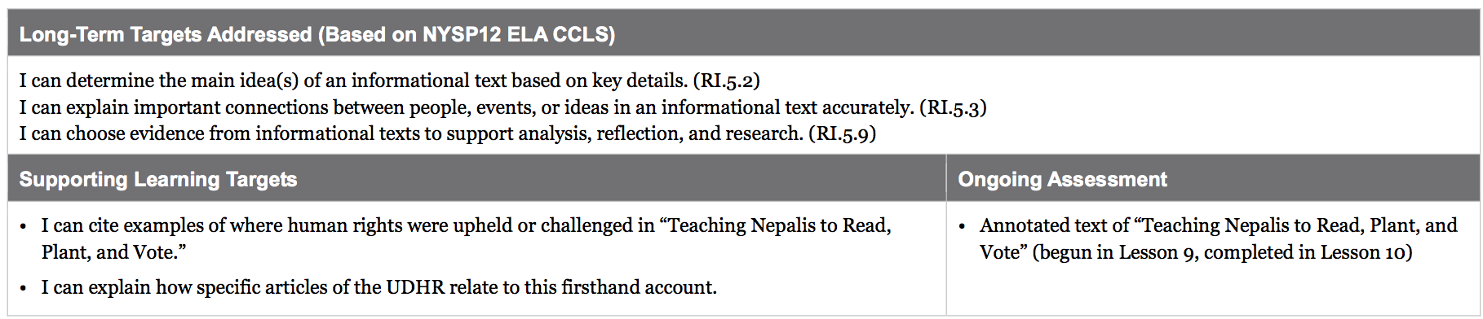

Slide 3
Opening
Revisiting 11 Articles from the UDHR (5 min)

Slide 4
Go stand in small groups by the 11 Article Charts around the room. There should be 2-3 students per chart.
Talk with your group:
What is this article mostly about? If you had to give it a nickname, what would you call it? Add your thinking to the chart

Slide 5
Work Time
Summarizing: “Nicknaming” 11 UDHR Articles (10 mins)

Slide 6
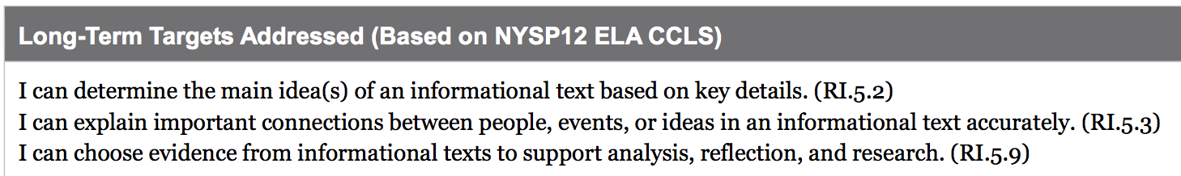
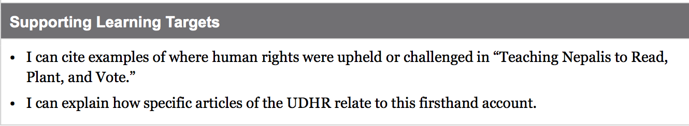
Learning Targets

Slide 7
Today we will continue talking about and reading the same text that we read in lesson 9: “Teaching Nepalis to Read, Plant, and Vote.”
Today you will practice citing examples: Finding specific passages in the text to prove a point.

Slide 8
The main focus of today is to find specific connections between this firsthand account and the UDHR you have been studying throughout Unit 1

Slide 9
Take out your UDHR note-catcher.
Briefly review each of the 11 articles that we’ve studied throughout this unit.
With a partner, give each article a nickname

Slide 10
B. Sorting Evidence: Relating Specific Passages in “Teaching Nepalis to Read, Plant, and Vote” to UDHR Articles (15 mins)

Slide 11
Briefly turn and talk to a partner about what you remember from “Teaching Nepalis to Read, Plant, and Vote,” the firsthand account you read in lesson 9

Slide 12
Yesterday, when we read this first hand account twice, many of you were referring to specific passages in the text to explain your thinking. This is something good readers do. Today, we are going to continue practicing that skill. Specifically, we will be thinking about how particular passages in this first hand account relate to the articles from the UDHR that we have been studying.

Slide 13
Open your envelopes.
Your challenge is to sort the evidence I have given you. As a group, spread out the UDHR article strips.
Then, read each evidence strip and discuss what article it goes with, and why.

Slide 14
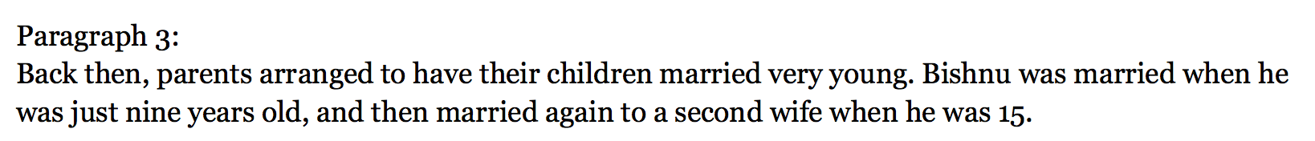
Teacher modeling

Slide 15
You should take turns reading the evidence strips out loud. As a group, you should discuss which UDHR article that evidence belongs with.
Many of the evidence strips could be matched with more than one of the UDHR articles, there isn’t always a single right answer. You need to provide reasons why you matched a piece of evidence with a given UDHR article.

Slide 16
As you work, think…
What human right was being challenged?
What human right was being upheld?
“One human right that was challenged/upheld is________, and I know this because_______.”

Slide 17
C. Discussion: Supporting a Point of View with Text-Based Evidence (10 min)

Slide 18
With a partner at your group, choose just one evidence strip you feel that you really understand.
Take that sentence strip and go to the anchor chart for the UDHR article you think it relates to.
Tape your piece of evidence onto the anchor chart and then write in an explanation:
“This piece of evidence shows that this human right was upheld/challenged because…”

Slide 19
D. Opinion Writing: What Human Right was Upheld or Challenged? (15 mins)

Slide 20
You will now have time on your own to practice supporting your point of view with reasons and information.
Remember how thinking and talking helps you deepen your understanding of a text. You will now capture that thinking on paper

Slide 21
Prompt:
Think about one human right that was challenged in the text. What was the right and how was it challenged? Use specific details from the text to support your response.

Slide 22
Closing and Assessment
How did working with the evidence strips help you understand this firsthand account?

Slide 23
Tomorrow in your end of unit assessment, you will have a chance to again practice closely reading a firsthand account and supporting your point of view with evidence. You will read a new firsthand account and relate it to an article from the UDHR.

Slide 24
