Slide 1
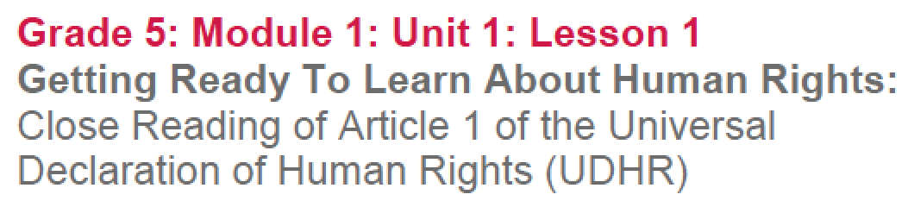

Slide 2
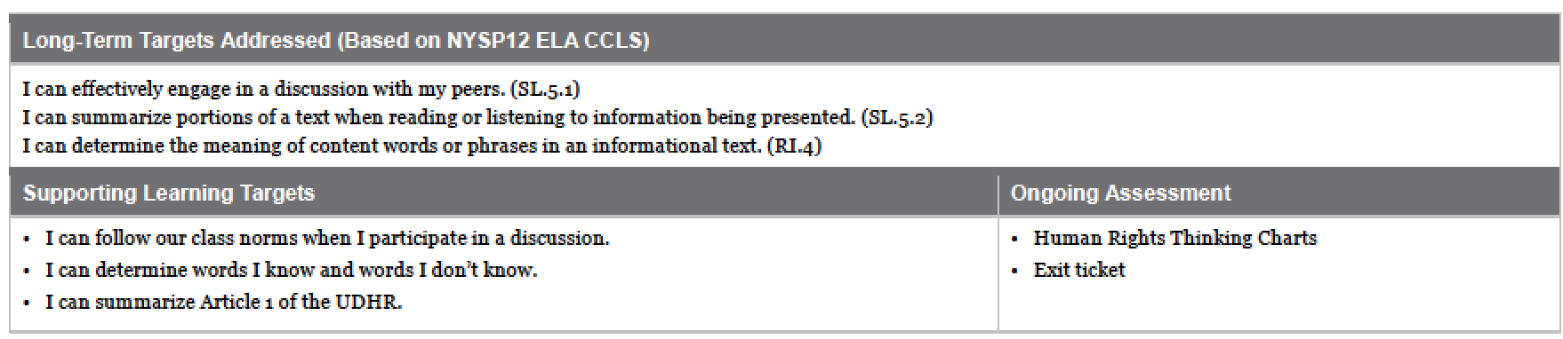

Slide 3
Opening
Engaging the Reader: Thinking about the Words “Human” and “Rights” (10 min)

Slide 4
Learning Targets
Why do we have learning targets?
They help you, as students, know what you are expected to learn and do during a lesson.
Throughout each lesson, and on each assessment, I will check in with you to see how you think you are doing with the learning targets.

Slide 5
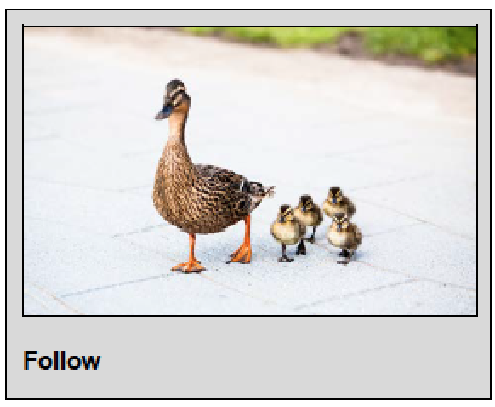
Learning Targets
I can follow our class norms when I participate in a conversation
What are some synonyms for the word follow?
I can define human rights
To define is to describe what something means.

Slide 6
Each group is going to get one large piece of paper and one colored marker.
On your paper, in large letters, write the words “Human” and “Rights” either at the top of in the middle of the paper.

Slide 7
Talking with your group FIRST, use just your one color to write and/or draw the meaning of the words “human” and “rights.”
Pay attention to our class norms as you work.
Look and listen to the person speaking
Take turns speaking so everyone has a chance
Respect each other’s ideas
Ask questions so that you understand each other

Slide 8
B. Check in (5 min)
Let’s check for understanding. Using the Fist to Five strategy, rate how you did attending to the first learning target:“ I can follow our class norms when I participate in a conversation.”
How would you rate your group?

Slide 9
Work Time
Text Structure: Scanning the UDHR (5 min)

Slide 10
This is a really cool primary source called the Universal Declaration of Human Rights, sometimes called the UDHR for short.
A primary source is a document or physical object which was written or created during the time under study. These sources were present during an experience or time period and offer an inside view of a particular event.

Slide 11
We will learn a lot more about this document in the next few days. For now, look it over. What do you notice about the way this document is structured or laid out on this page?

Slide 12
Turn and talk about what you notice about how this document is set up on the page.
We will discuss how this text is set up, or the “text structure,” in greater detail throughout the unit.

Slide 13
Did anyone notice another way that the document identifies the numbered paragraphs?
The Universal Declaration of Human Rights has 30 different articles, or specific sections. Each article identifies a different right, or claim, about something that the people who wrote this document believe should be true for all human beings. Over the next few days, we will be looking closely at some of these rights or claims.
Articles in the UDHR are claims about things that the authors of this document believe should be true for all human beings.

Slide 14
B. Introducing Close Reading: Article 1 of the UDHR (20 min)
Turn and talk with your group about what claims you think the authors of the UDHR might make about things that should be true for all human beings.
*groups share out ideas*

Slide 15
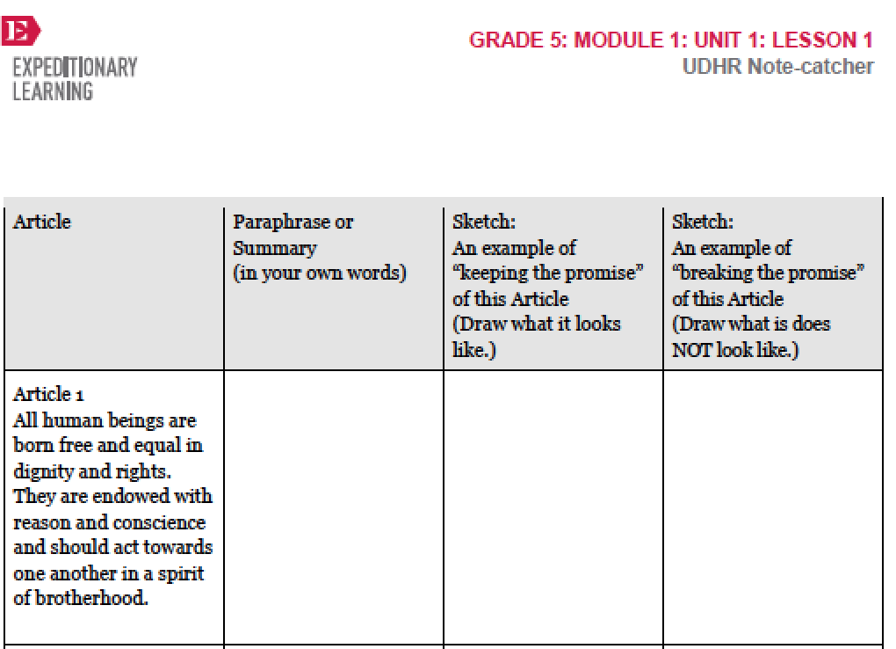

Slide 16
What do you notice about the note catcher?
You will work on understanding some of the articles from the UDHR using this note catcher to help you.

Slide 17
Article 1
Follow along as I read article 1 aloud, twice. I will not explain the text.
“All human beings are born free and equal in dignity and rights. They are endowed with reason and conscience and should act towards one another in a spirit of brotherhood.”

Slide 18
THINK silently about what you think this first article might mean.
PAIR: Turn to a partner and share what you think this article might mean.
SHARE with the class what you think this article means.

Slide 19
What are some words from this first article that you don’t know the meaning of? Discuss with a partner and circle any words that you are still unsure of.
Dignity:
endowed:
conscience:
the state of being valued and worthy of respect
given
an inner sense of right and wrong

Slide 20
Dictionary definitions
Word Definition Sentence

Slide 21
NOTICE!
To understand difficult text, good readers almost always have to read it more than once, especially after they have learned more about the words in the text.

Slide 22
Reread just the first sentence of Article 1, focusing on words or phrases that might help you to determine what claim the authors of the UDHR are making about what should be true for all people. Underline 2 or 3 pivotal words.
“All human beings are born free and equal in dignity and rights.”
Who underlined this phrase?

Slide 23
Reread Article 1, again, looking for and thinking about words that may help you determine the right that the article is referring to.

Slide 24
Reread with synonyms/Paraphrase
people
with
<
“All human beings are born free and equal in dignity and rights. They are endowed with reason and conscience and should act towards one another in a spirit of brotherhood.”
respect and freedoms.
each have the power
to think and know right from wrong
treat each other as family.
All people are born free and with equal respect and freedoms. They each have the power to think and know right from wrong and should treat each other as family.

Slide 25
Picture
Picture in your mind what it would look like if Article 1 was turned into a picture.
Share your idea with a partner and then sketch that image in the 3rd column. It doesn’t matter how good your sketch is, the drawing is just to help you remember the main meaning.
Complete the 4th column for what it does not look like.

Slide 26
C. Begin Close Reading Anchor Chart (10 min)
The process we just went through is called close reading. There are lots of different ways to read closely, but the main point is to figure out specific words and read more than once to get a deeper understanding of a difficult text. We probably STILL don’t fully understand Article 1 of the UDHR, which is fine, but let’s review the steps we took to read this challenging text.

Slide 27
Close Readers Do These Things
Read the text slowly at least twice
Circle words you aren’t sure of and try to figure them out
Reread, annotate, and underline key vocabulary
Talk to each other about what you think it means.
Read to summarize or answer specific questions.

Slide 28
Today, with Article 1, you answered questions by drawing what the “promise kept” and “promise broken” might look like. With different texts, you will consider different strategies, but almost always, you will read, reread, think, talk, and write.

Slide 29
We will often use specific note-catchers to help you record your thinking while reading closely. For the next 8 weeks, we will repeatedly come back to the four-column UDHR note-catcher, paraphrasing different articles of the UDHR and visualizing what it means for that promise to be kept or broken.

Slide 30
D. Return to Key Concept: Thinking about “Human Rights” (10 min)
Look back at the chart from the beginning of the lesson with the words “human” and rights” written on it. Think now about the phrase “human rights.” (use a different color to write your new thinking)

Slide 31
We learned about one thing the authors of the UDHR claim should be true for all people, a “right.” Why do you think they need to write a document like this? Why should we pay attention to human rights?
Write your ideas on your chart.

Slide 32
Closing and Assessment
Debrief (5 min)

Slide 33
Fist to Five
Using the Fist to Five strategy, rate yourself on meeting each of our learning targets:
I can follow our class norms when I participate in a conversation
I can determine words I know and don’t know
I can summarize Article 1 of the UDHR

Slide 34
Exit Ticket
On a sticky note, complete the sentence:
The authors of the UDHR claim that all people are _________________________________.

Slide 35
Homework
Write: Why should we pay attention to human rights? Why do you think a document like this needs to be written?

