Slide 1
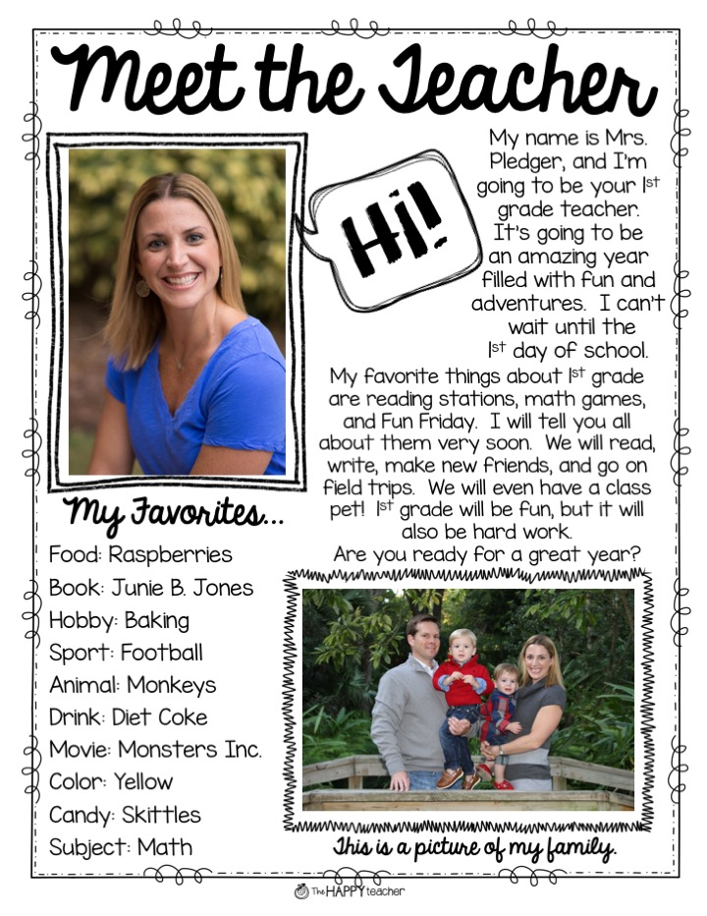

Slide 2
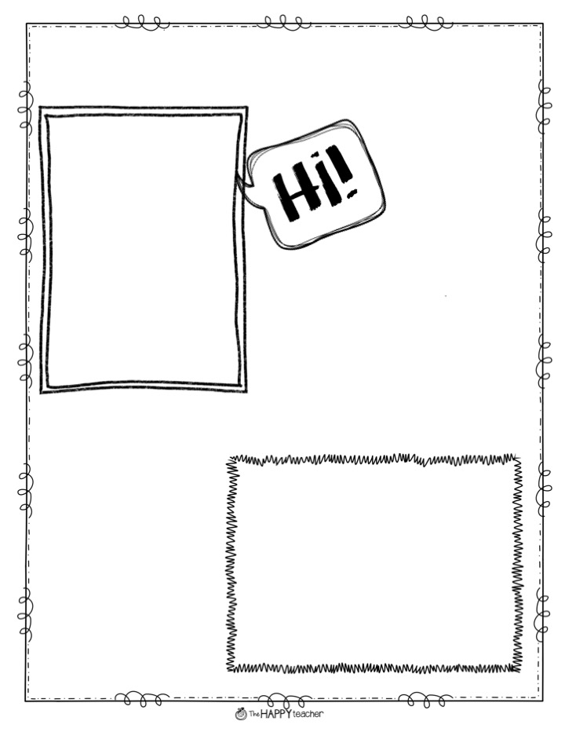
Meet the Teacher
My name is ...
My favorite things about 1st grade are ...
My Favorites...
Food:
Book:
Hobby:
Sport:
Animal:
Drink:
Movie:.
Color:
Candy:
Subject:
This is a picture of my family.

Slide 3
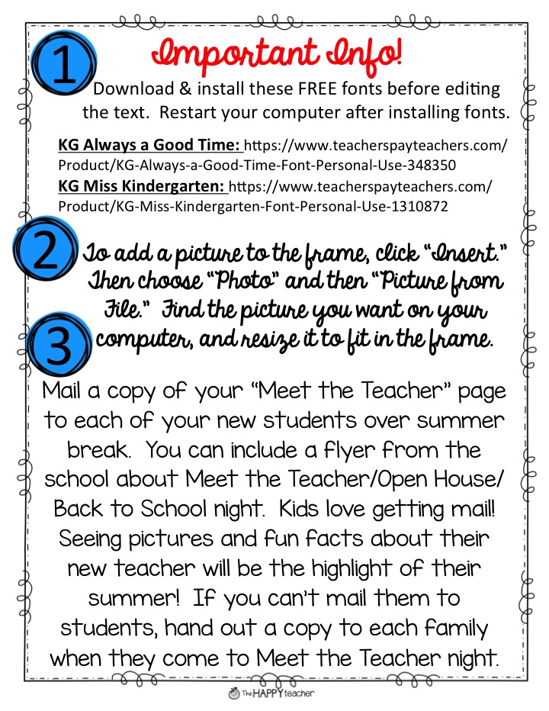

Slide 4
Questions?
If you have any questions,
please e-mail me at TheHappyTeacherTPT@gmail.com, and I can help you troubleshoot!

